Slide 1
Achieving Accessibility: Streamlining PDF Compliance in Higher Education
Notes:
This presentation provides an in-depth look at the differences between non-binding technical guidelines and legally binding directives around Accessibility standards. It covers various accessibility standards such as PDF/UA, WCAG 2.2, and the Matterhorn Protocol, explaining their key features and compliance requirements. The presentation emphasizes the importance of creating accessible digital content and the limitations of automated accessibility checkers. It also discusses the compliance hierarchy in different regions, including the US, EU, and Australia. Finally, it highlights the challenges and best practices for automating accessibility compliance and setting realistic expectations for achieving full compliance.

Slide 2
01
The Case for Accessibility
02
Adobe’s Accessibility roadmap - Rob Haverty
Aɡenda
03
PDF Remediation at Ohio State University – Cory Tressler
04
Adobe and our partners are here to help

Slide 3


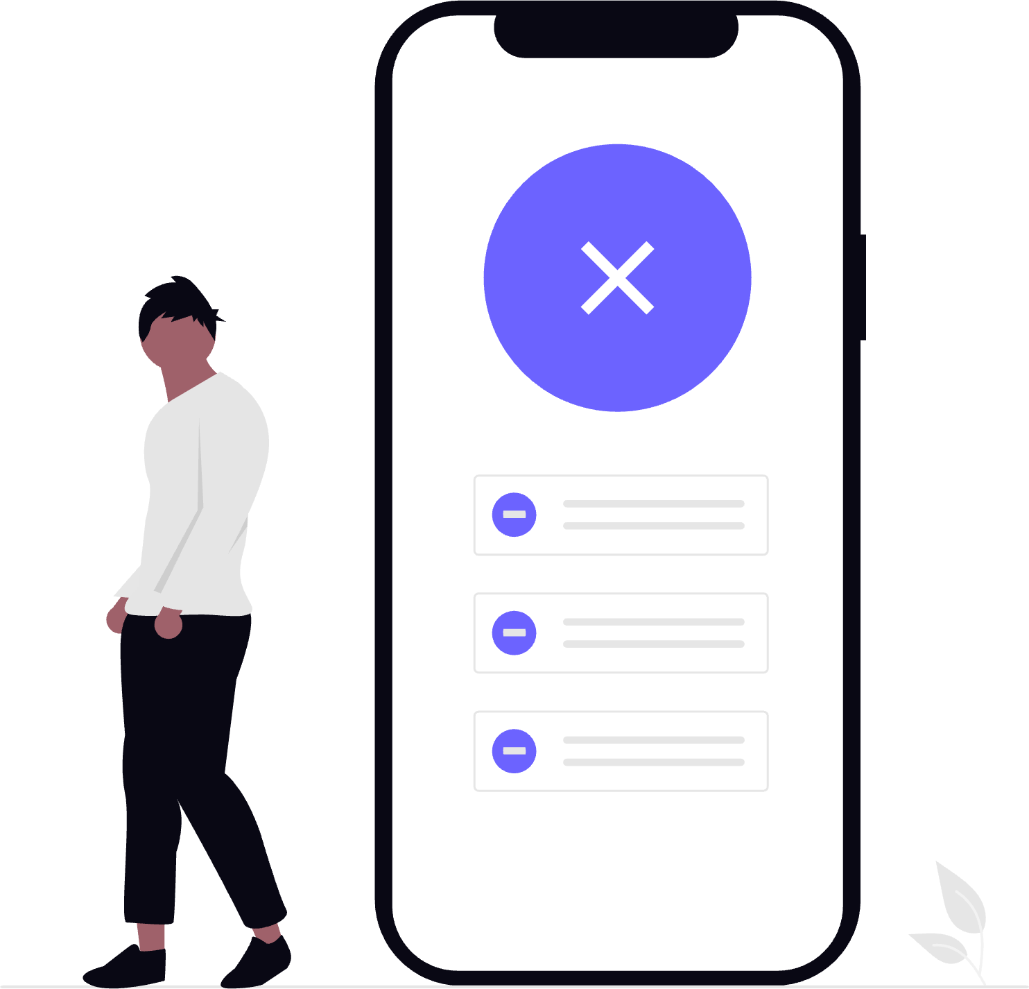

The Case for Accessibility
17% of the global population has a disability, representing the largest minority group worldwide. ¹
>1 in 4
57%
26/50
U.S. adults has some form of disability. ²
of Americans with disabilities reported barriers to civic engagement. ³
states had 10+ accessibility issues on their website. ⁴
Source: 1. Word Economic Forum (2022), 2. CDC (2022), 3. National Civic League (2022) 4. Adobe Digital Government Index (2025)
Notes:
We want to contextualize the importance of accessibility in state and local government. Taking a step back, the World Economic Forum has identified that 17% of the global population has a disability currently, which represents the largest minority group in the world.
When we look at the U.S. specifically, over 1 in 4 U.S. adults is reported to have a disability. And disabilities come in many forms—there are visual, auditory, physical, psychological impairments, etc.—regardless of whether these disabilities are visible or invisible, affected individuals can face many challenges on a day-to-day basis with online and in-person interactions.
Over half of Americans with disabilities believe that having a disability creates barriers to civic engagement, which means the onus falls on government agencies to ensure it’s as easy as possible for impacted residents to participate fully in the democratic process and access government services. The mandate for government agencies is to serve its entire constituency—no one should be denied access or left behind from a government experience based on their abilities.
Today, there is a lot of progress to be made--in Adobe’s most recent 2025 DGI report, 26 out of 50 states had 10+ accessibility issues on their website.
1. https://www.weforum.org/impact/disability-inclusion/
2. https://www.cdc.gov/disability-and-health/media/pdfs/disability-impacts-all-of-us-infographic.pdf
3. https://www.nationalcivicleague.org/making-civic-engagement-easier-for-people-with-disabilities/
4. https://business.adobe.com/resources/reports/digital-government-index-for-united-states.html

Slide 4



The Cost of Nonconformance:
Lawsuits
Legal Penalties
Digital Exclusion
The number of ADA-related digital accessibility lawsuits is rising, with 8,800 complaints filed in 2024—a 7% increase over the previous year. ¹
A first violation for ADA non-compliance can carry a maximum civil penalty of $75,000, and subsequent violations can result in a maximum civil penalty of $150,000. ²
71% of users with disabilities will leave a site that is not accessible to them. ³
Source: 1. Seyfarth Shaw LLP (2024), 2. AudioEye (2025), 3. Forbes (2019)
Notes:
Beyond the fact that investing in accessibility improves constituent engagement, reach, and participation, we can also recognize that the cost of nonconformance for agencies who don’t abide by the DOJ’s most recent mandate is high. The number of ADA-related digital accessibility lawsuits continues to rise every year, with legal penalties ranging up to 150k. But more importantly, the cost of digital exclusion is extraordinarily high. 71% of users with disabilities will leave a site that is not accessible to them.
1. https://www.adatitleiii.com/2025/03/ada-title-iii-federal-lawsuit-numbers-rebound-to-8800-in-2024/#:~:text=In%202024%2C%20plaintiffs%20filed%208%2C800,first%20started%20compiling%20these%20numbers.
2. https://www.audioeye.com/post/ada-compliance-fines/
3. https://www.forbes.com/sites/ryanrobinson/2019/09/25/website-accessibility-online-business/?sh=266907859c19

Slide 5



Adobe Partners for PDF remediation

Slide 6
Notes:
No additional notes for this slide

