Slide 2
Get started building with Power BI
Notes:
Before delivering this presentation, review the associated module on Microsoft Learn.
The estimated time to present these slides is 30 minutes.

Slide 3
Learning objectives
How Power BI services and applications work together.
Explore how Power BI can make your business more efficient.
How to create compelling visuals and reports.

Slide 4
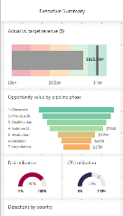
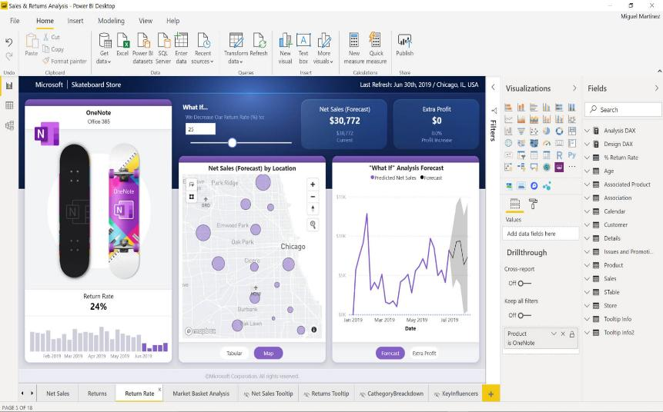
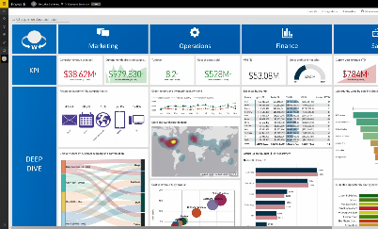
Introduction to Power BI environment
Create with Power BI Desktop
Distribute with Power BI service
Access with Power BI Mobile
Notes:
Microsoft Power BI is a collection of software services, apps, and connectors that work together to turn your unrelated sources of data into coherent, visually immersive, and interactive insights. Whether your data is a simple Microsoft Excel workbook, or a collection of cloud-based and on-premises hybrid data warehouses, Power BI lets you easily connect to your data sources, visualize (or discover) what's important, and share that with anyone or everyone you want.
Desktop: A free application you install on your local computer that lets you connect to, transform, and visualize your data.
Service: A SaaS service which brings together dashboards, workspaces, reports, and semantic models for keeping a finger on the pulse of your business.
Mobile: Connect to and interact with your cloud and on-premises data. You create reports in Power BI Desktop. You create dashboards, and view dashboards and reports in the Power BI report service. You view on-premises Power BI reports on Power BI Report Server. All these reports and dashboards are available in the Power BI mobile apps, whether they're on premises or in the cloud.
How you use Power BI might depend on your role on a project or a team. And other people, in other roles, might use Power BI differently, which is just fine.

Slide 5


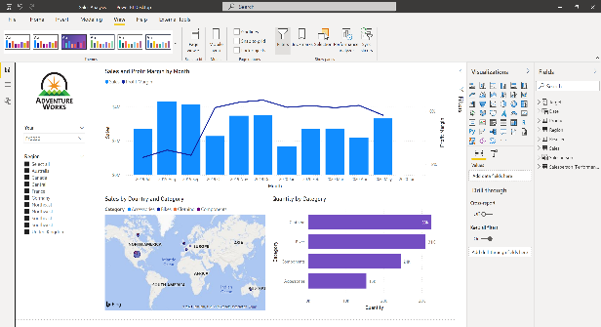





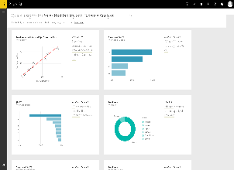
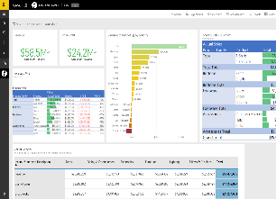
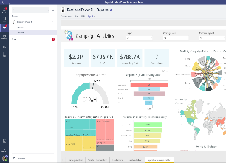
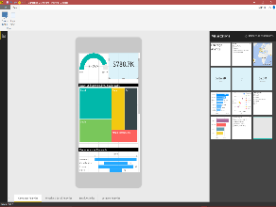

The flow of Power BI
Data sources
Power BI Desktop
Power BI service & Mobile
Notes:
The flow of Power BI is:
Connect to data with Power BI Desktop.
Transform and model data with Power BI Desktop.
Create visualizations and reports with Power BI Desktop.
Publish report to Power BI service.
Distribute and manage reports in the Power BI service.

Slide 6
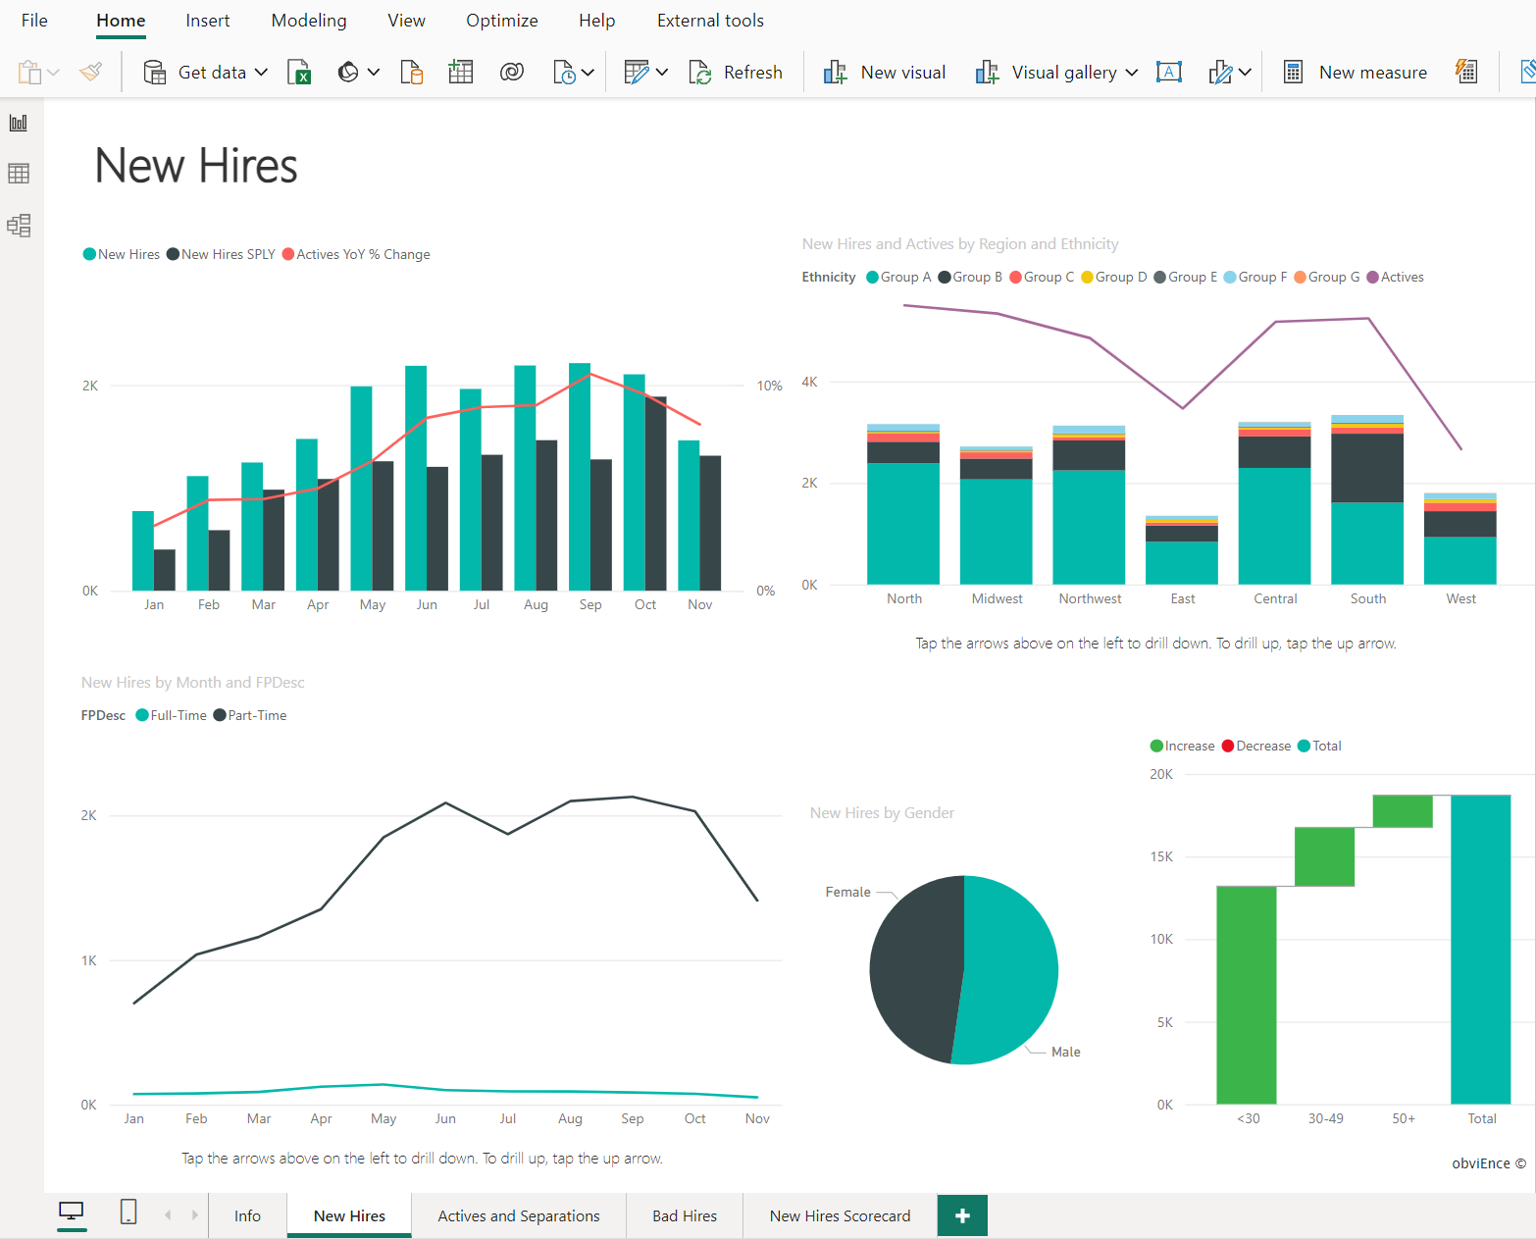
The building blocks of Power BI
Semantic models
  Connected data, transformations, relationships, and calculations.
Visualizations
  Interactive representation of data through various charts and graphics.
Notes:
The building blocks of Power BI are semantic models and visualizations. Create a semantic model and then use visuals to build a report. Let's explore these items in more detail and how they relate to the flow of Power BI.
Create a semantic model
A semantic model consists of all connected data, transformations, relationships, and calculations. To follow the flow of Power BI, you first connect to data, transform data, and create relationships and calculations to create a semantic model.
First, connect to as many data sources you need. Then clean and transform the data to your needs. Add relationships between tables and calculations to extend the semantic model. After all of that, now you can create a report.
Create visualizations in a report
In Power BI Desktop, when you create a visualization (also called visual), you add it to the canvas for a report page. Choose your visualizations to build pages in your report. It's ideal to keep each page simple with related data, so consumers can easily see the insights.
Power BI is a low-code solution, which means that you can "drag and drop" data field directly onto the canvas. Power BI will choose a visual for your data field. You can easily change between visuals for the same fields, and add or remove data fields to the visual.
One of the most valuable features of Power BI reports is the interactivity between visuals. Consumers can select different data points in the visual and see how that affects the other visuals. Depending on your design, they can also drillthrough from one visual to more detail or filter based on different fields in the report.

Slide 7
Demo
Get started with Microsoft data analytics
Notes:
https://microsoftlearning.github.io/PL-300-Microsoft-Power-BI-Data-Analyst/Instructions/Demos/01-get-started-data-analytics.html

Slide 8
Knowledge check
What is the common flow of activity in Power BI?
Create a report in the Power BI service, share it to Power BI mobile, and interact with it in Power BI Desktop.
Create a report in Power BI Desktop, share it to the Power BI service, and interact with reports in the service and Power BI Mobile.
Create a report in Power BI mobile, share it to Power BI Desktop, and interact with reports in the Power BI service.
Which of the following are building blocks of Power BI?
Tiles and visualizations.
Semantic models and visualizations.
Semantic models and reports.
What is a collection of reports and dashboards called in Power BI?
Canvas.
Scheduled refresh.
App.
Notes:
Use the slide animation to reveal the correct answers.

Slide 9
Recap
In this section, we covered:
Discovered the concept of data analysis with Microsoft.
Reviewed roles in data and the tasks of a data analyst.
Explored building blocks of Power BI applications and services.

Slide 10

Further reading
Get building with Microsoft Power BI
https://learn.microsoft.com/training/modules/get-started-with-power-bi/
Notes:
Encourage students to review the online material on Microsoft Learn on which this presentation is based.

