Slide 1
IQA Activity Plans
3 plans nearly always needed

Slide 2
IQA Plans:
Summary arrangements for what will be monitored by whom by when
Assessor practice plan
Meeting & standardisation plan
Sample and tracking plan
Notes:
Unit

Slide 3
E.g. IQA Sample Plans
Take into account all the variables

Slide 4
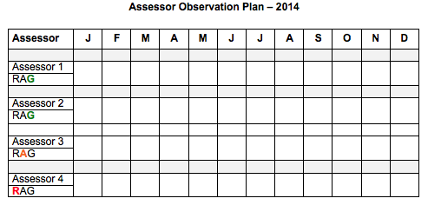
Take into account experience, number of learners, locations
Notes:
PR6
Once per year or 2 hours every 3 months?

Slide 5
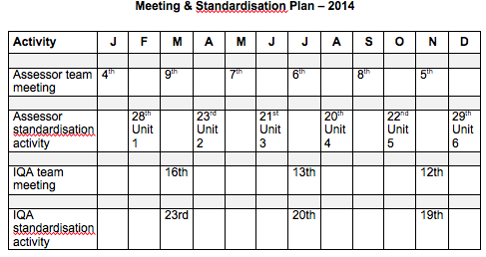
Agenda, minutes, activities

Slide 6
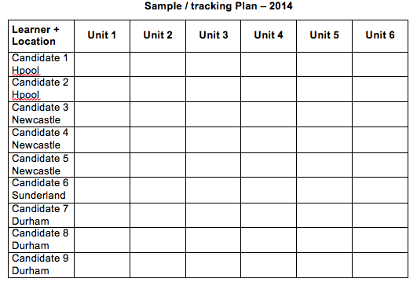
Take into ac
Sampling methods – horizontal, vertical, diagonal, percentage, random, thematic
Notes:
Horizontal – from all areas [units?] over time
Vertical – the same area for each candidate
Diagonal – one area from all learners
Percentage – eg 10% from each learner or each assessor
Random – unsystematic, cannot be predicted
Thematic – relating to a particular activity eg managing blood loss

Slide 8
Analyse, Evaluate the Plan
Consider
Strengths/weaknesses
IQA rationale
Risk
  Assessor workload, expertise, location
  Units sampled – complex, simple
  Methods sampled
  Processes sampled
  Dates of samples
  Countersigning of decisions
Notes:
Look at rationale

