Slide 1
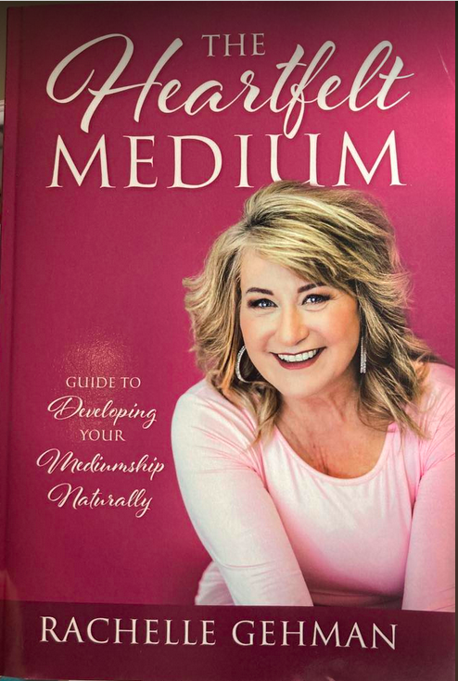
Mechanics of Mediumship 6 week Course Developing Your Mediumship Naturally

Slide 2
Course Overview
Thorough Understanding of Mediumship
Get confident with Building Your Connection and working with Spirit
Learn The History of Spiritualism and Mediumship
Meet and strengthen your relationship with your Spirit Guides (Key)
Set up Boundaries
Agreements with your Guides
Learn Give Powerful Accurate Messages
Learn to Work with Energy Frequency and Vibration
Learn Your Essence and work with your Energy Signature
Aspects of Building a Strong Spiritual Practice
Learn Ethics and Discernment
Learn How to Release Unwanted Energy and Close the Door to Spirit

Slide 3
Week 1
Your Purpose in Becoming a Medium
Foundational Elements of Mediumship
Difference between being empath, intuitive, Psychic and Medium
Working with the Flow of Energy
Energy, Frequency and Vibration - the Breath
Ego vs. the Essence
Brain versus the Mind, right brain vs. left brain vs. the Heart
The Spirit Connection
Guides Framework – Your Spirit Team
Setting Boundaries – How You Work With Spirit
Setting up Agreements with Guides
Creating a Sacred Space for your spiritual practice
Judgement vs. Observing
Lesson Today

Slide 4
What is Mediumship
Similar Terms are Psychic Medium, Intuitive Medium or Spirit Medium, Evidential Mediums
Provide evidence to clients of assed loved ones in spirit for the purpose of there is life after what we call “death.”
Meditation is key to build the power to match the vibration of the spirit world to receive evidence.
Develop mediumship through practice with a development circle
Mediumship is done from the Heart with Love

Slide 5
Foundational Elements of Mediumship
Meditation
Evidence
Energy Frequency Vibration
Connection to Spirit: is in the Heart
Builds the Relationship with Your Guides
How to Work with Spirit Team
Having Strong Boundaries
Discernment and Ethics
Self-Development – Making room for gifts
Communication with Spirit,
It demonstrates there is life after “death”,
Can heal both the spirit communicator and the sitter/recipient
Provide guidance, healing, reassurance, and upliftment
Make us aware of our true spiritual nature
Spiritual Process is Based on Love

Slide 6
Psychic Mediumship Terminology
Sitter- is the client that comes to a psychic medium for a reading.
Recipient - is a sitter in the audience when a medium is doing a mediumship demonstration
Spirit Communicator- The loved ones that are in the spirit world, that are trying to communicate with the sitter.
Psychic Medium -Is the translator of information by the spirit to the sitter.
Evidence - purpose of evidence - pieces and types of information that is meaningful to the sitter that is personal in nature.
Gate Keeper - is your main guide that protects you
Runner- goes and gets the sitter’s loved one
Channeling-Direct Communication with Spirit or Loved One
Trans Channeling- move out of the way so spirit takes over to deliver a message.

Slide 7
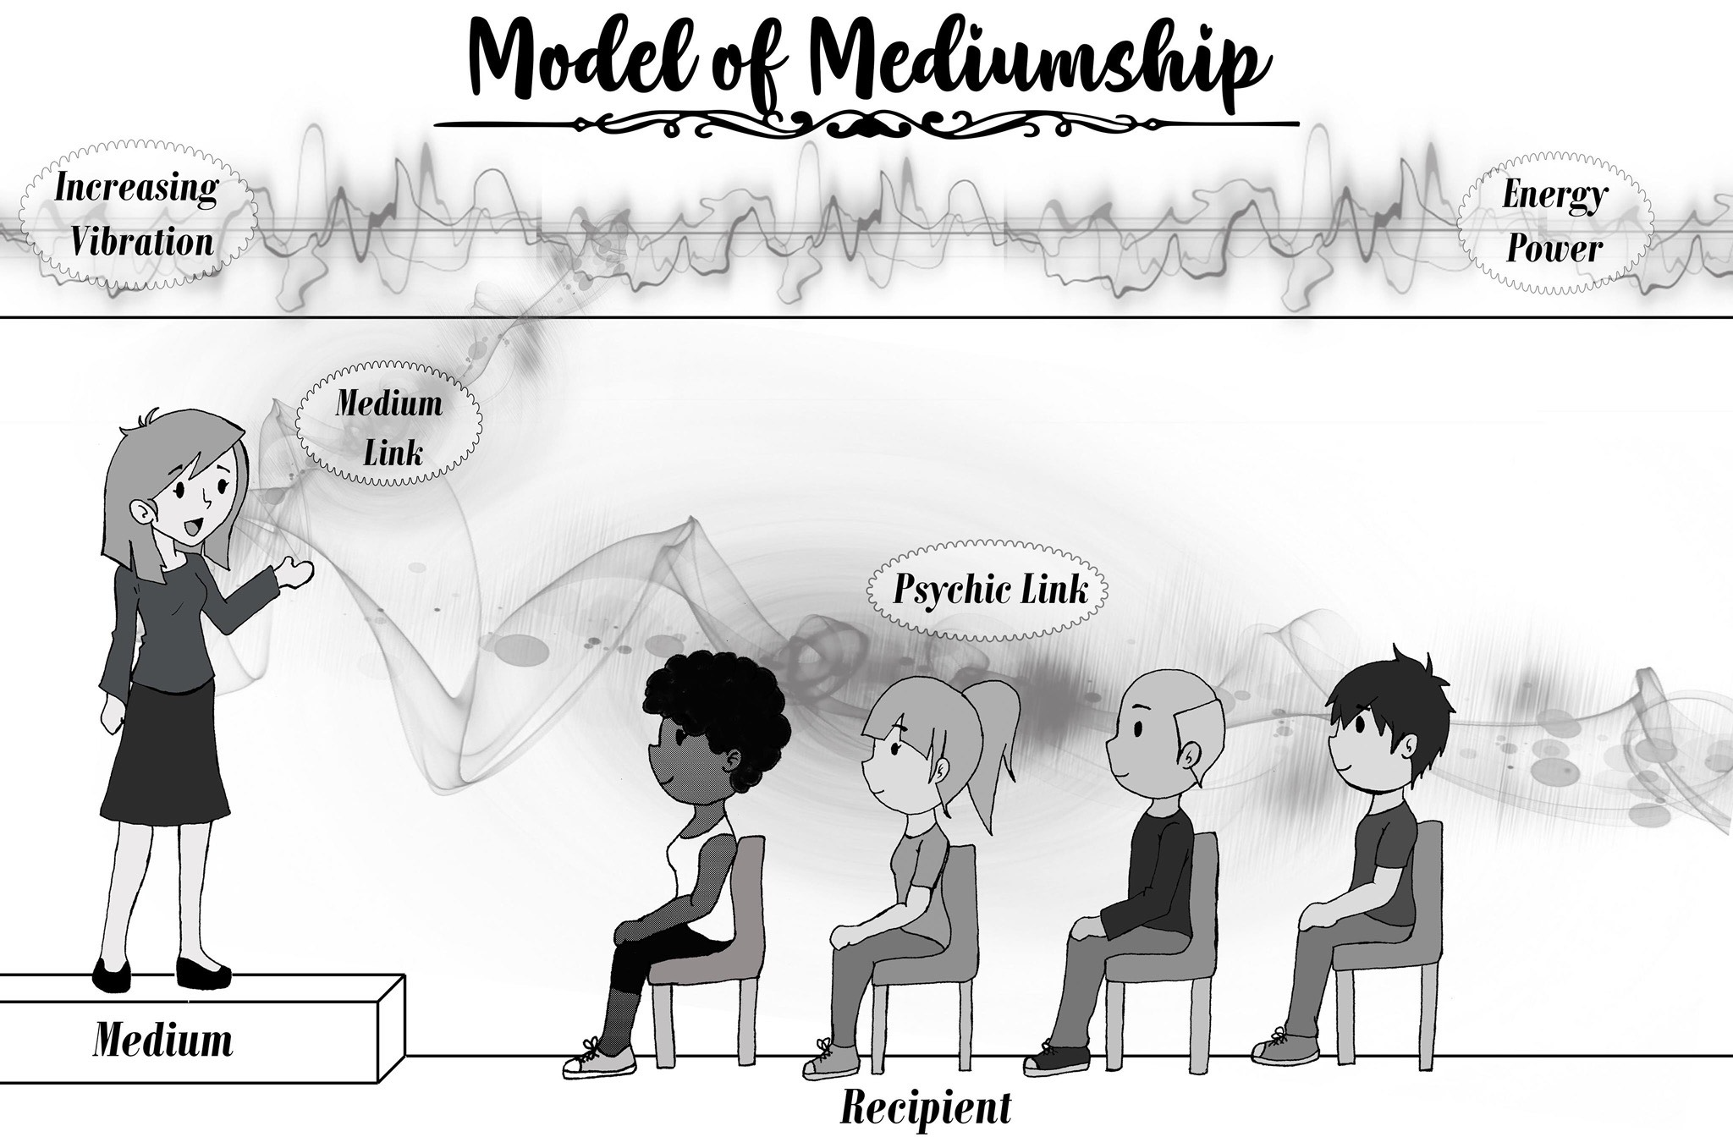

Slide 8
Pathway to Mediumship
Difference between Empath, Intuitive, Psychic, Medium
Along the spectrum, we need to learn the flow of energy
We also need to master our energy, spirit helps us
***Utilizing our Body as a Barometer is Key!***

Slide 9
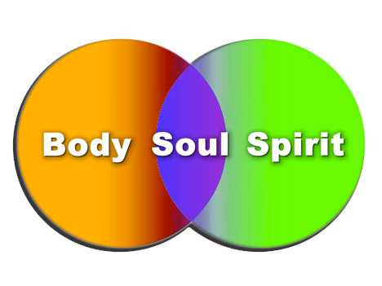

Slide 10

Energy Frequency Vibration
Earth is 8.32 Hz
Human Body 65 Hz
Spirit 400 Hz and Above
Connection – through Meditation

Slide 11
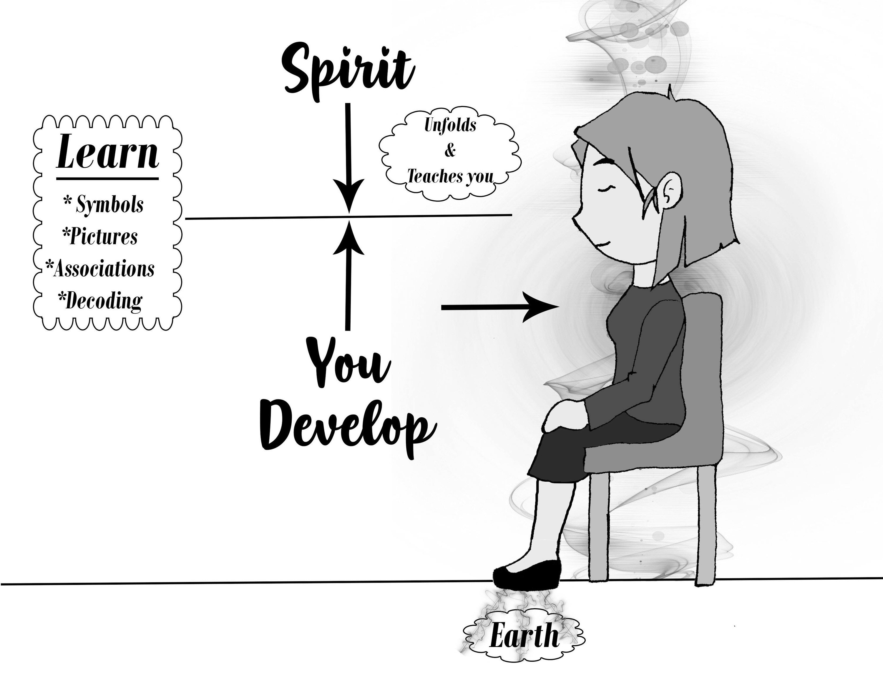

Slide 12
Mediums – Different Vibrational Match

Slide 13
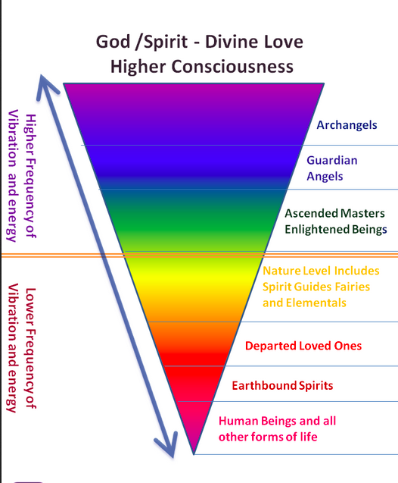

Slide 14
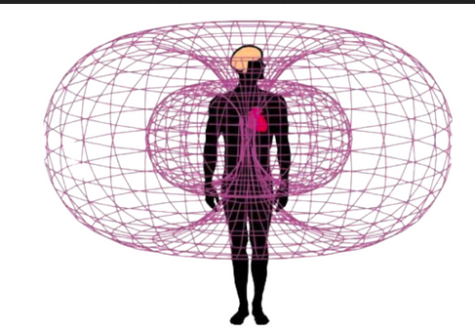

Slide 15
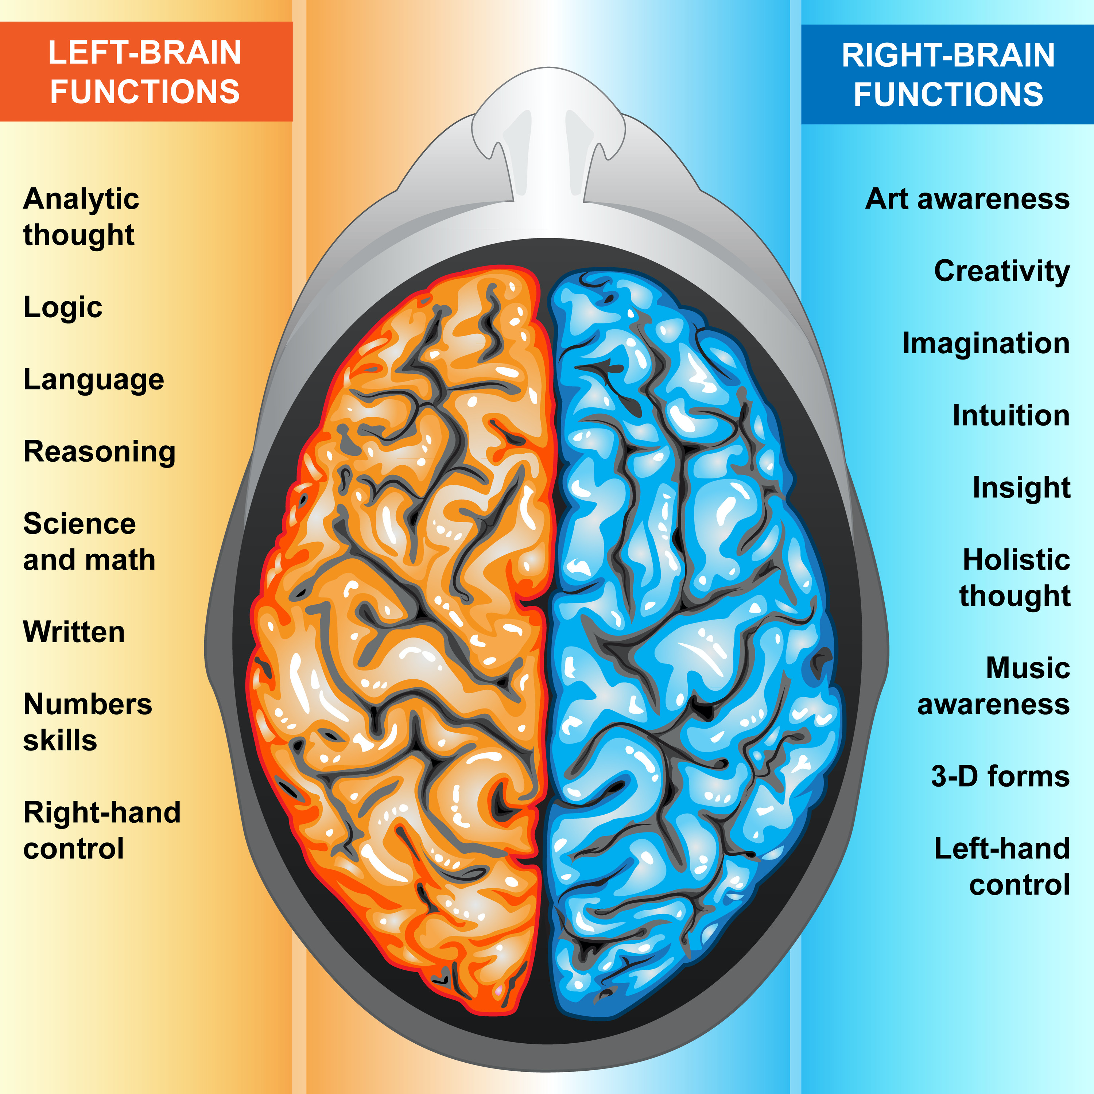
All things that separate from our essence can stop the flow of spirit
Logical thought
Unworthiness
Anxiety
Self worth
Limiting Self Beliefs
Key is to go to the Heart

Slide 16
School
Identity
Morals
Values/Ethics
Life Stories/Trauma
Socialization
Parents Imprint
True Essence
Your Spirit - Connection to the All
Ego
I have Prestige
I am not good enough
Limiting self beliefs
Limiting Self talk
I am better than anyone else

Slide 17
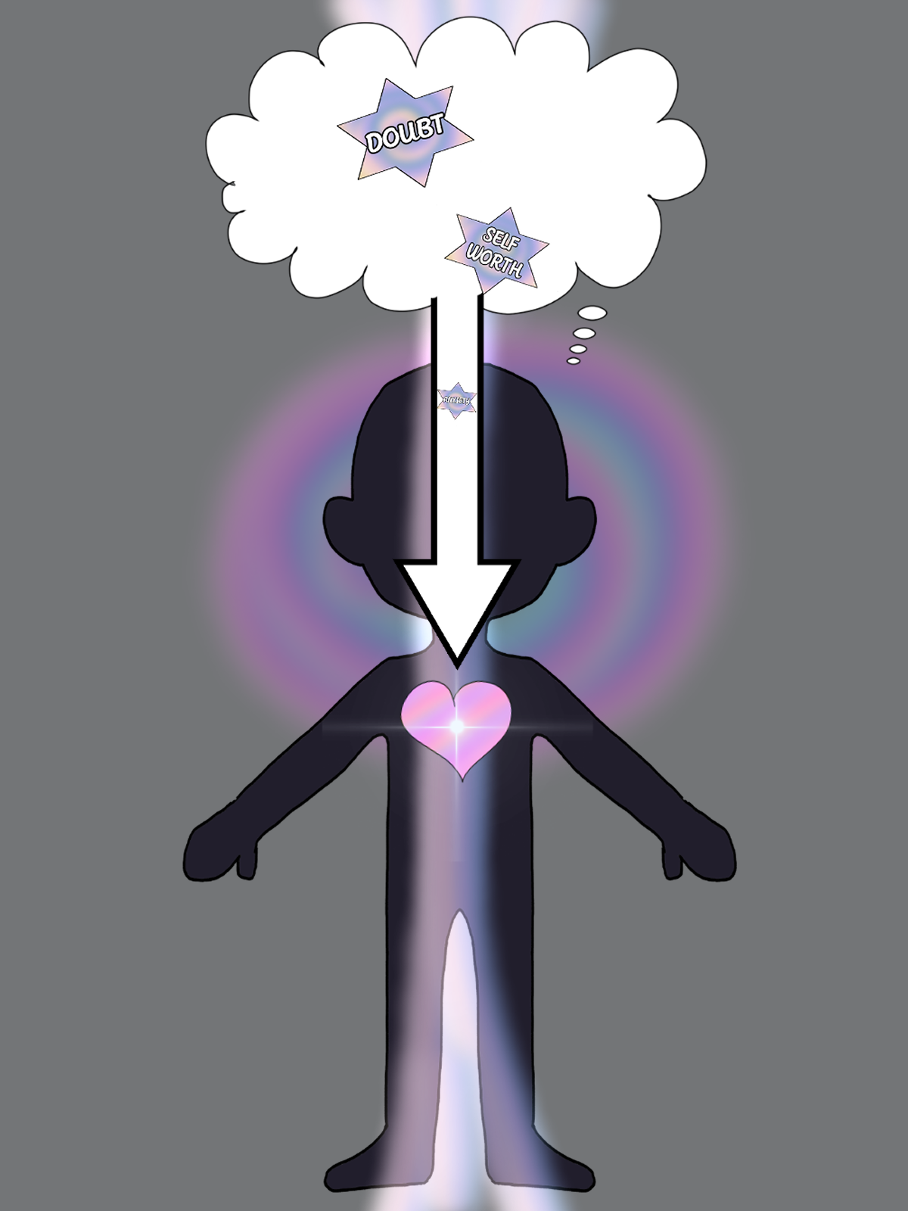
Toridial Field

Slide 18
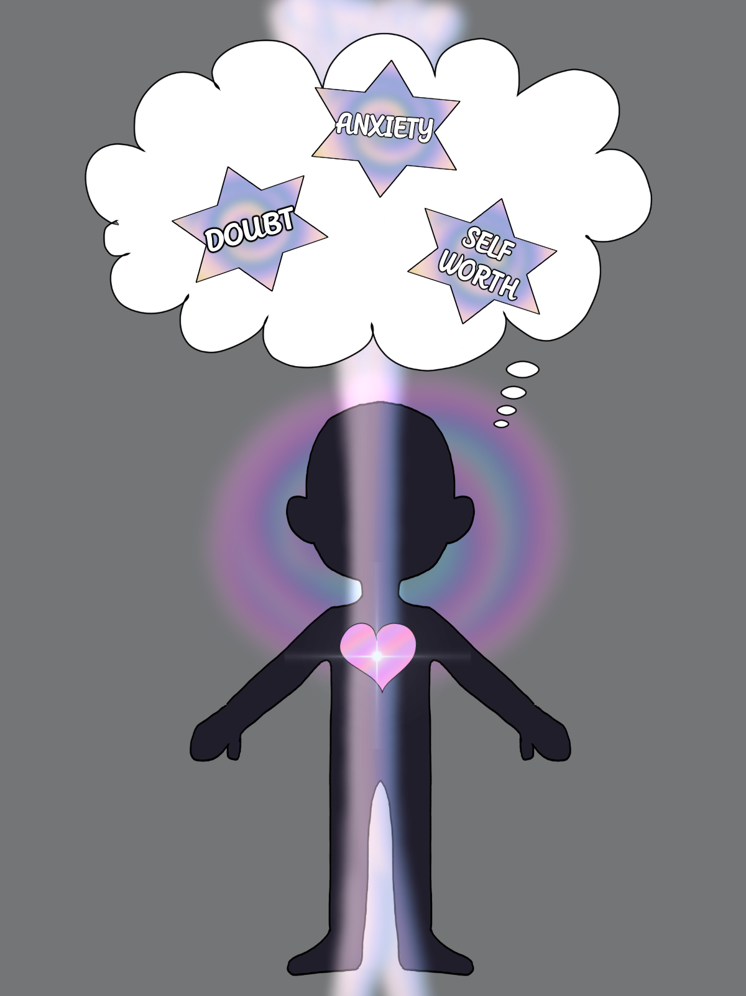
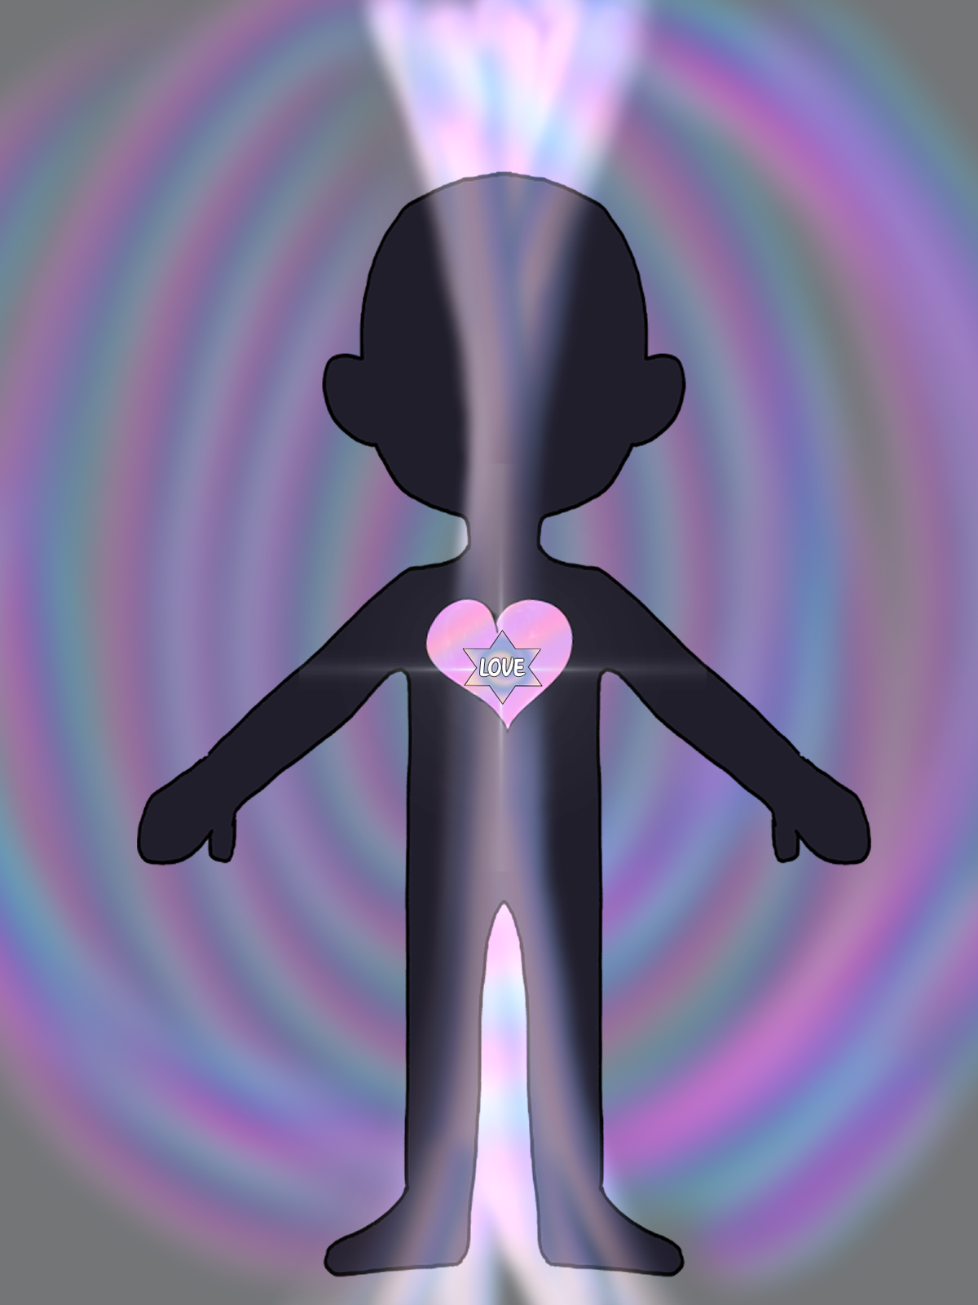

Slide 19
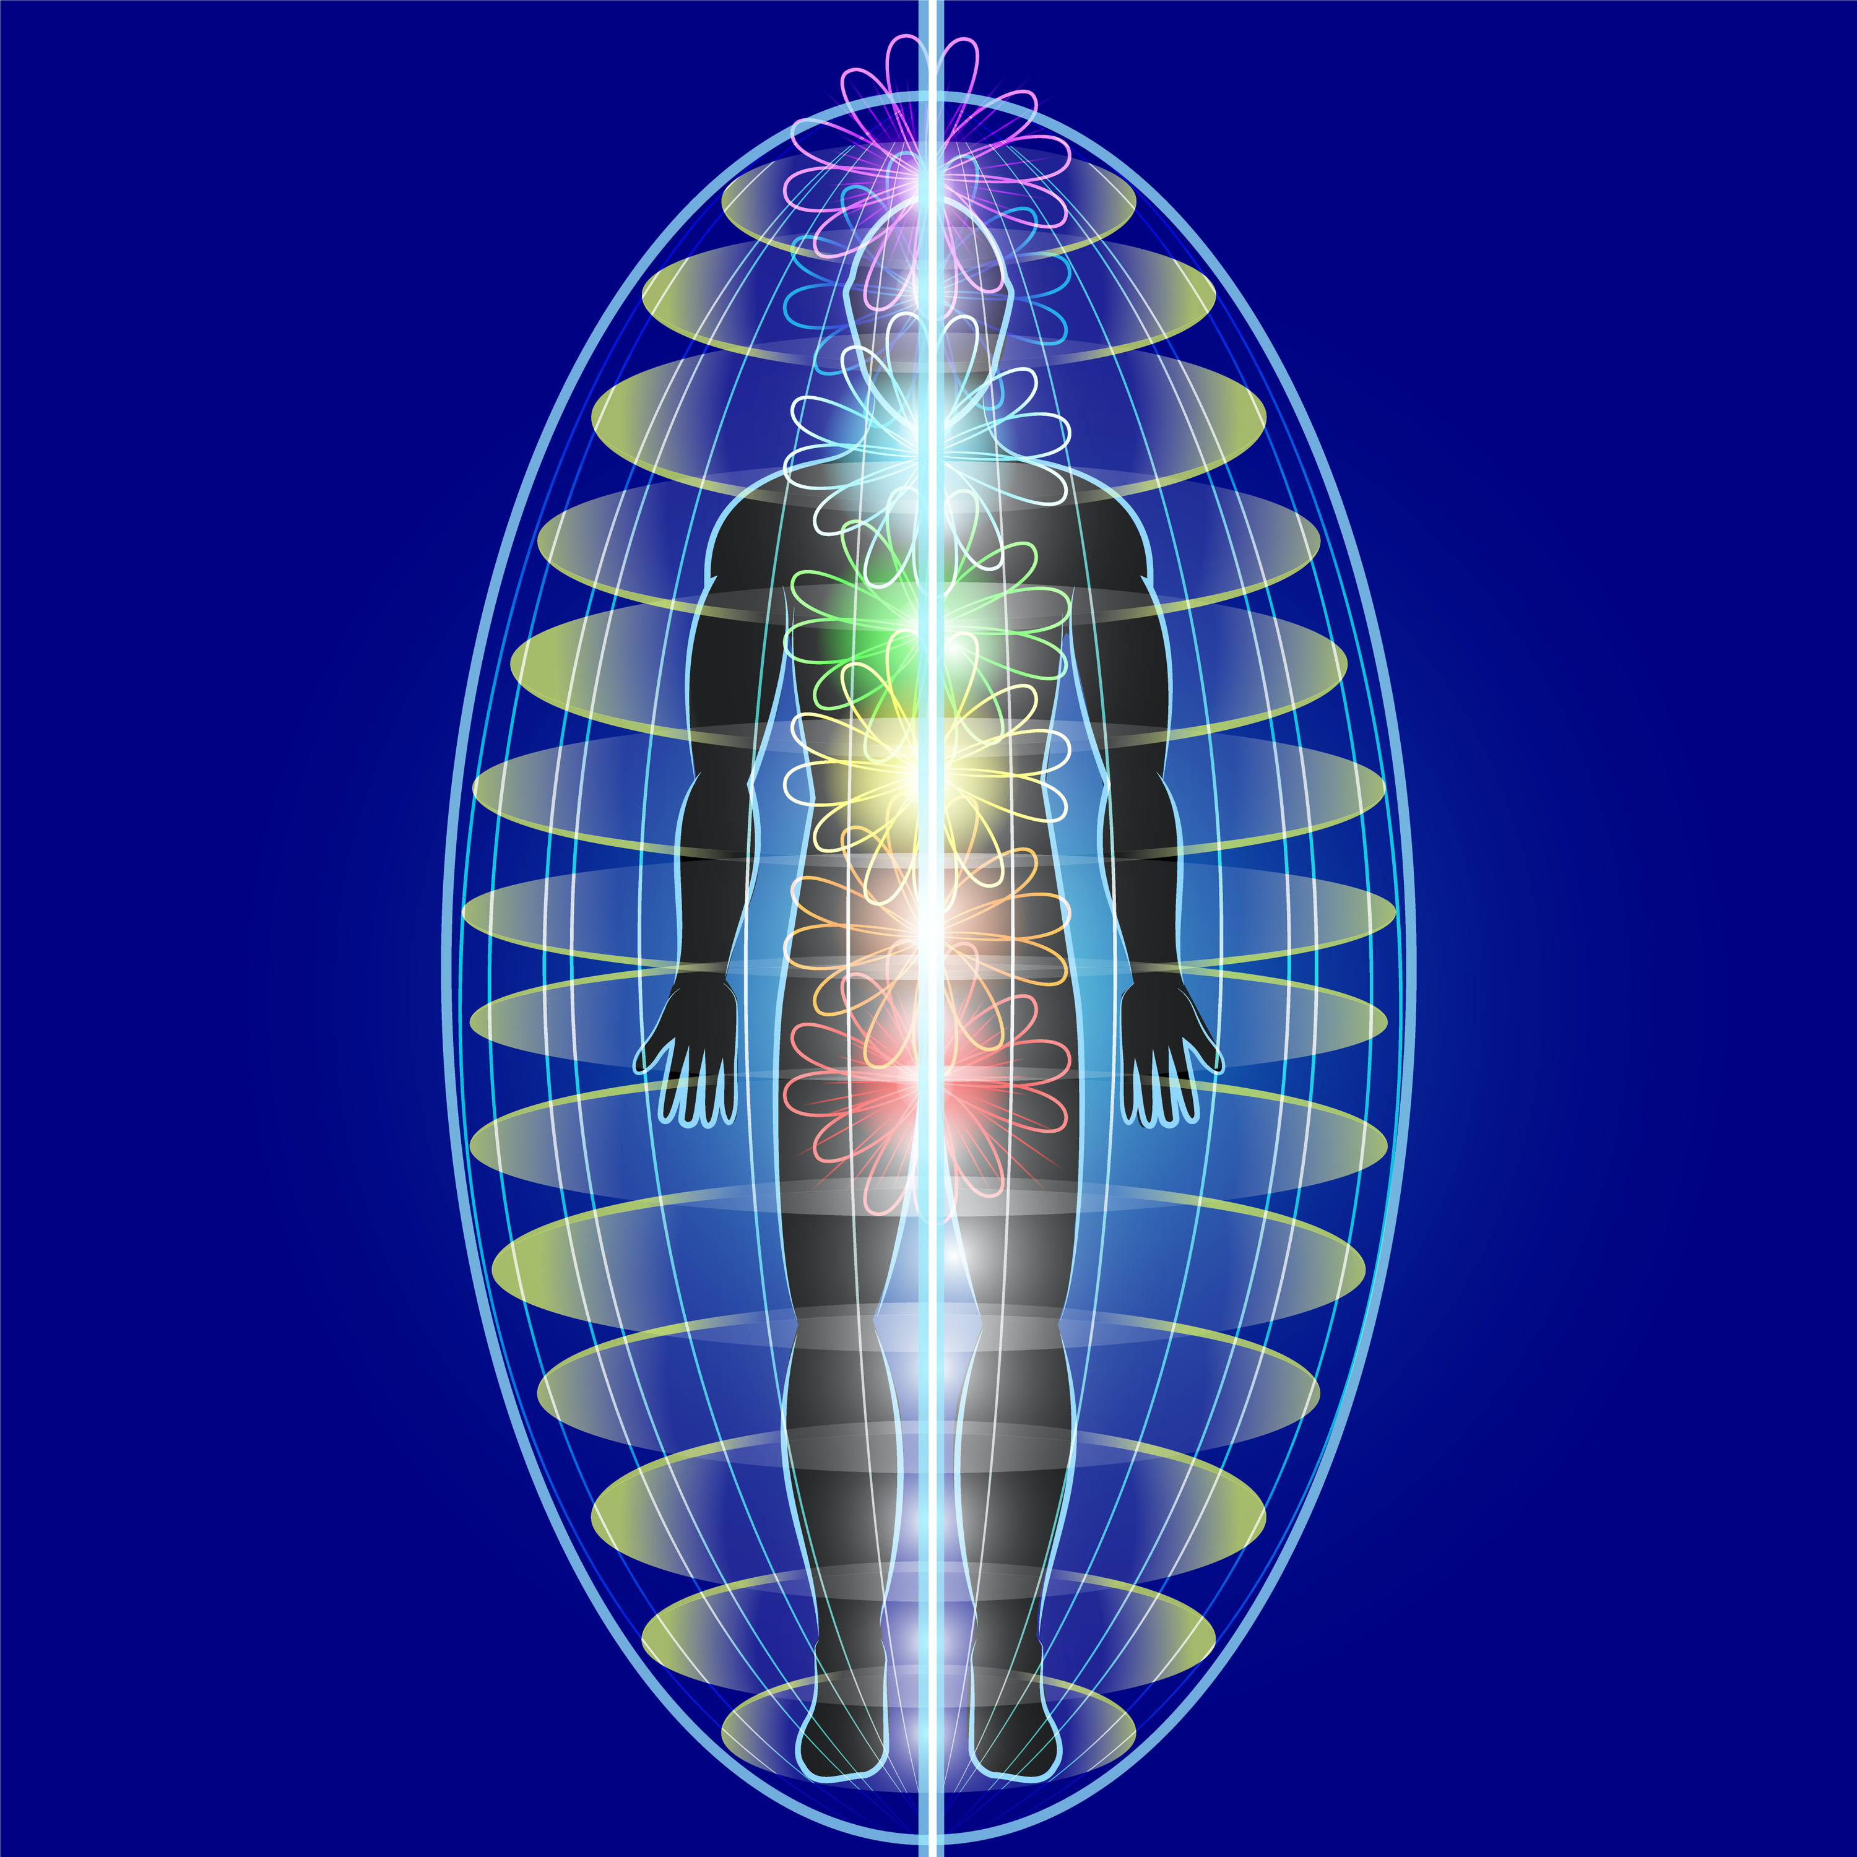
Running the Energy
Up and Down
Around
Back and Forth
Do This from the Heart

Slide 20
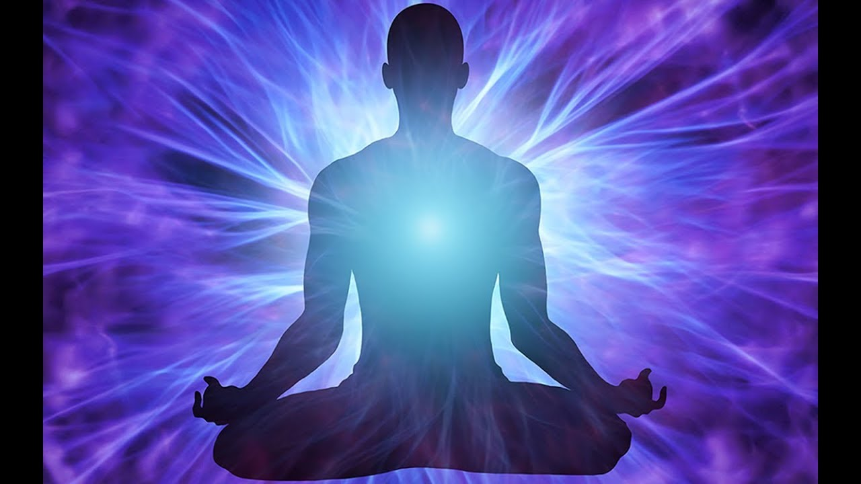

Slide 21
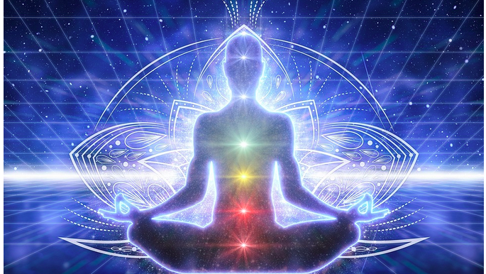

Slide 22
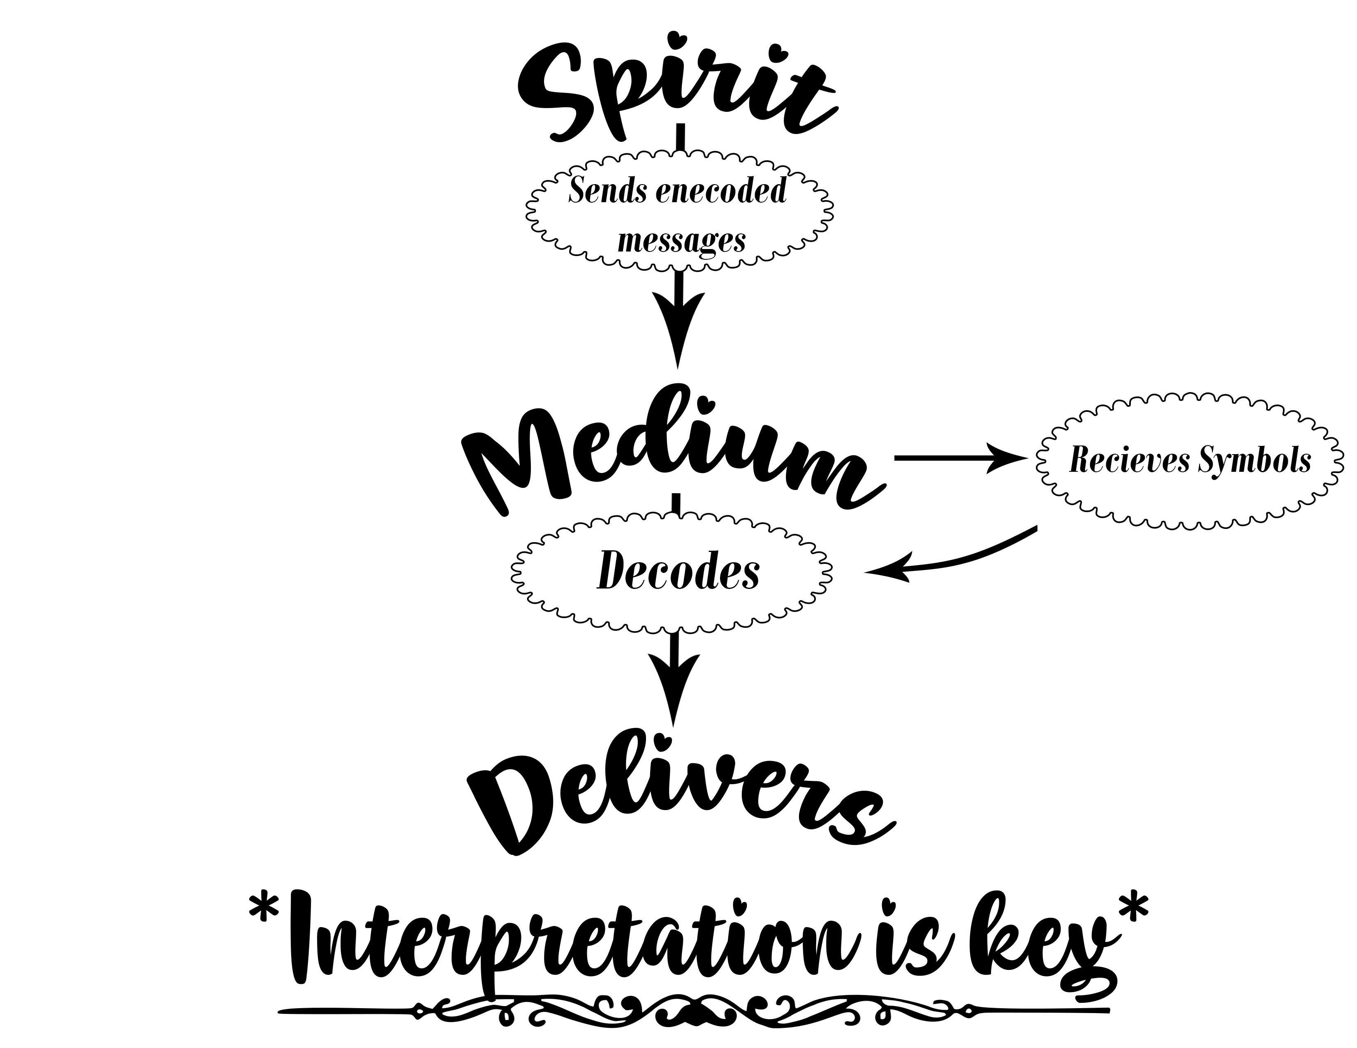

Slide 23
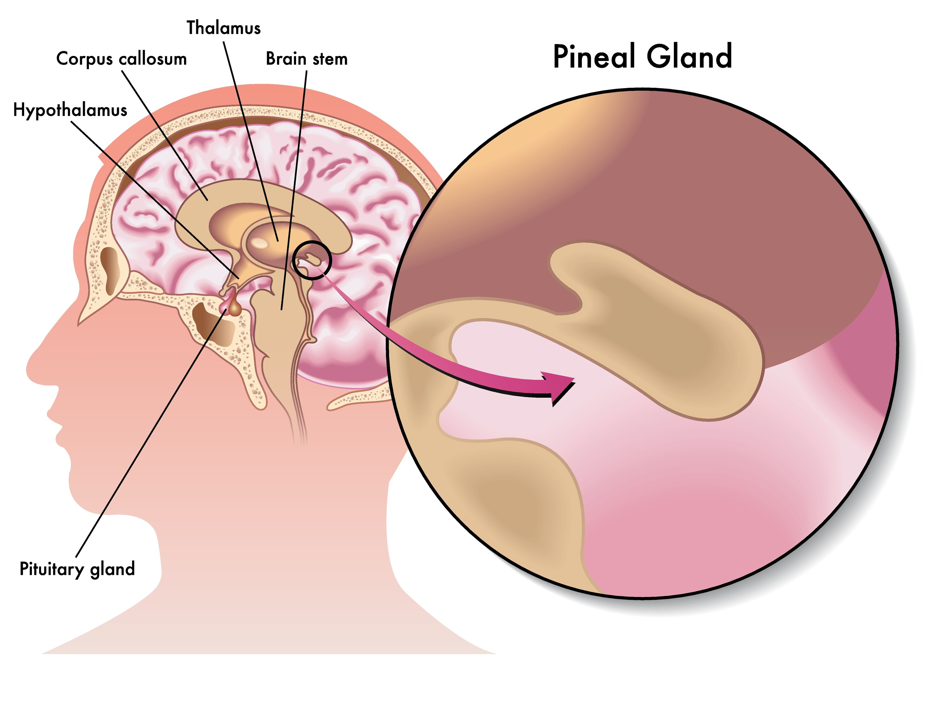

Slide 24
Where are Memories Stored?
Brain is a functioning Organ
Mind=the collective cloud
Collective Consciousness
Memories are stored in the cloud
Brain Access these memories

Slide 25
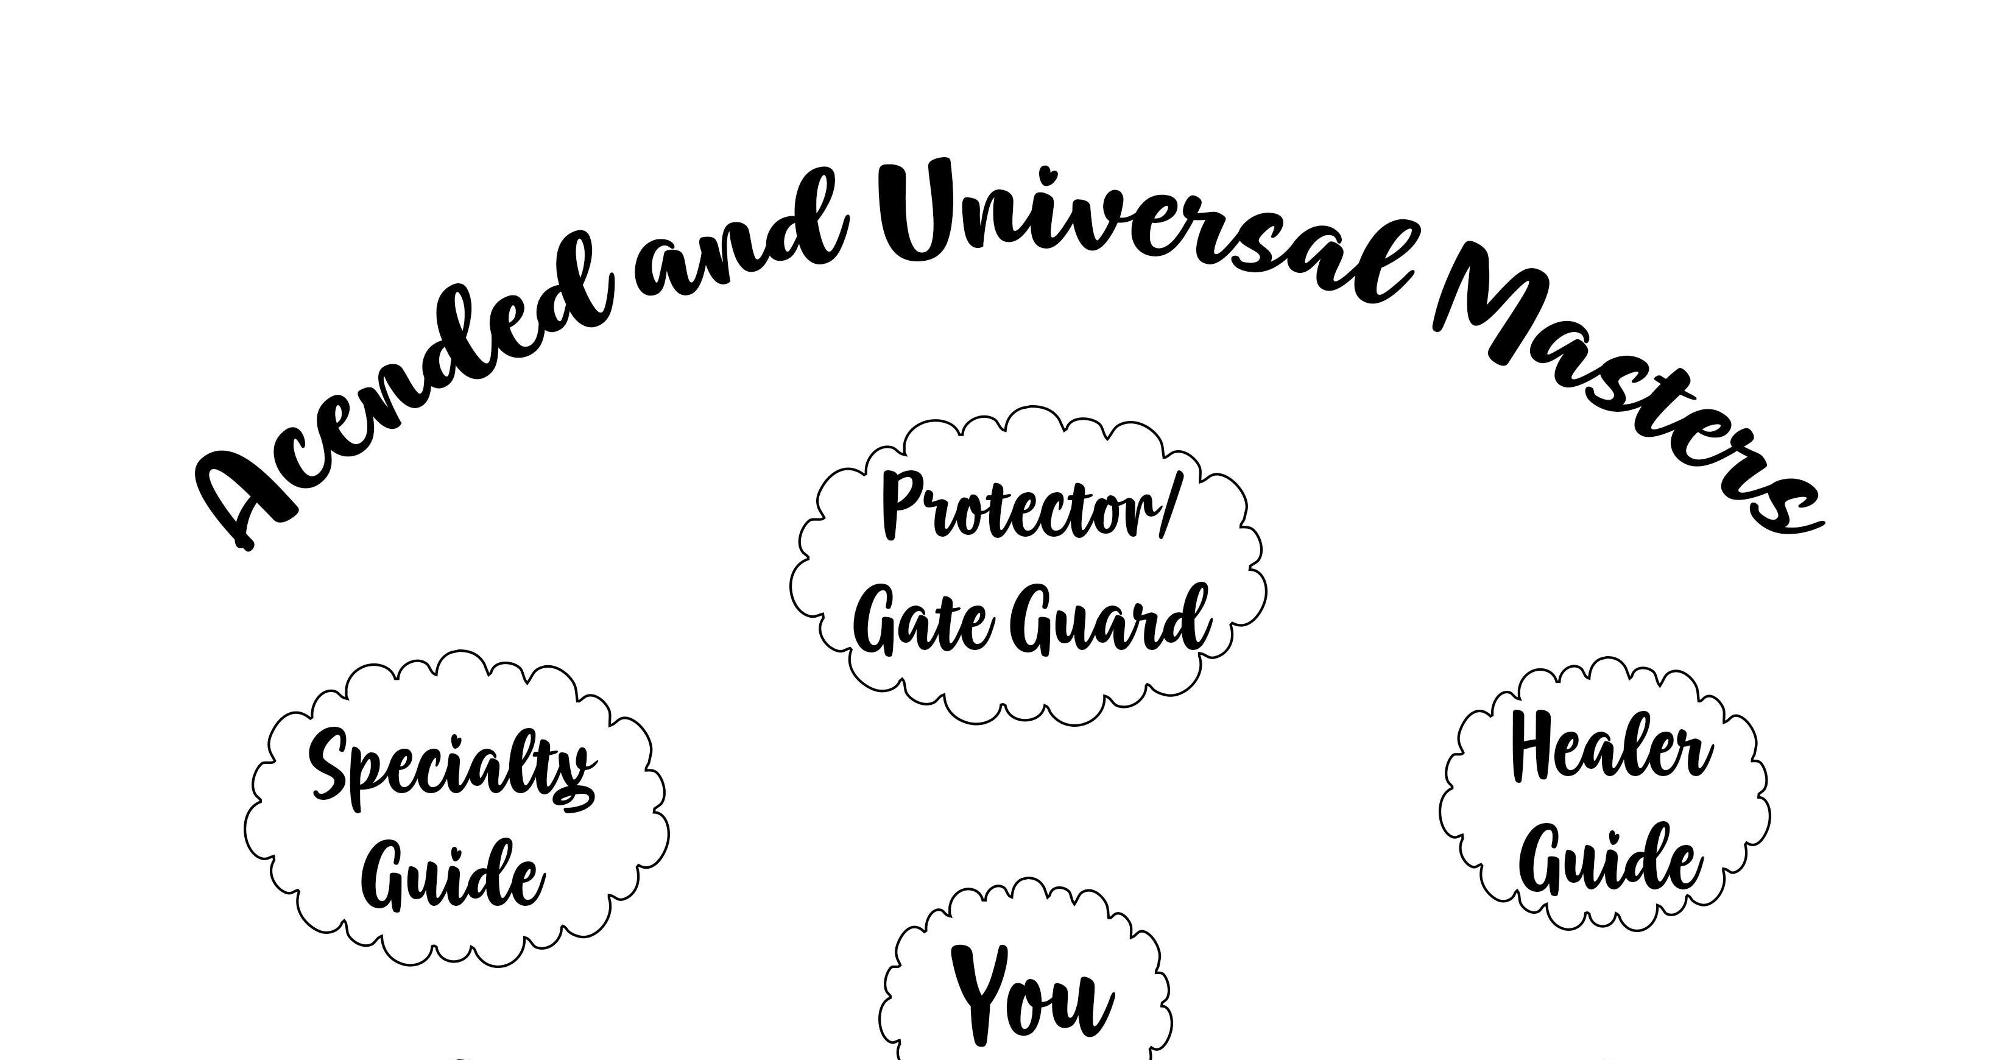

Slide 26
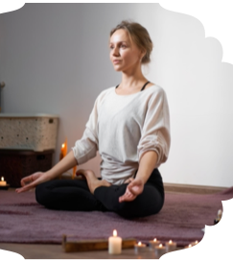
Setting Up Your Sacred Space
Place of Meditation
Put things you love
Builds the vibration
Space needs to be clear
Place where you nurture your soul
You become more of your true essence

Slide 28

Questions/Comments
Meditation – 12 minute
Meeting your Guides
Practice Running Energy

