Slide 1
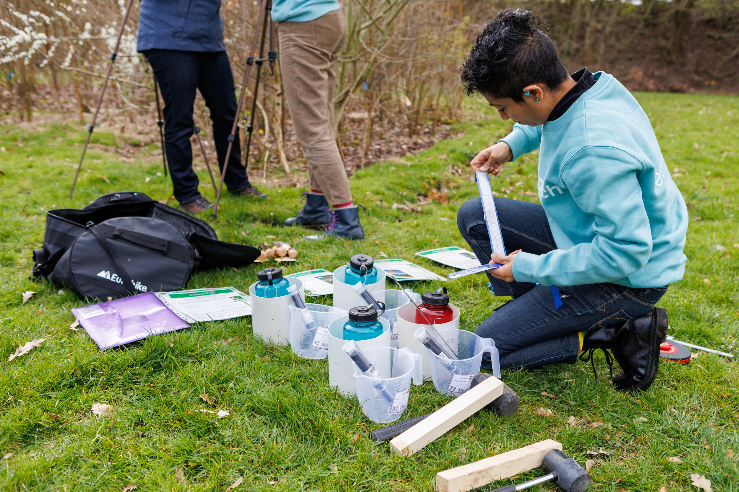

Overview of Citizen Science and Learning Outdoors
How to bring nature and science into your school.
WHAT DO YOU THINK CITIZEN SCIENCE MEANS?

Slide 2
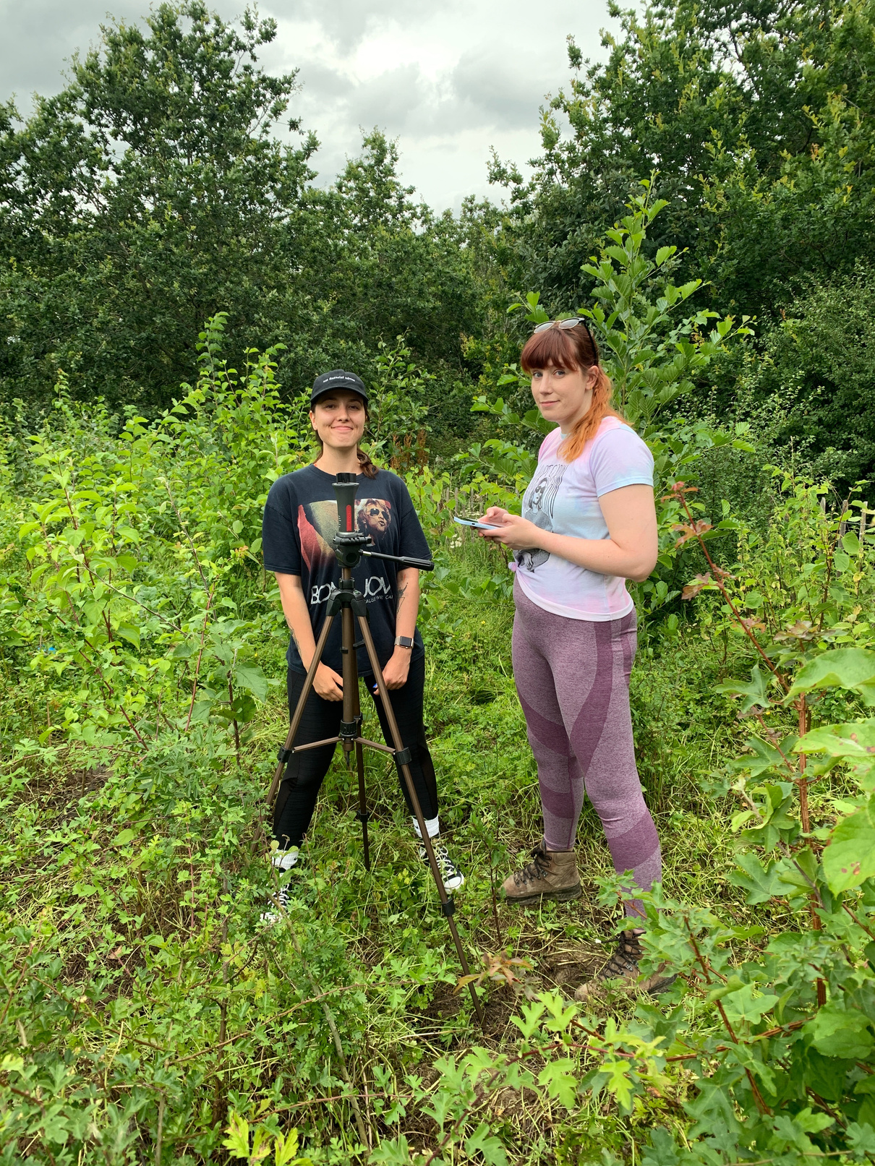
Overview
What is citizen science? Benefits and roles of citizens in projects.
What is outdoor learning? Benefits and challenges, plus motivations behind citizen science project participation.

Slide 3
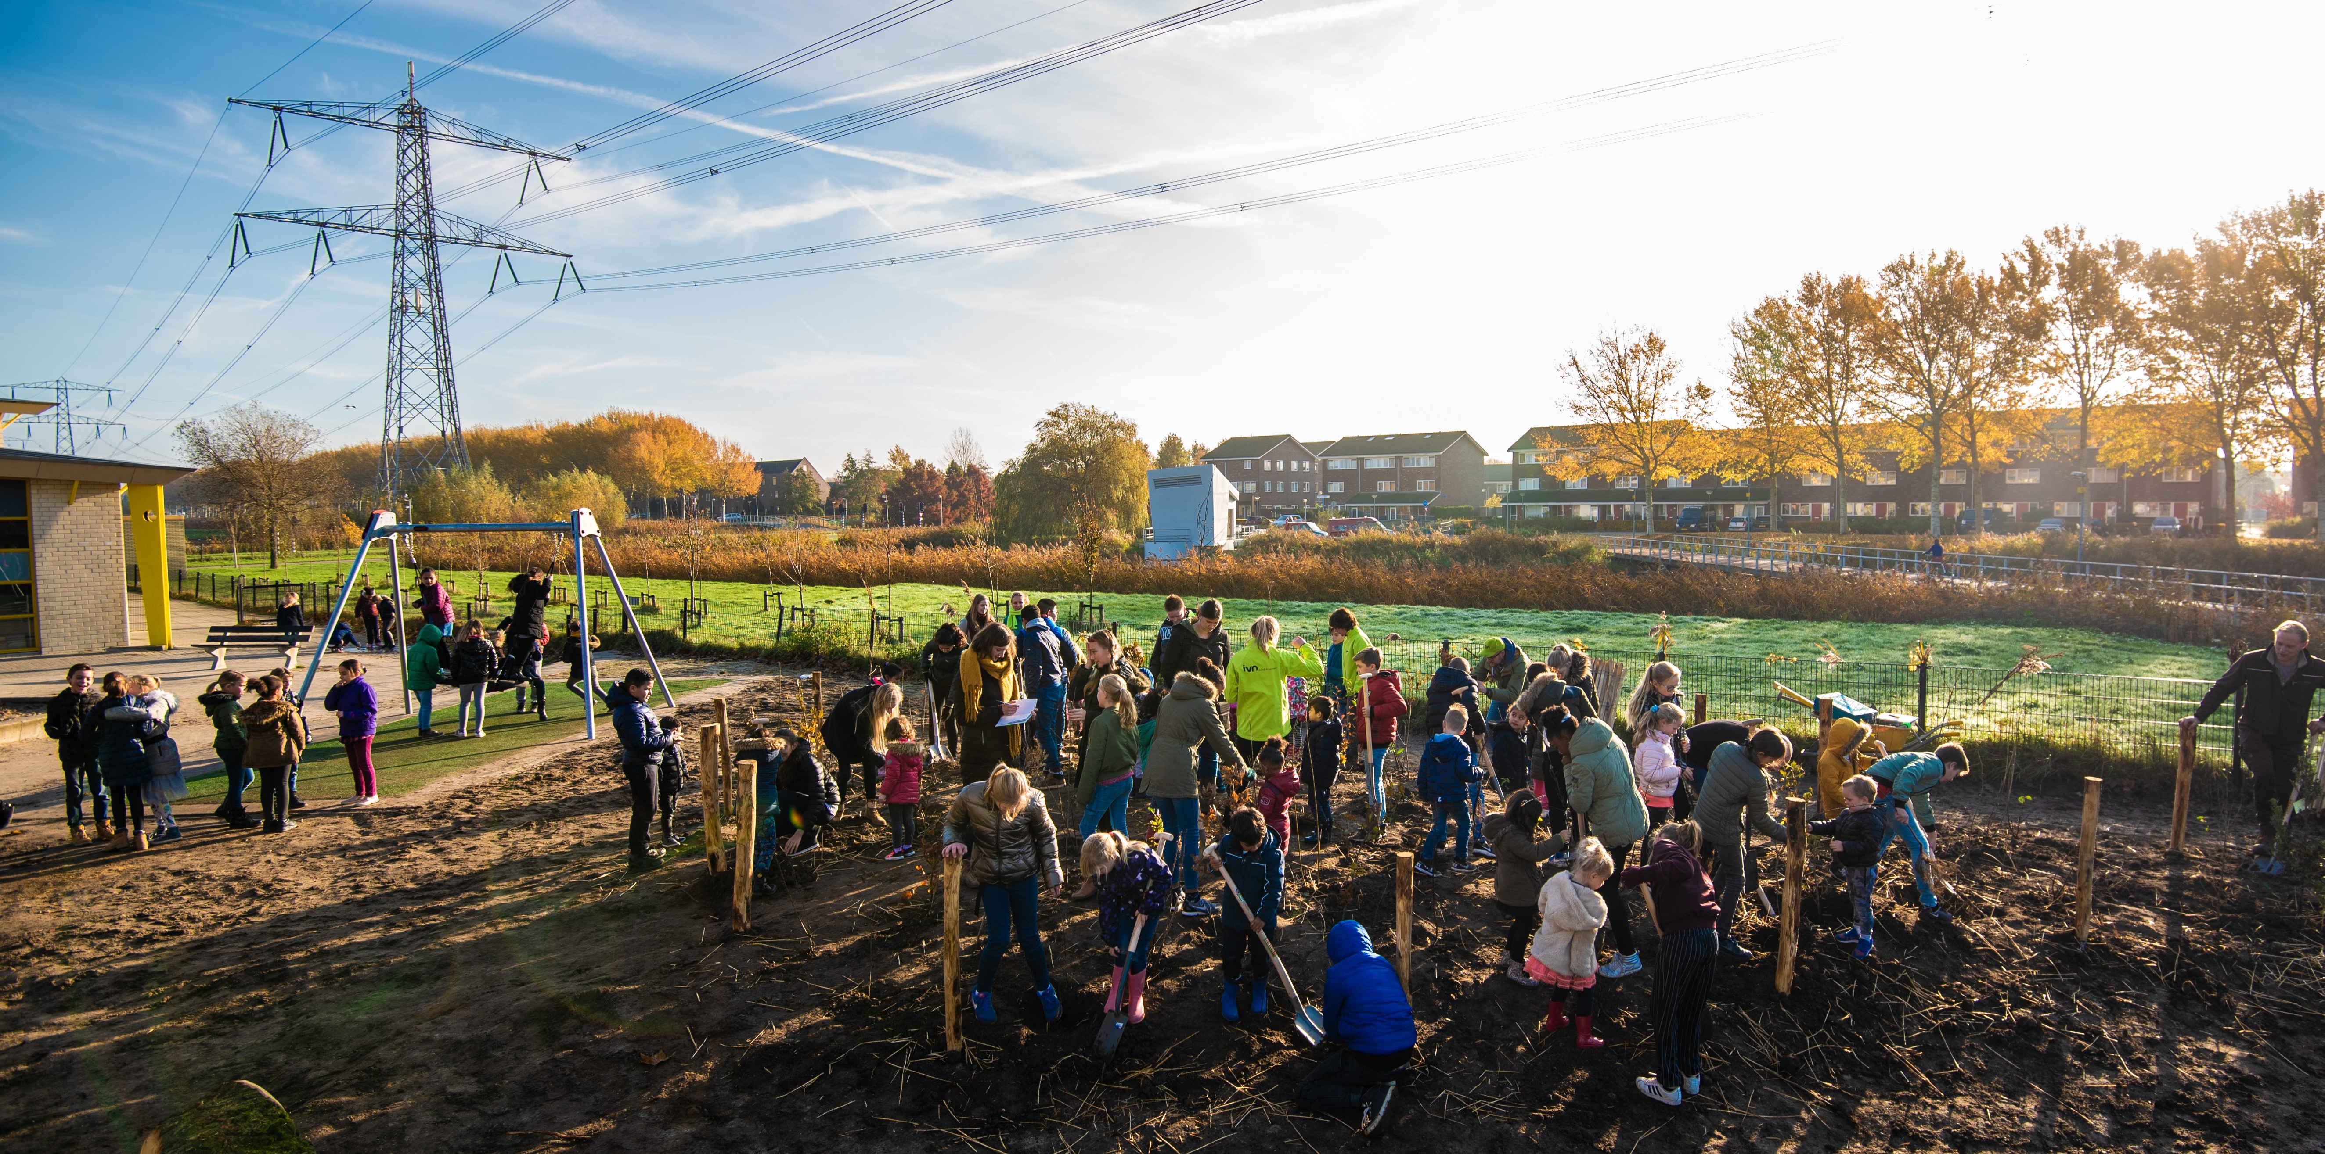

What is citizen science?
...and what are the benefits.

Slide 4
Citizen science
Citizen science is when the public volunteer to support with scientific research to address real-life problems. There are multiple ways citizens can help, often data collection is the main method.
Activities include birds and bug counts, measuring plants, and water testing. The results are sent to scientists, supporting research and providing a large amount of data that scientists could not gather on their own.
There are lots of different ways to take part in citizen science, including involving your students.

Slide 5
Benefits of citizen science
Accessible - it opens up science to people from all backgrounds, ages and abilities, allowing them to gain experience and scientific skills. There are no qualification barriers.
Mixing scientists and non-scientists increase overall creativity and innovation as people bring different opinions and new ideas.
Citizen science projects can increase participants nature connection and increase their likelihood to protect it.
Allowing people to take action for nature reduces feelings of eco anxiety.
More data can be collected.
More data = better understanding and knowledge of nature.

Slide 6
From astronomy to zoology, wildlife surveys to exploring WW1 diaries - there is a project for anyone and everyone! But....
The main way citizens help is through data collection. This can be as simple as taking a photo of an animal or plant and uploading it to a database. Or, it can be more complicated, such as testing water and recording the results.
Other ways to be involved include designing the project, data analysis, sharing results, and encouraging others to get involved.
What do citizens actually do in citizen science?
Observe nature
Record data
Share with scientists

Slide 7
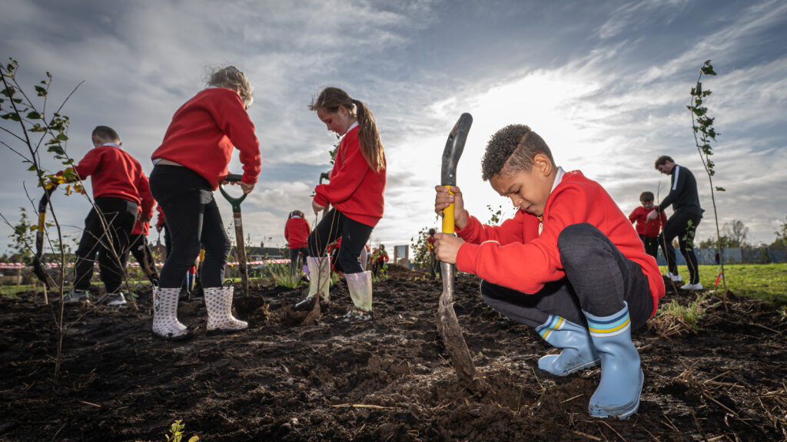
What is outdoor learning?
It’s benefits and challenges. Plus participant citizen science motivation.

Slide 8
Outdoor Learning
What is outdoor learning?
Outdoor learning breaks down the boundaries of typical classroom-based learning in education. It connects pupils with the natural world.
A key principle is to complement and support the curriculum, enhancing transferable skills, e.g. communication and problem solving.
There are benefits and challenges to outdoor learning.
Benefits
Challenges
Communicating environmental challenges
Connection to Nature
Improved Wellbeing
Time Constraints
Confidence
Behaviour
Notes:
What is outdoor learning?
Outdoor learning breaks down the boundaries of typical classroom-based learning in education, acting as a strategy to connect people with the natural world and engage them in the outdoors.
Key principle is to complement and support the curriculum, enhancing transferable skills, such as communication and problem solving, as well as promoting self-development.
In fact, a recent study found that as little as two hours of outdoor time a week could have drastic improvements for personal well-being.
Spending time outdoors improves children's confidence, motivation and concentration. 75% of respondents to a survey stated that their pupils concentration levels increased after outdoor learning, supporting academic performance.

Slide 9
Benefits to outdoor learning
Outdoor education enhances social relationships and can promote behaviour for learning among students, particularly those who struggle in traditional classroom settings. Other benefits include:
Connection to Nature
Around 1 in 3 people in England don’t have access to natural spaces near their homes.
Connection to nature results in pro-environmental behaviour.
Improved Wellbeing
Being outdoors relieves anxiety and stress
Removes pupils from a overstimulating environment.
The Wildlife Trust states that appreciating the natural world can improve mental wellbeing and connect children to their emotions.
Communicating environmental challenges
Pair climate change conversations with examples of nature-based solutions. Shows existing solutions to environmental problems.

Slide 10
Challenges with outdoor learning
We have an Outdoor Learning Contract template!
Time Constraints
Lots of organisations, e.g. Wildlife Trust, the RSPB and Earthwatch have curriculum linked resources and activities for outdoor learning.
Outdoor learning can look different.
Confidence
Structure -have a clear starter, main and final activity.
Start small.
Community - find groups on social media, or chat with colleagues about outdoor learning. Establish a support network this can offer guidance on best practise.
Behaviour
Form an outdoor learning contract.
Establish a noise/action that signals the class to stop and listen.
Short activities can assist with focus.
Introduce the lesson indoors and establish a focus point for the session.
LACK OF CONFIDENCE LACK OF CAPACITY
Notes:
Behaviour
Before going outside, form an outdoor learning contract - a list of rules in collaboration with the class. Establish a noise or action that signals the class to stop and listen. Warn, if the contract is broken it may prevent future outdoor learning.
Short activities can assist with focus and can feed into a bigger task at the end of a session or topic.
Allow for hands-on exploration. Establish a physical connection with nature among children by deepening their understanding.
Introduce the lesson indoors and establish a focus point for the session. Explain why you're going outdoors and why it is important.

Slide 11

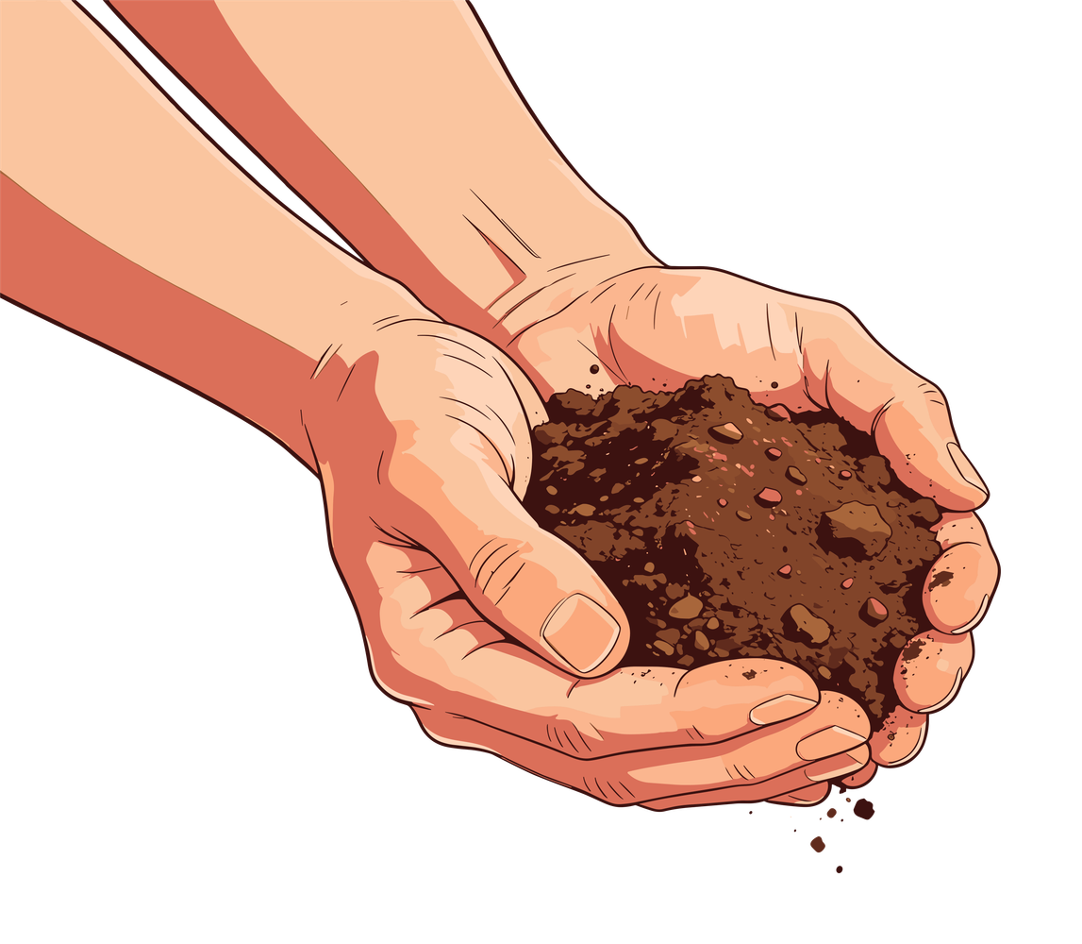

Incoporating motvation
Understanding the motivations of people can increase their participation in citizen science projects. You’ll know your class best - so you will have an insight into what motivates them.
Some common motivators:
Connection to nature
Sharing and presenting
Competition and gamification
Becoming a scientist
Notes:
Include nature connection element/how the project helps nature.
This will come naturally with most of the CS activities, so may not require additional planning. Simply highlight how nature will be helped with their support
Gamification of the project
Many projects involve an element of counting - this can easily be made into a class competition with a simple prize for the winner.
You could have a long term leaderboard that relates to all CS projects taken across the year - the more students get involved with, the more points the gain.
Sharing
Some students may want to present what they did and what they learnt. This could be something they will want to work towards. Other students may dislike the idea of sharing. You’ll know best whether this is a suitable motivation for your class.
Highlight science contribution
There could be certificates handed out for science contribution! The Great UK WaterBlitz gives all participants a certificate.

Slide 12
Summary:
Citizen Science allows anyone to get involved in scientific research and make a real difference, enriching the value of these projects.
The data we collect helps deepen scientist’s understanding of what’s happening in nature, gathering more evidence to ask for changes to protect our planet.
Outdoor learning and citizen science provides students with multiple benefits.
There are challenges to outdoor education, but by talking about them and sharing solutions, we can practice overcoming them.
The Big Picture → when communities work together, we can protect nature and have a big impact

Slide 13
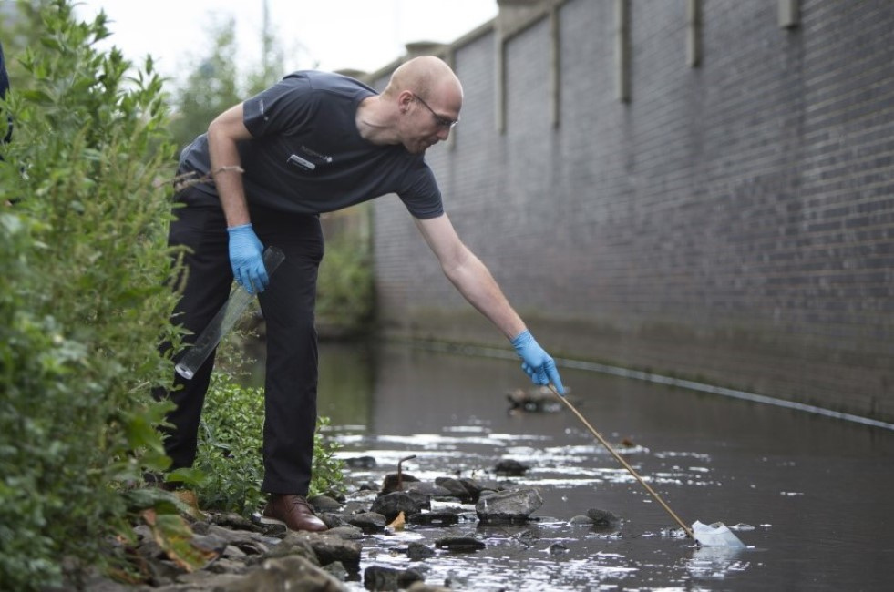
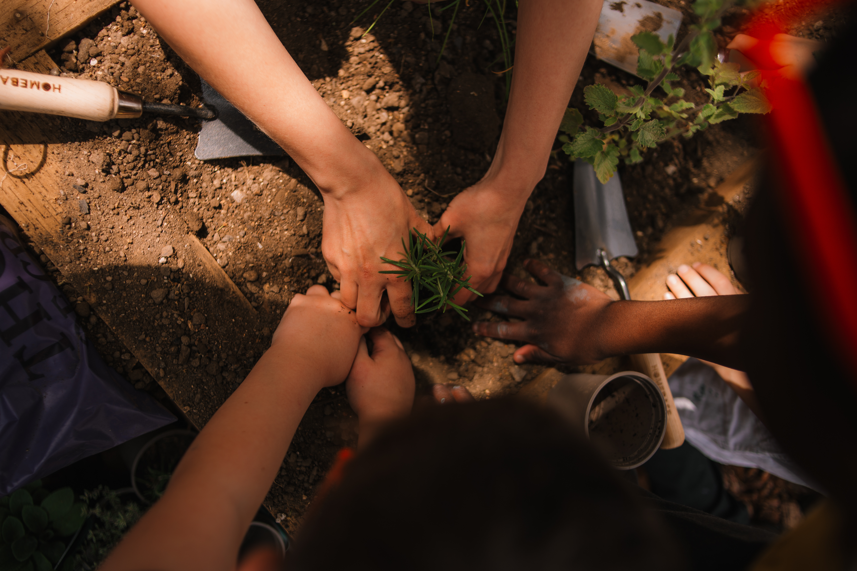
Any questions?
Please email them to education@earthwatch.org.uk!

