Slide 1
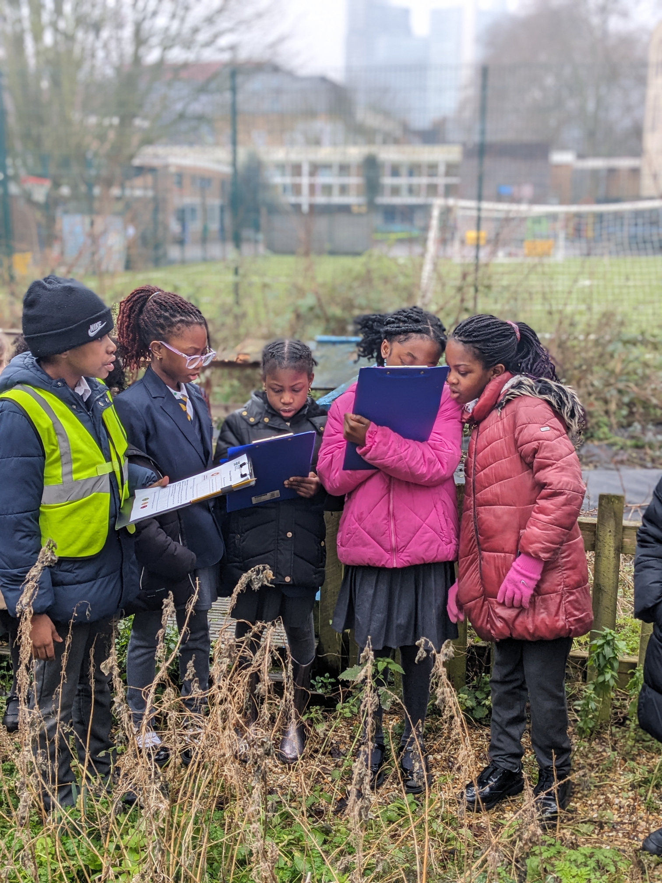

A Calendar of Citizen Science Projects
How to bring nature and science into your school.

Slide 2
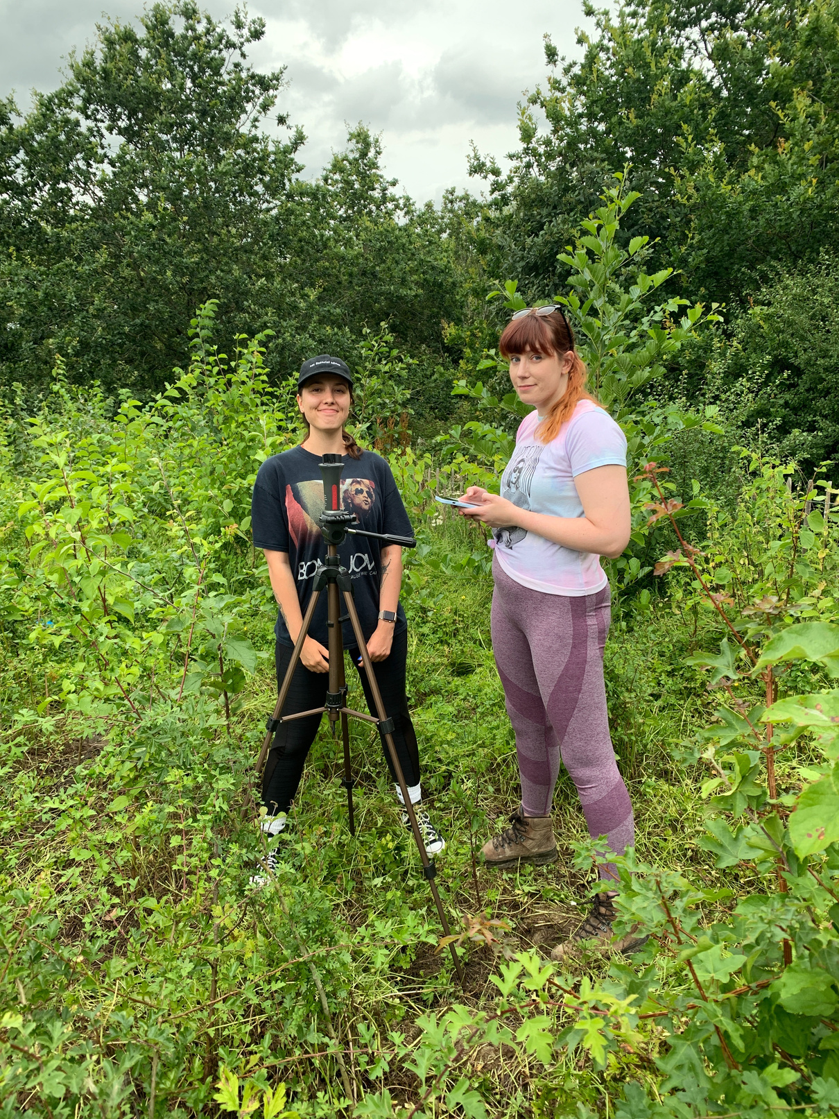
Overview
A range of real citizen science projects your students can get involved in across the year.
What, when, why, plus curriculum links, practical adaptations.

Slide 3

January
RSPB Big Schools’ Bird Watch
When - Late Jan
What - Count the birds in your school grounds, resources supplied by RSPB, including ID guides.
Why - Results are submitted to a national database helping scientists monitor bird population trends.
Timing - 15/30 minutes
Difficulty - Easy
Who - KS1 (supported) /2/3
Adaptations - Bird watching through the window and make your own bird feeders. Identify single bird species at a time. Bird identification quizzes, analyse historical Birdwatch data (provided by RSPB) and make graphs from results.
Link to the project
English Curriculum Links
Science: Living things & habitats; animals including humans; seasonal change; working scientifically
Maths: Data handling; statistics
Geography: Fieldwork skills
Curriculum for Wales
Science & Technology: Scientific enquiry; interdependence of living things
Humanities: Understanding local environments (cynefin); enquiry and investigation
Mathematics & Numeracy: Data collection and representation

Slide 4


February
Woodland Trust - Natures Calendar
When - Year round, Feb/Spring is a good time to start.
What - Choose a location and record changes to nature that you witness e.g. first leaf on a tree, first butterfly of spring.
Why - Help scientists monitor the effects of weather and climate change on wildlife.
Timing - 15-30 minutes
Difficulty - Easy
Who - KS1/2/3
Adaptations - Observing through classroom window. Students could win a prize for noticing something on the school grounds. Graph seasonal data, compare historical records, hold climate change discussion.
Link to the project
English Curriculum Links
Science: Plants; seasonal change; climate impacts
Maths: Graphs; time data
Geography: Weather and climate
Curriculum for Wales
Science & Technology: Observing change through evidence; ecosystems
Humanities: Natural processes and environmental change
Mathematics & Numeracy: Pattern recognition and data trends

Slide 5


March
The Big Plastic Count
When - one week in March
What - Pupils or classes count every piece of plastic their household throws away over the course of a week.
Why - Help scientists understand how much plastic is thrown away.
Timing - 1 week of counting plastic items.
Difficulty - Medium, big time commitment for students.
Who - KS1/2
Adaptations- Use example data to make graphs, create posters about reducing waste, research recycling in the UK.
Link to the project
English Curriculum Links
Science - Understanding human environmental impact
Maths - Classification and recording; Categorisation; statistics
Geography - Human impact; Sustainability and waste
PSHE / Citizenship - Making responsible choices
Curriculum for Wales
Science & Technology: Human influence on ecosystems, investigating materials
Humanities: Ethical, informed citizenship and sustainability
Mathematics & Numeracy: Categorising and analysing data

Slide 6

April
Great UK WaterBlitz
When - Registration opens in Feb/March, event is in April and repeats in September.
What - Measure water quality by testing for phosphates and nitrates.
Why - Contributes to nationwide water-quality monitoring reports
Timing – 60–90 minutes
Difficulty – Moderate
Who - KS2, KS3, KS4
Adaptations - Watch our ‘What’s in your water?’ webinar, discuss sources of water pollution. Encourage pupils to take part with families and share experiences with the class.
Link to the project
English Curriculum Links
Science: Working scientifically; ecosystems; materials
Maths: Measurement; interpreting data
Geography: Rivers; human environmental impact
Curriculum for Wales
Science & Technology: Evidence-based investigation; human impact on ecosystems
Humanities: Sustainability and environmental responsibility
Mathematics & Numeracy: Interpreting numerical environmental data.

Slide 7

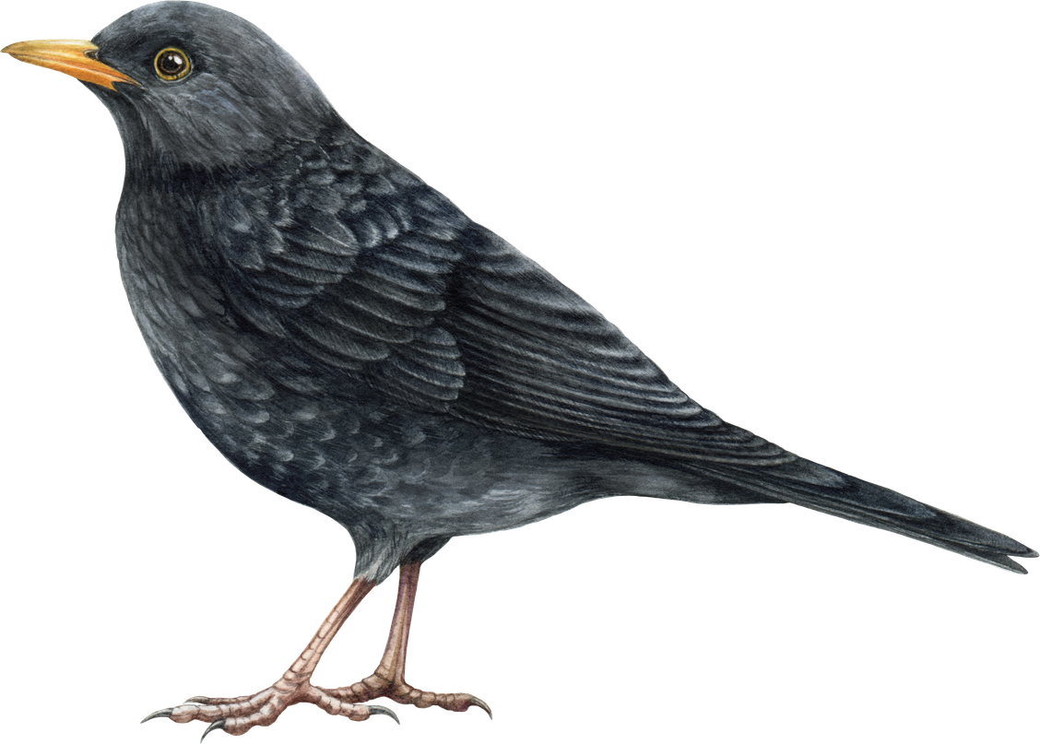
May
Merlin
When - all year round, but May is when the dawn chorus peaks.
What- an app that records birdsong and detect bird species.
Why - supports wildlife recordings.
Timing - 15 minutes, however you could run a Dawn Chorus activity, this will require more time and planning.
Difficulty - easy to moderate
Who - KS1/KS2/KS3
Adaptations- find a new bird, make a research page about it, including facts and drawings.
Link to the project
English Curriculum Links
Science: Identification; seasonal change; habitats; scientific enquiry
Maths: Classification and recording data
Geography: Local environment study, Observing and recording physical features
Curriculum for Wales
Science & Technology: Biodiversity investigation; scientific observation; identifying and classifying living things.
Humanities: Understanding local environments.
Mathematics & Numeracy: Sorting and categorising evidence .
Digital Competence Framework: Collecting and recording data, using digital tools, evaluating digital information.

Slide 8

June
UK Pollinator Monitoring Scheme - FIT Counts
When – April to September, but June is an ideal time for it.
What –Pupils observe a flowering plant for 10 minutes and count pollinating insects.
Why -contribute to national pollinator monitoring.
Time – 15–30 minutes
Difficulty – Easy
Who - KS1 (supported), KS2, KS3
Adaptations - Hopefully its sunny! Pollinator biodiversity quizzes, lifecycle and food chain investigations, draw and label your favourite pollinator
Link to the project
English Curriculum Links
Science: Plants; ecosystems; food chains
Maths: Sampling; tally charts
Geography: Sustainability; land use
Curriculum for Wales
Science & Technology: Interdependence of living things
Humanities: Sustainable use of environments
Mathematics & Numeracy: Recording observations systematically

Slide 9
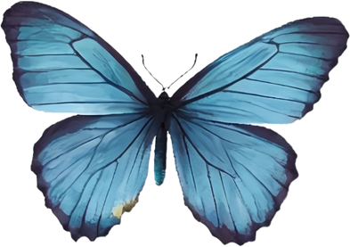

July
The Big Butterfly Count
When – Mid-July to early August
What – Students complete a 15-minute butterfly survey, identifying species.
Why - Allow scientists to track national population changes.
Time – 15 minutes of watching for butterflies
Difficulty – Easy/Moderate
Who – KS1, KS2, KS3
Adaptations - Study the butterfly lifecycle, look at their adaptations, look at previous years maps of butterfly date, make comparison.
Link to the project
English Curriculum Links
Science: Habitats; adaptation; life cycles
Maths: Data recording and graphs
Geography: Climate and habitats
Curriculum for Wales
Science & Technology: Biodiversity and adaptation
Humanities: Environmental change awareness
Mathematics & Numeracy: Data presentation

Slide 10

Sept
Autumn round of Great UK WaterBlitz
Adaptations - can students compare data from April? Did they notice anything different about results or process? How might the weather effect the pollution they may or may not be seeing.
Link to the project

Slide 11

October
Million Mile Scream - Surfers Against Sewage
When - Million Mile Clean runs throughout the year. In October it’s made Halloween themed!
What - It’s a litter pick but with data gathering incorporated. At the end of the clean tally up the items and brands found.
Why -This helps end single use plastic.
Time – 60 mins, depending on where clean is
Difficulty – Higher if travel is required
Who - KS2, KS3
Adaptations -Students can make costumes out of household rubbish to do their litter pick in (SAS gives prizes to top costumes). School litter audit, plastic lifecycle investigations, plastic footprint.
Link to the project
English Curriculum Links
Science: Materials; environmental impact
Maths: Categorisation; statistics
Geography: Coasts; human impact
Curriculum for Wales
Science & Technology: Human influence on ecosystems
Humanities: Ethical, informed citizenship and sustainability
Mathematics & Numeracy: Categorising and analysing data

Slide 12

November
English Curriculum Links
Science: Plants; seasonal change; habitats; scientific enquiry
Maths: Classification and recording
Geography: Local environment study, Observing and recording physical features
Curriculum for Wales
Science & Technology: Biodiversity investigation; scientific observation; identifying and classifying living things.
Humanities: Understanding place and environmental change.
Mathematics & Numeracy: Sorting and categorising evidence .
Digital Competence Framework: Collecting and analysing data, using digital tools, evaluating digital information.
Seek App, by iNaturalist
When – Year around, however nice to incorporate in winter when nature isn’t as obvious.
What – An app that uses recognition technology to identify the plants and animals all around you.
Why - Acts as a nature tracker, allowing scientists to know what species are where.
Time – 15-30 minutes
Difficulty – Easy
Who – KS1, KS2, KS3
Adaptations - Find a new plant/bird, make a research page about it, including facts and drawings. Species identification skills.
Link to the project

Slide 13
Year round
Woodland Trust - Ancient Tree Inventory
When - all year round
What - map ancient or old trees that you find. You find and plot the location of the tree, adding information about the tree species (can use the Seek app to confirm this) and its size.
Why - help protect and celebrate UK oldest trees.
Time - Any!
Diffculty - Low to medium
Who - KS1 and KS2
Adaptations- use the map to locate ancient trees near your school! Treat this like a treasure hunt - could students get a photo with an ancient tree, or draw their own tree map.
Link to the project
English Curriculum Links
Science: Plants; seasonal change; habitats; scientific enquiry
Maths: Classification and recording
Geography: Local environment study, Observing and recording physical features
Curriculum for Wales
Science & Technology: Biodiversity investigation; scientific observation; identifying and classifying living things.
Humanities: Understanding place and environmental change.
Mathematics & Numeracy: Sorting and categorising evidence .
Digital Competence Framework: Collecting and analysing data, using digital tools.

Slide 14
Summary:
Citizen Science projects are happening across the year.
These project link to multiple areas of the curriculum allowing cross curricular links.
Many projects have different time commitments, and some are available to use throughout the year.
Adapt these projects to the needs of your school and pupils - use them as starters to explore a new topic in an exciting way!
Data collected on ecosystems through citizen science projects can lead to real change.
The Big Picture → when communities work together, we can protect nature.

Slide 15
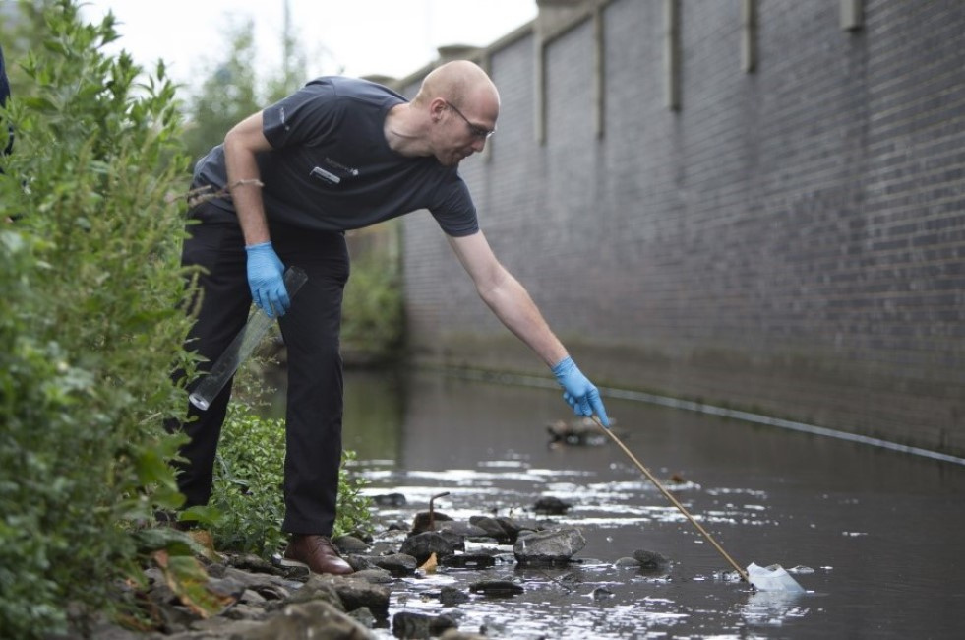
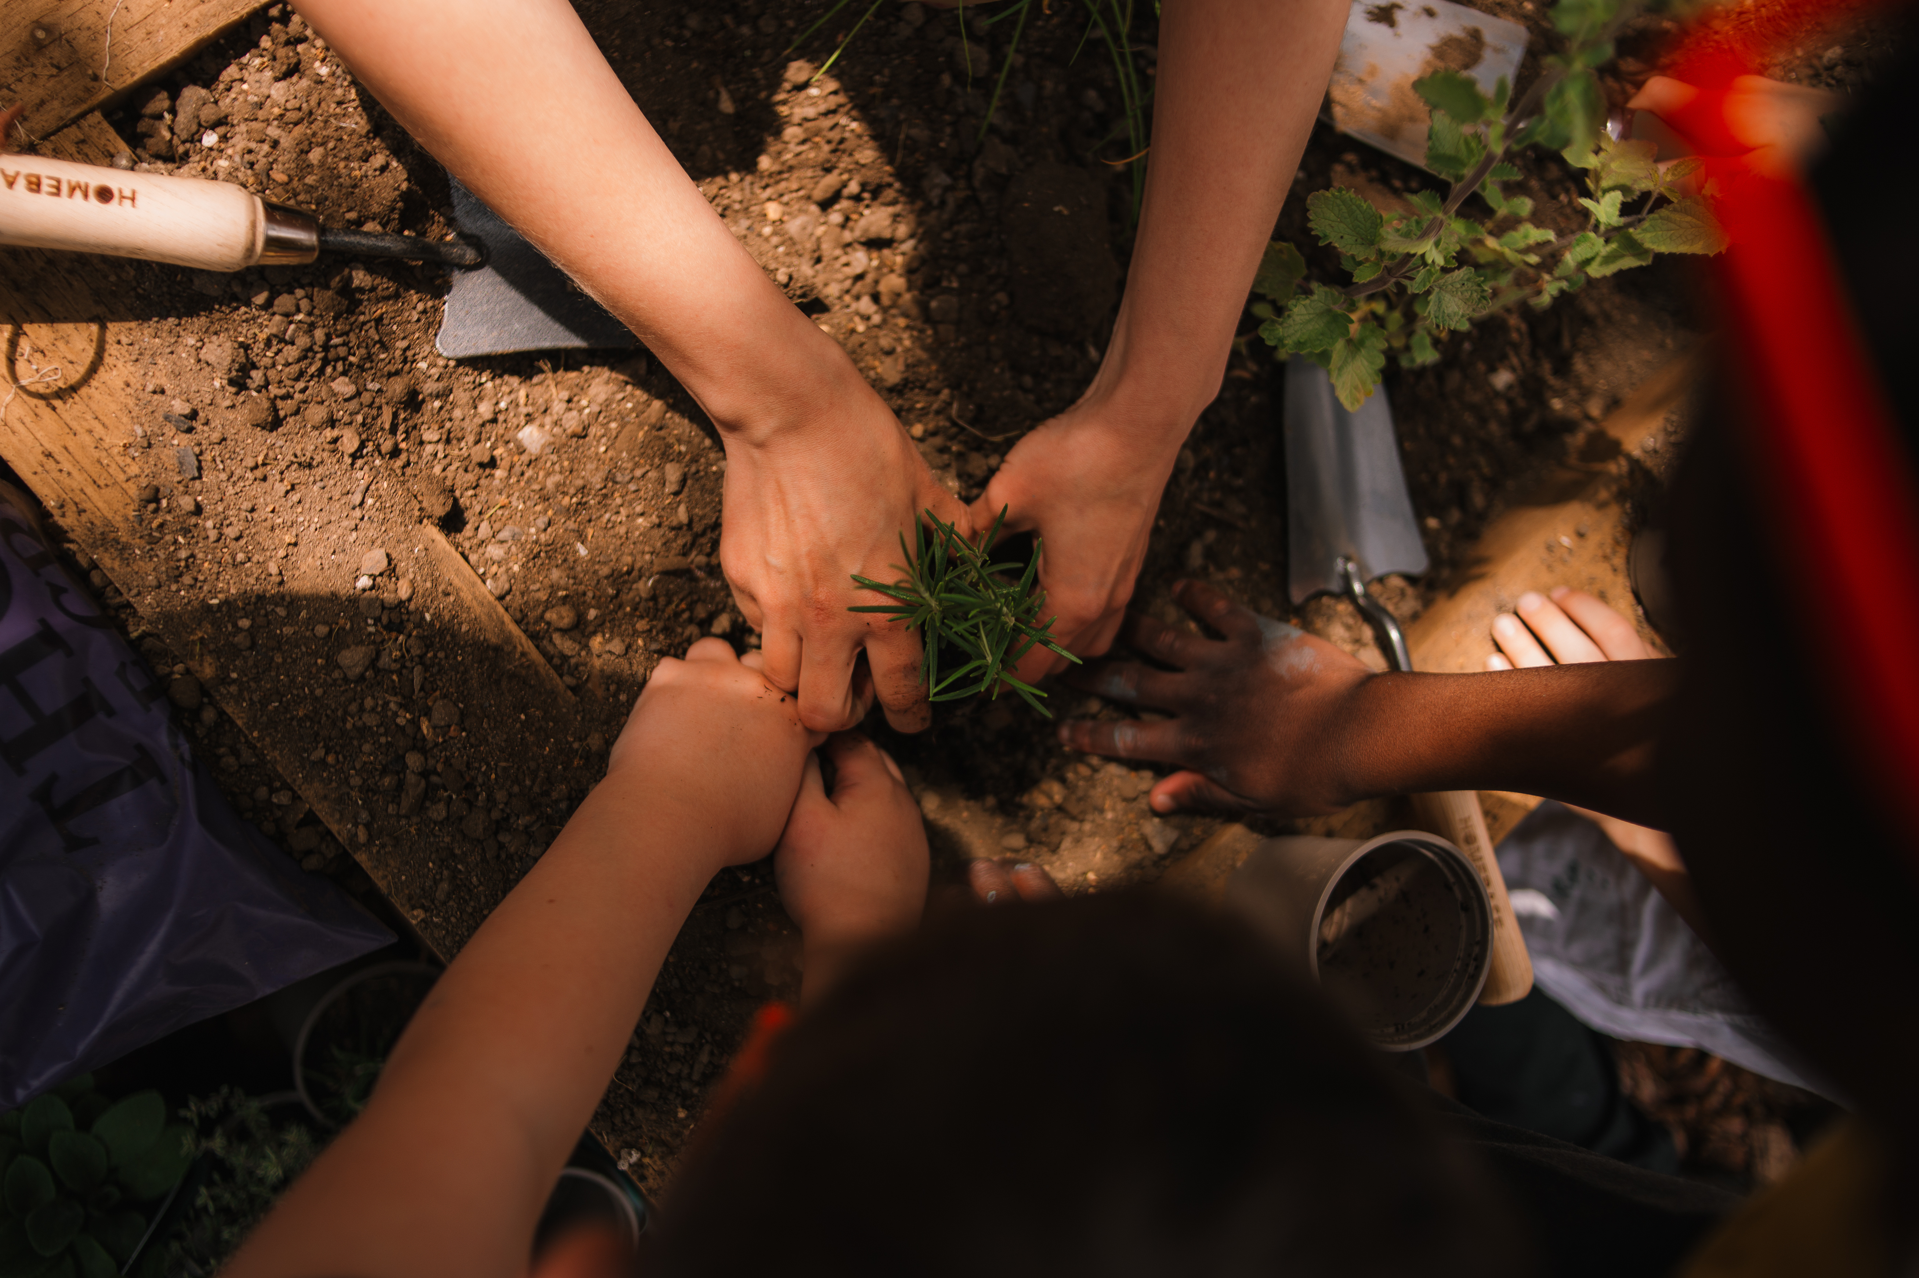
Any questions?
Please email them to education@earthwatch.org.uk!

