Slide 1
Monarch Overview
BABA MAJEKODUNMI
FOUNDER & PRINCIPAL CONSULTANT
2026

Slide 2
Agenda
Chrysalis Consulting Group
Monarch Overview
  One Slide Summary
  Detailed Summary
    What is Monarch
    Why Monarch (Business Value)
    Who Uses Monarch
    Key Use Cases
    Why it’s Different
  Recap with One Slide Summary

Slide 3
Chrysalis Consulting Group

Slide 4
Business Overview
Chrysalis Consulting Group is a specialized consulting firm focused on helping organizations transform complex, manual, and Excel-driven processes into scalable, trusted, and efficient processes using Monarch.
What We Do
Enterprise data preparation & process optimization using Monarch
How We Help
Replace manual, Excel-heavy business processes
Standardize and scale Monarch across teams
Improve reconciliation, reporting, and adherence with compliance
Who We Serve
Financial Services
Healthcare (Finance & Revenue Cycle)
Manufacturing & Distribution (Finance & Supply Chain Operations)
How We’re Different
Practitioner-led, outcome-focused, value-based engagements

Slide 5






About Baba
2006
2007 – 2012
2012 – 2015
2019 – 2025
2015 – 2019
2026+
Finance Transformation Practitioner
10+ Years Experience in Finance Transformation
Monarch Subject Matter Expert
Scaled and Governed Monarch across multiple enterprises
Cross Industry Financial Operations Depth
Summer Intern Analyst
Senior Research Assistant
Debit Card Analyst
Introduction to Monarch
Senior Payments Analyst
(Unofficial) Product Manager of Monarch
  Managed Monarch for the Enterprise
  Drove Process Improvement Initiatives
Monarch Sales Strategy & Enablement Leader
Collaborated on new GTM
Created Monarch App Library
Certification Committee Member
Founder & Principal Consultant
Profile of Customers
Financial Institutions
Healthcare
(Finance & Revenue Cycle)
Consumer/Retail/Manufacturing
(Financial Operations)
Trusted Advisor/Challenger/Consultant
Monarch Expertise
Finance Domain Expertise
Tier 1-2 FI’s: $100BN+
Tier 3-6 FI’s: $1BN - $100BN
Financial Service Providers
Insurers
Large Integrated Delivery Network
Critical Access Hospitals
Consumer Packaged Goods
Industrial Machinery
Electronics & Components

Slide 6
Monarch Overview
One – Slide Summary

Slide 7
Monarch – One Slide Summary
Self-Service Data Preparation application, primarily used for Finance.
Complements but does not replace; Traditional ETL, OCR, BI & Analytics Platforms, or ECM applications.
What is Monarch?
Despite significant investments in various mission critical technology systems, many organization still struggle to access and integrate data across those systems. Most solutions require expensive programming and customization with long delivery timelines.
Monarch provides a cost-effective, self-service, scalable, and time saving solution to the challenge of ‘Self-Service Data Prep for Finance’
Why Monarch?
(Business Value)
Any Organization and Persona within or adjacent to Financial Operations
Organizations
Financial Services
Healthcare Finance
Manufacturing & Distribution
Personas
Accountants
Analysts
Auditors
Who uses Monarch?
Any use case the requires cleaning, combining, transforming and analyzing data
Business Use Cases
Reconciliations & Operations
Reporting & Analysis
Risk/Regulatory & Compliance
Data Use Cases
Data Extraction
Data Preparation
Data Integration/Engineering (ETL)
Key Use Cases
Why it’s Different
Unique Data Extraction from PDF, Text, and Excel Based Reports
Monarch Solution Accelerators provides prebuilt templates for many technology systems that provide increased ROI.
7

Slide 8
Monarch Overview
Detailed Summary

Slide 9
What is Monarch?

Slide 10
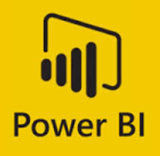









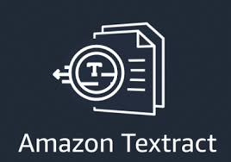

What Monarch is Not (Primarily)
Business Intelligence/Data Analytics Platform (BI/DA)
Enterprise Content Management (ECM)
Optical Character Recognition (OCR)
Data Integration/Extract Load Transform (ETL)

Slide 11
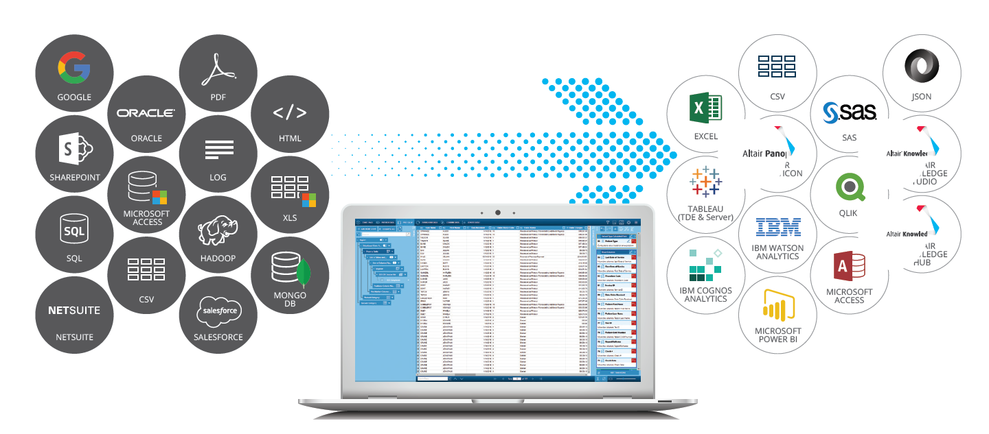
What Monarch is Self-Service Data Prep for Finance
“Monarch is primarily a Finance product” – Gareth Horton, VP – Product Management
A Self-Service Financial Data Preparation Product
  Primarily Used by Finance & Finance Related Roles
  Target Personas = VP Controller, VP Operations
Finance Transformation Initiatives
    Optimize Investment of Mission Critical Systems
      ERP (Enterprise Resource Planning)
      HCM (Human Capital Management)
      CBS (Core Banking Systems)
Unique Value Proposition
    Data Extraction from ‘Reports’
    Unique Capabilities with Spreadsheets

Slide 12
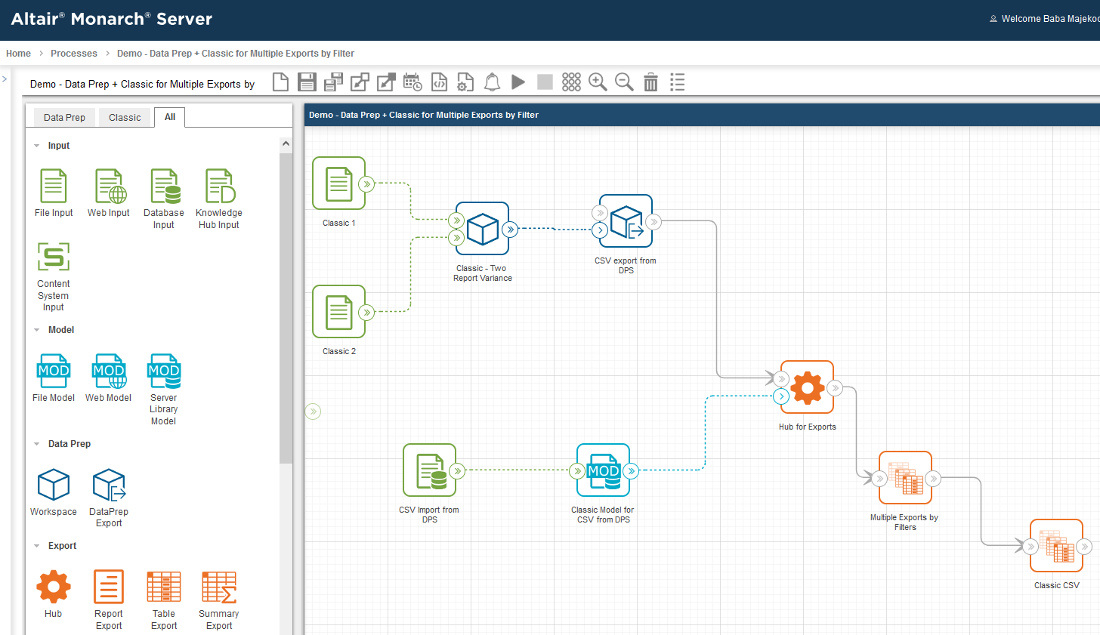
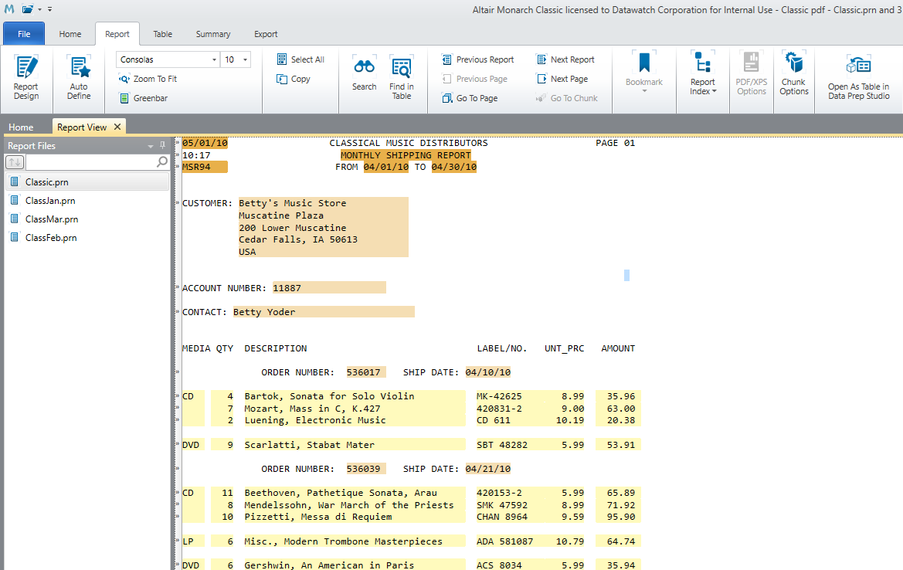
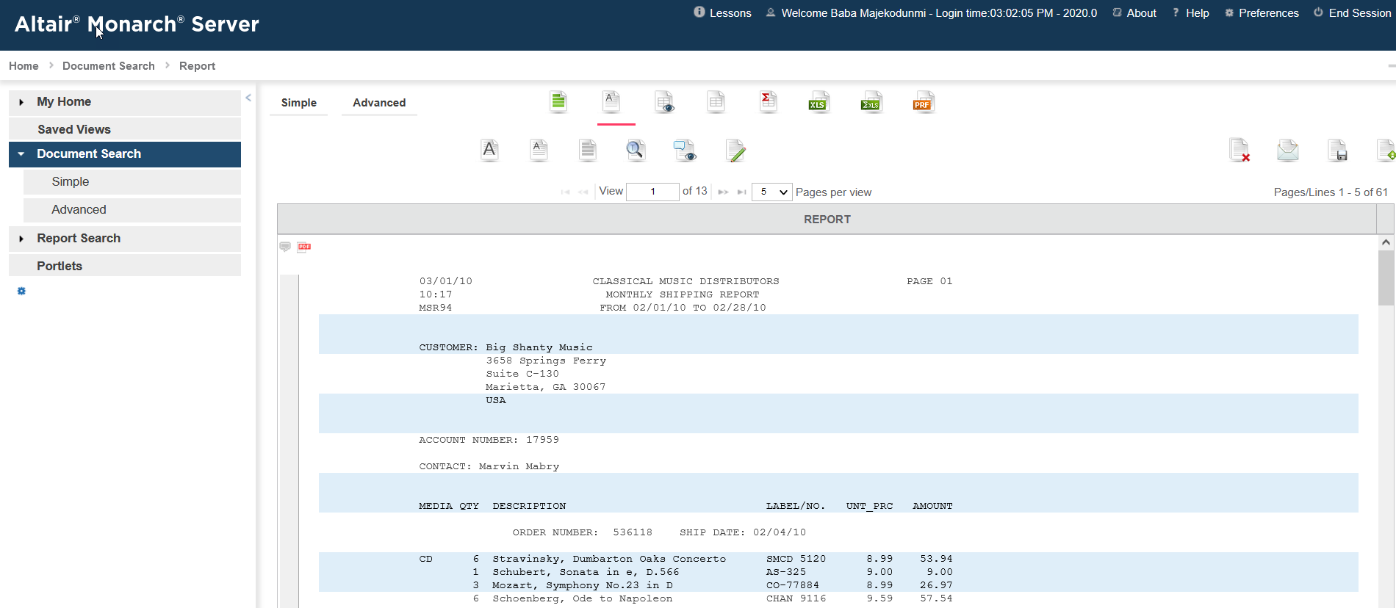
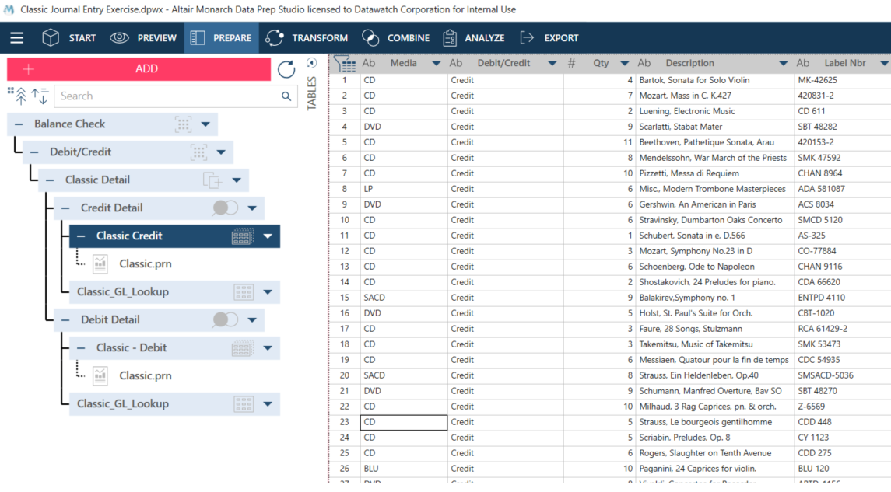
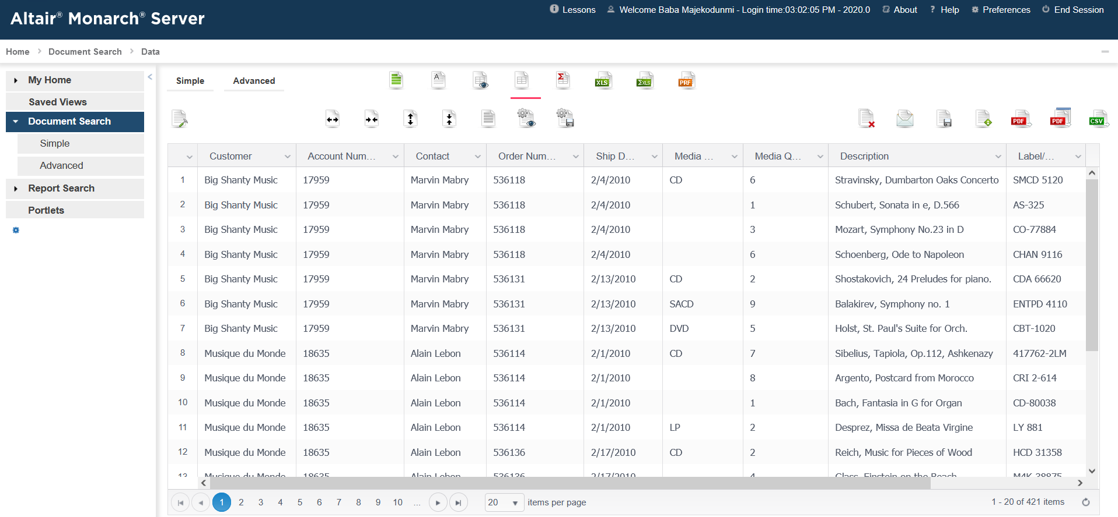
Monarch Platform Consists of 5 Products
Automator
Classic
Monarch Server
Report Warehouse
Monarch Desktop
Data Prep Studio
Report Mining

Slide 13
Monarch Platform Consists of 5 Products – 2 Core Products
Monarch Desktop – Data Prep Studio
Monarch Server – Automator
Self-Service Data Preparation
Acquiring, Combining & Transforming Data (ACT)
Unique Data Extraction (text, pdf, csv, xml, json)
Used by Financial & Operational Professionals to Build "Workspaces"
Data Engineering
Extract, Transform & Load (ETL)
Automation & Data Warehousing
Used by Data & IT Professionals to Build "Processes"

Slide 14
Why Monarch?
(Business Value)

Slide 15
Why Monarch (Business Value)
Monarch provides a cost-effective, self-service, scalable, and time saving solution to the challenge of ‘Self-Service Data Prep for Finance’
Core Banking System
(Deposits, Consumer Loans, Customer Information)
Finance & Accounting Systems
Loan
Origination
ATM System
Human Capital Mgmt
Content Mgmt Systems
Loan
Servicing
ACH/Wires
Credit & Debit Card
Financial Services
Electronic Healthcare Record
(Scheduling, Order Entry, Charge Capture, Master Patient Index)
Finance & Accounting Systems
(Billing, Revenue Cycle, Charge Master)
Laboratory Information Systems
Diagnostic Systems
Human Capital Mgmt
Remote Patient Monitoring
Robotics & Surgical Systems
Ambulatory
Urgent Care
Emergency
Patient Portal
Enterprise Resource Planning (ERP)
Finance & Accounting Systems
Warehouse Management
Customer Relationship Mgmt
Human Capital Mgmt
Point-of-Sale Systems
Logistics
Manufacturing Execution
System
E-Commerce Platform
Healthcare
Manufacturing & Distribution
Notes:
Avg IT Budget is 10% of Revenues and Data Integration Challenges can Impact ROI on Technology Systems.

Slide 16
Why Monarch (Business Value)
Monarch provides a cost-effective, self-service, scalable, and time saving solution to the challenge of ‘Self-Service Data Prep for Finance’
Type | Financial Services | Healthcare Finance | Supply Chain | Human Capital Management (HCM)
Reconciliation | How do I reconcile activity in my systems of record for products against my Financial ERP? | How do I reconcile patient payments in my EHR against my Financial ERP? | How do I reconcile my sales activity in my CRM against my Financial ERP? | How do I reconcile Payroll activity against my Financial ERP?
Operations | How many closed accounts had a payment that was rejected/unposted? | How do I Identify and manage Patients who have overpaid (Credit Balances) | How many customers paid for products that were not delivered? | How do I identify and Process Payroll Exceptions?
Analytics | What are the Key Performance Indicators (KPI’s) for our products? | Which Payers (Insurance) pay us faster, and for what procedures? | What are the Key Performance Indicators (KPI’s) for our products? | What are the Key Performance Indicators (KPI’s) for our products?
Audit/Compliance | How many employees performed override transactions? | What % of procedure were denied due to clerical errors vs system errors? | How many employees performed override transactions? | How many employees performed override transactions?
Project Management | How do we successfully migrate data from one system to another? | How do we successfully migrate data from one system to another? | How do we successfully migrate data from one system to another? | How do we successfully migrate data from one system to another?

Slide 17
Why Monarch (Business Value)
Monarch provides a cost-effective, self-service, scalable, and time saving solution to the challenge of ‘Self-Service Data Prep for Finance’
“Our organization has one or multiple expensive technology systems, modern and legacy systems, and those systems contain data that is critical for running business operations & financial reporting.
However, the data within those systems are not easy to access or integrate with other systems because it is ‘trapped’ in semi-structured reports; text, pdf, excel reports. Furthermore, I often work with data from external third-party sources and I have little or no control over the formatting of that data provided.
As a result, I can spend an average of 2 hours of my day trying to prepare the data (acquire/extract, clean, combine, transform, analyze, and export) manually, or relying on others to assist me. This can involve;
  Copy & Paste, Complex Excel Formulas, Pivot Tables, & Macros
  Custom/Complex Programming (ie python, visual basic, etc)
  Outsourcing to IT / Ticket Requests to the Vendor
Because this is a self-service issue that many others may be facing, and because IT and the Vendor are swamped with a backlog of requests and their own initiatives, I am at their mercy, and my request could be at the bottom of their list.
Furthermore, if I cannot prepare this data in a timely manner, I will may not be able to perform my duties as efficiently and effectively as possible. This could have a severe impact on our business operations, financial reporting, adhering to compliance, and potentially our ability to stay in business.
If only there were a solution that could help meet my business needs…..”

Slide 18
Who Uses Monarch?

Slide 19
Who Uses Monarch? – Organizations
~70%: Financial Companies are the #1 User of Monarch
  10 of Top 10 US Banks
  9 of Top 10 US Credit Unions
  2 of Top 3 Core Banking Providers
~30%: Within Non-Financial Companies (Finance Departments are #1 Users of Monarch)
  Manufacturing & Distribution
  Healthcare Finance
  Public Sector (State, Local, Federal)

Slide 20
Who Uses Monarch? – Persona’s
“Monarch is primarily a Finance product” – Gareth Horton, VP – Product Management
Industries | Financial Services | Healthcare | Manufacturing & Distribution | Federal/State/Local
Common Roles | Controller Corporate Accountant AP Accountant AR Accountant Tax Accountant Payroll Analyst | Controller Corporate Accountant AP Accountant AR Accountant Tax Accountant Payroll Analyst | Controller Corporate Accountant AP Accountant AR Accountant Tax Accountant Payroll Analyst | Controller Corporate Accountant AP Accountant AR Accountant Tax Accountant Payroll Analyst
Niches Roles | Deposit Operations Loan Operations Escrow Administration Investor Reporting Compliance Analyst Audit | Director Revenue Cycle Revenue Integrity Analyst Charge Master Coordinator Clinical Informatics Manager Pharmacy Analyst Decision Support | Inventory Accountant Supply Chain Analyst Trade Deductions Analyst | Cyber Security
Supported By IT | Director IT Operations IT Operations Analyst Project Manager Business Analyst System Analyst Data Engineer

Slide 21
Key Use Cases

Slide 22
Types of Use Cases
3 Business Use cases
Reconciliations & Operations
Reporting & Analysis
Risk, Regulatory, Compliance
3 Data Use cases
Data Extraction
Data Preparation
Data Integration/Data Engineering (ETL)

Slide 23
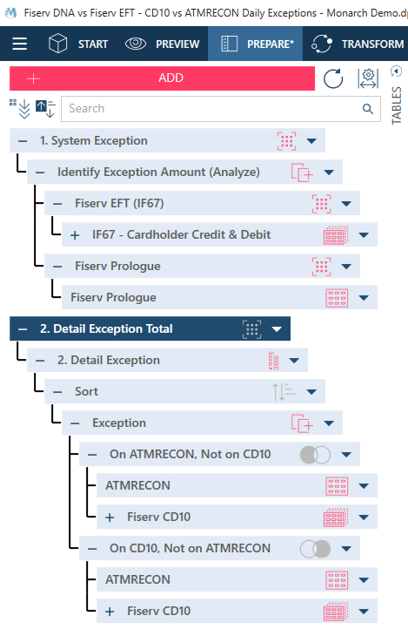
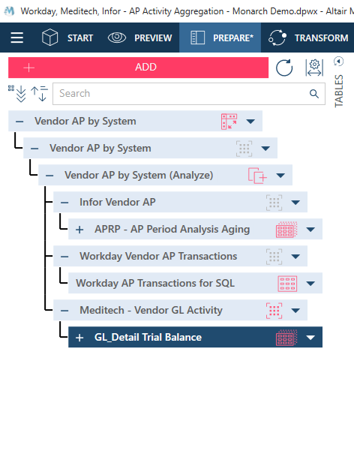
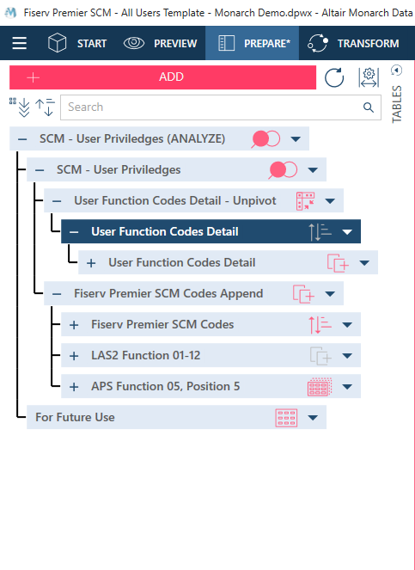
3 Types of Business Use Cases
Reconciliations & Operations
Reporting & Analysis
Risk, Regulatory & Compliance
Comparing & Contrast Data Sources
Acquire Data for an Operational Process
Compile & Aggregate Data from Multiple Sources
Analyze Data to understand trends
Monitor Data for specific Internal Controls
Prepare for an Internal/External Audit

Slide 24
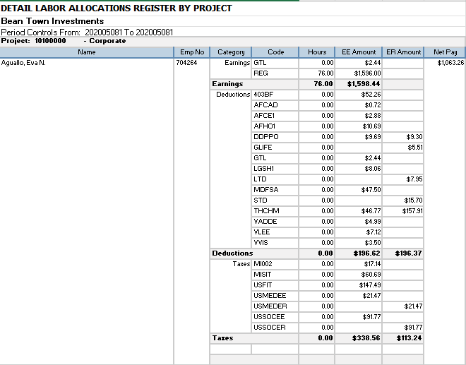
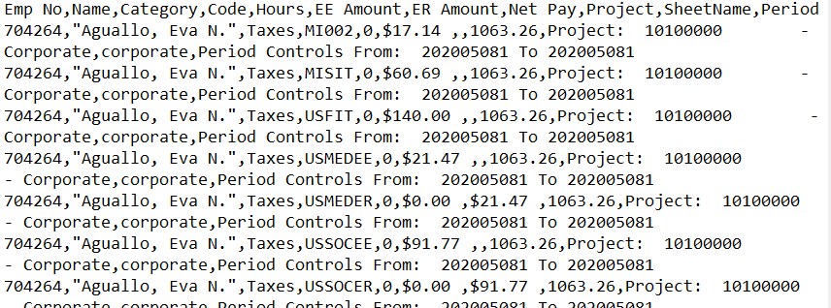
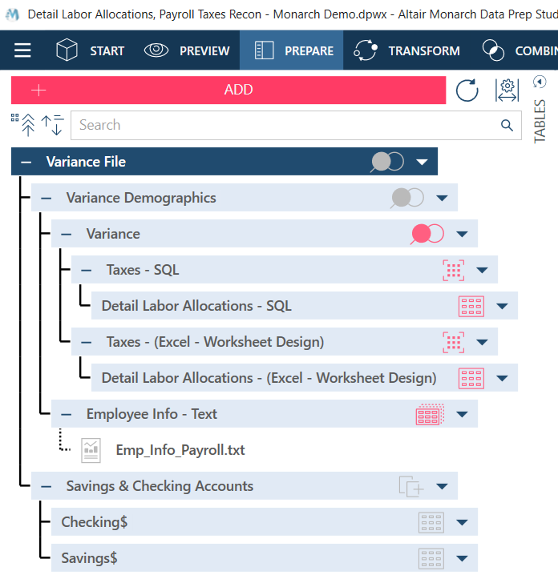
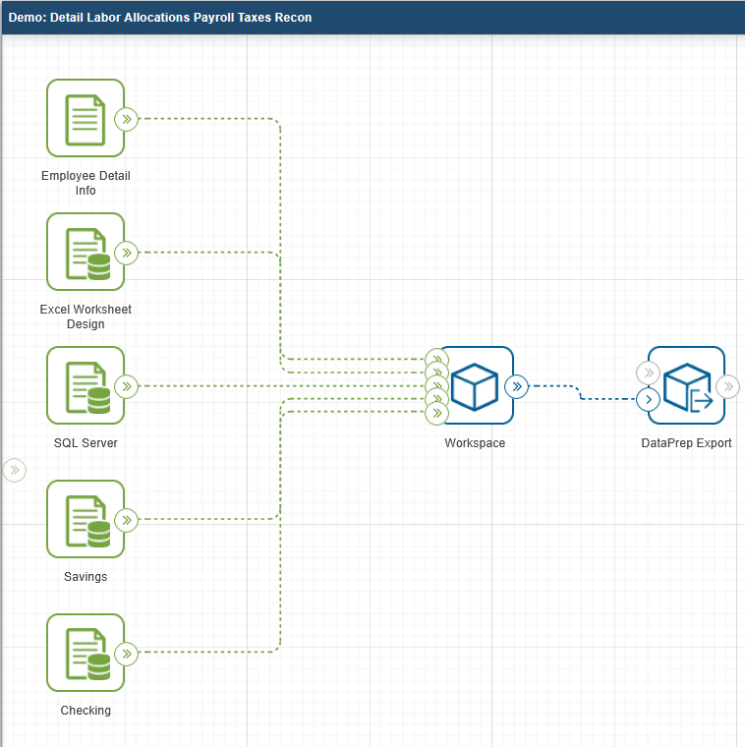
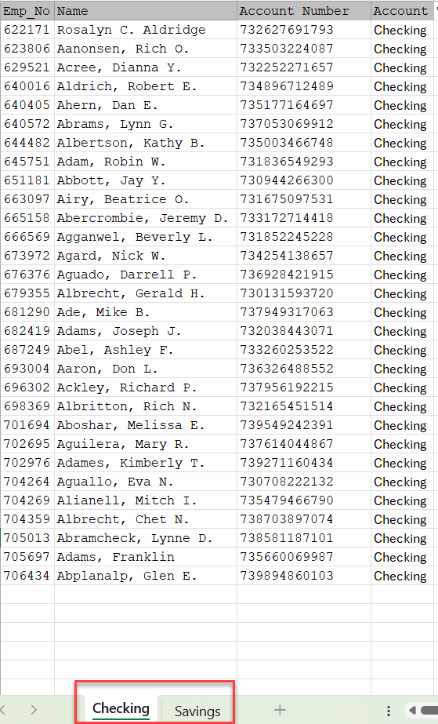
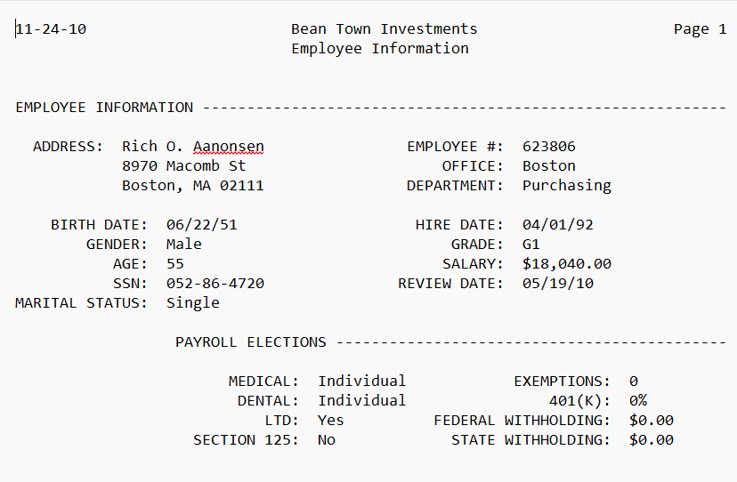
3 Types of Data Use Cases
Data Extraction
Classic
Data Preparation
Data Prep Studio
Data Engineering
Monarch Server - Automator

Slide 25
Use case Examples by Industry
Industry | Reconciliations & Operations | Reporting & Analysis | Risk, Regulatory, Compliance
Financial Services | Deposit, Loan General Ledger Reconciliations | Financial Close Reporting | Call Report (NCUA/FFIEC)
 | Credit, Debit Card/ATM Settlement & Disputes | Visa/MasterCard Quarterly Reporting | User Access Monitoring
 | Mortgage Corporate Advance Reconciliation | Mortgage Investor Reporting | SCRA Reporting
Healthcare Finance | Cash Posting Reconciliation | Financial Close Reporting | Medicare Cost Reporting
 | Claims & Remittance Processing | Denials Management | Medicare DSH Reporting
 | Charge Rejection | Payer Analysis | CMS Hospital Price Transparency
Manufacturing & Distribution | Bank Reconciliations | Financial Performance | SOX Controls & Audit Support
 | Intercompany Reconciliations | Sales & Channel Analytics | Revenue Compliance (ASC 606)
 | Payroll Processing | Inventory & Supply Chain Analytics | Sales & Tax Use Fillings
Business
Industry | Data Extraction | Data Preparation | Data Integration/Engineering (ETL)
Financial Services | Core Banking Reports | M&A Systems Conversions | AI & RPA Data Provisioning Automation of Business Operations Database Warehouse Augmentation Systems and Data Migrations
 | Loan & Mortgage Servicing Systems | Incentive Plan Enablement
 | Third Party Invoices & Statements | Audit
Healthcare Finance | EHR Systems Reports | Claims Processing
 | LIS System Reports | Coding & Revenue Recognition
 | Medical Billing Reports & Statements | AR & Collections
Manufacturing & Distribution | ERP System Reports | Vendor Trend Analysis
 | Warehouse Management System Reports | Sales & Channel Analytics
 | Supplier Invoices & Statements | Inventory & Supply Chain Analytics
Data

Slide 26
Why is Monarch Unique/Different?

Slide 27
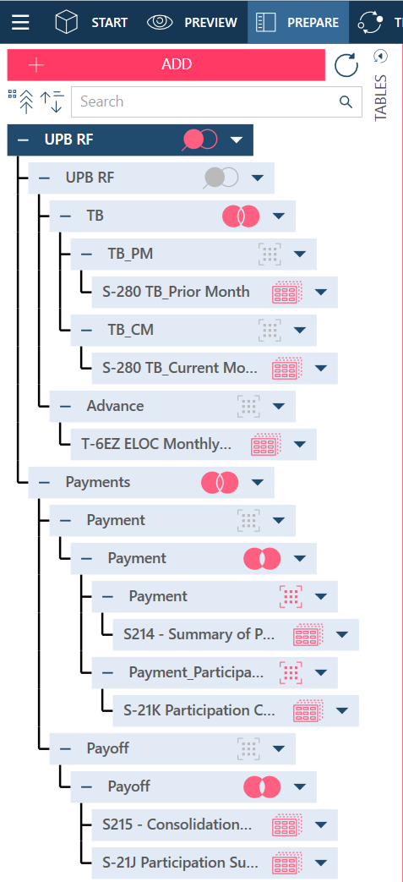
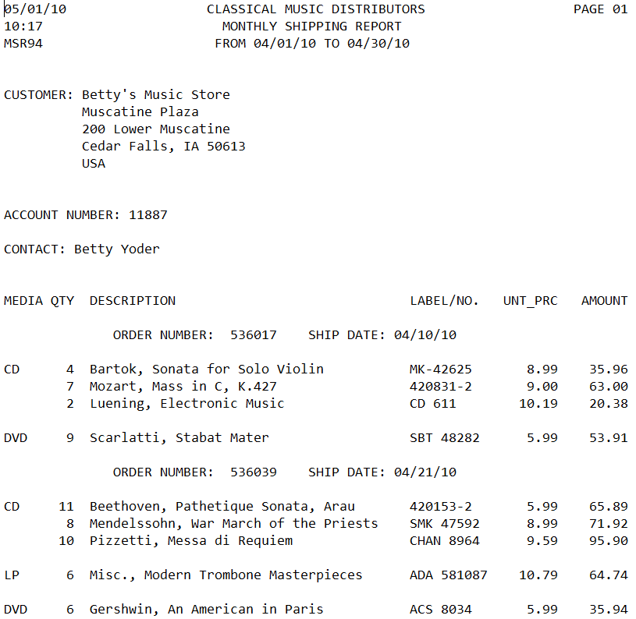
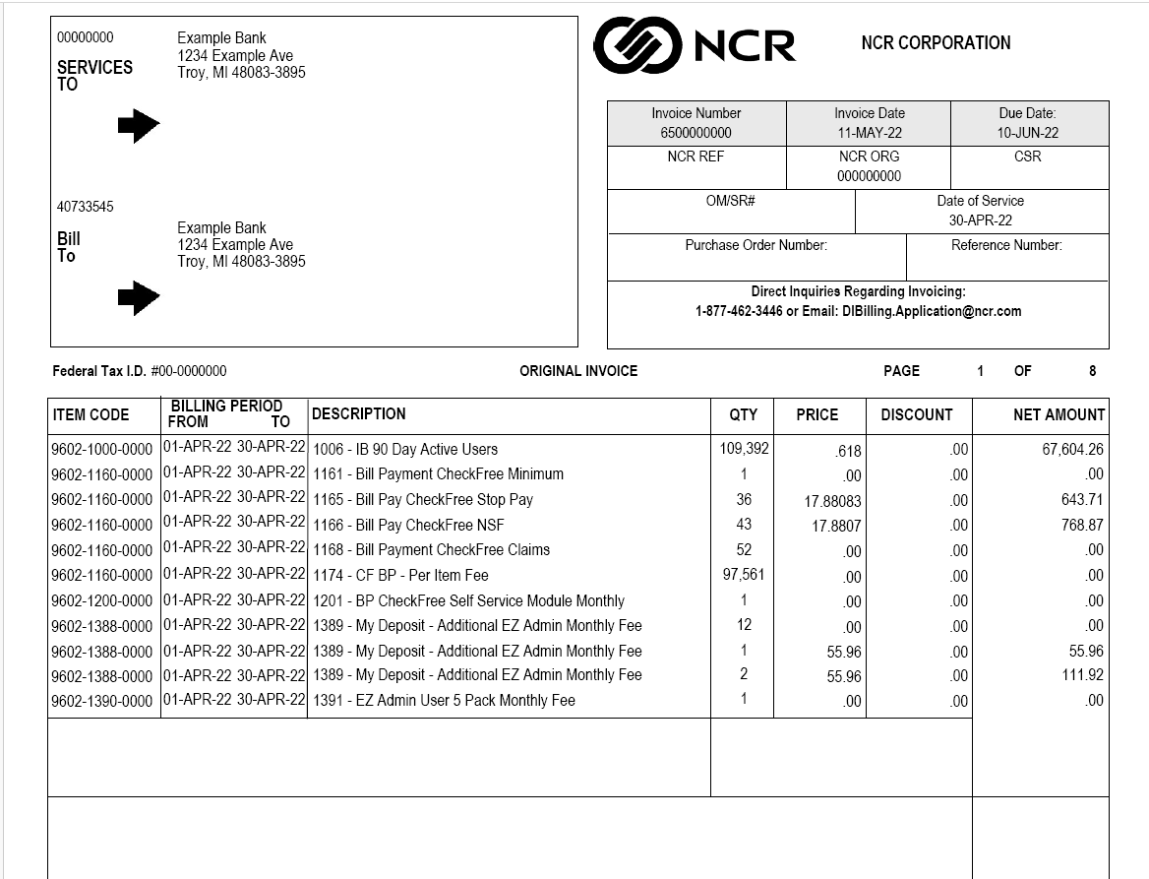
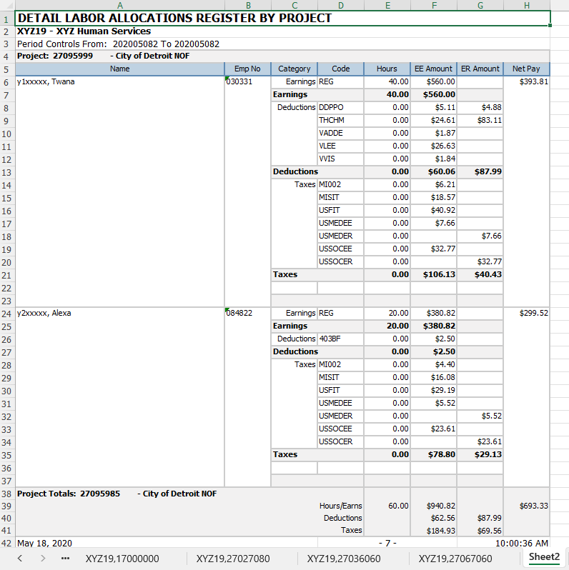
Why is Monarch Unique – Data Extraction & Ease of Use
    Unique Differentiation, especially Reports.
      Data Extraction without Code
      Text files (Reports)
      PDF files (ie Invoices)
      Excel Reports (ie ERP)
    (Subtle) Unique Differentiation on Ease of Use
      Data Profiling: Show & Create Statistics
      Data Cleansing without Code
        Clean, Extract, Split, Insert Text
      Multiple Combine Operations
        9 Join Types & Self-Joining
        Append
      Complex Data Transformation without Code
        Unpivot, Duplicates
        Transpose, Pivot, Group
      Analyze (Summary)
        Custom Designed Summaries
      Shareable and Repeatable Processes
        Models, Workspaces, Change Lists
      Unique Exporting Capabilities
        Exporting by Key, Filter, Summary
        Exporting a Pre-Built Pivot Table

Slide 28
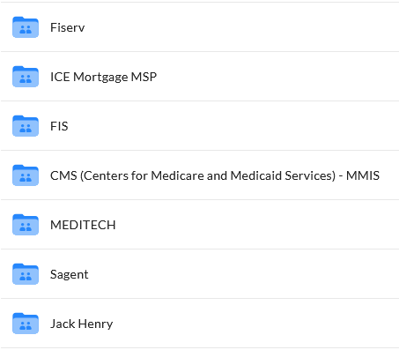
Why is Monarch Unique - Solution Accelerators
Over 3,000+ Complimentary Prebuilt templates for many different Systems
Banking
Healthcare
Payroll
ERP
Retail
Education
Core Banking System
(Deposits, Consumer Loans, Customer Information)
Finance & Accounting Systems
Loan
Origination
ATM System
Human Capital Mgmt
Content Mgmt Systems
Loan
Servicing
ACH/Wires
Credit & Debit Card

Slide 29
Monarch Overview
One – Slide Summary

Slide 30
Monarch – One Slide Summary
Self-Service Data Preparation application, primarily used for Finance.
Complements but does not replace; Traditional ETL, OCR, BI & Analytics Platforms, or ECM applications.
What is Monarch?
Despite significant investments in various mission critical technology systems, many organization still struggle to access and integrate data across those systems. Most solutions require expensive programming and customization with long delivery timelines.
Monarch provides a cost-effective, self-service, scalable, and time saving solution to the challenge of ‘Self-Service Data Prep for Finance’
Why Monarch?
(Business Value)
Any Organization and Persona within or adjacent to Financial Operations
Organizations
Financial Services
Healthcare Finance
Manufacturing & Distribution
Personas
Accountants
Analysts
Auditors
Who uses Monarch?
Any use case the requires cleaning, combining, transforming and analyzing data
Business Use Cases
Reconciliations & Operations
Reporting & Analysis
Risk/Regulatory & Compliance
Data Use Cases
Data Extraction
Data Preparation
Data Integration/Engineering (ETL)
Key Use Cases
Why it’s Different
Unique Data Extraction from PDF, Text, and Excel Based Reports
Monarch Solution Accelerators provides prebuilt templates for many technology systems that provide increased ROI.
30

Slide 31
WEBSITE
https://www.chrysalisconsultinggrp.com/
CONTACT US PAGE ON WEBSITE
Contact Form
EMAIL
baba@chrysalisconsultinggrp.com

