Slide 1
2025 AT&T/Radancy March Madness W3 Award Submission
Talent Attraction Activation

Slide 2

March Madness Talent Attraction Connection
By framing our employees as a powerhouse lineup driving seamless connectivity, we highlight the specialized skills and critical contributions that make each role essential to our business’s success.
“Talent Attraction Starting 5 Lineup”
Our ‘starting five’ represents the elite talent propelling us forward, with each player bringing a unique edge that strengthens the entire team.
Objectives:
Present traits and skills that we would want potential candidates to possess
Reinforce the high caliber of existing employees, setting a clear standard
Engage high-potential candidates who may not be actively job-seeking but could be inspired by the culture and opportunity.
Goal: >1.01% CTR
Results: 2.0% CTR
8.4k Careersite visits
View Post Here
2 Social Media Strategy / © 2025 AT&T Intellectual Property - AT&T Proprietary (Internal Use Only)
Notes:
Only care about LinkedIN
KPIs Clicks to the jobs

Slide 3
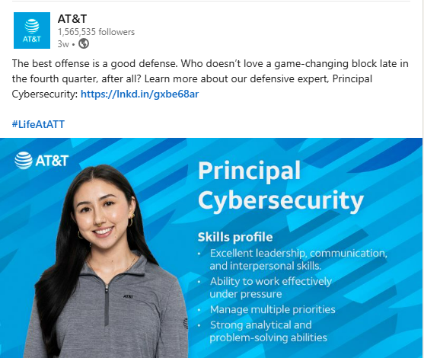
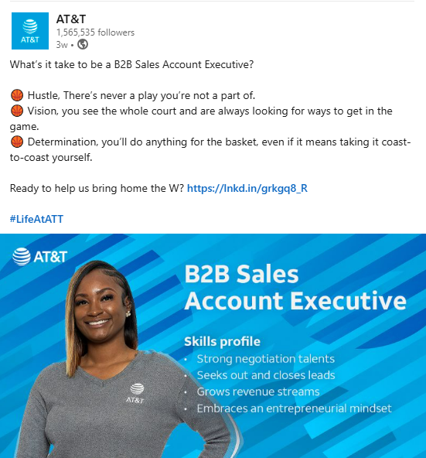
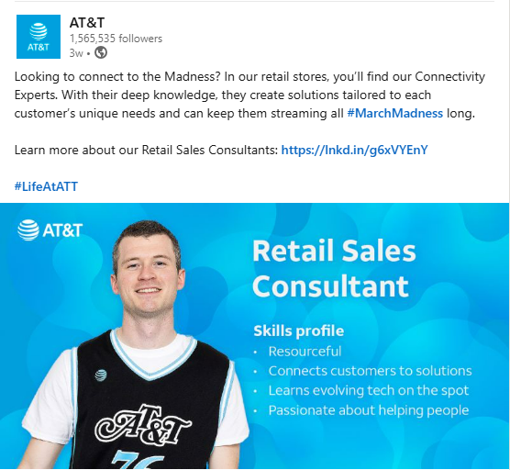
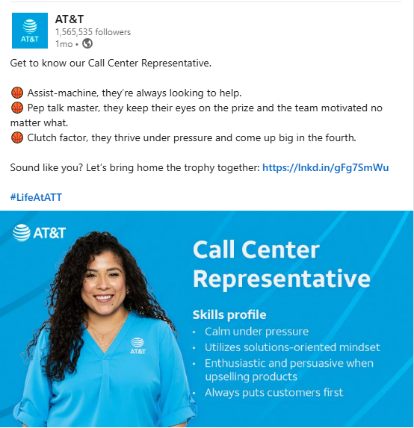
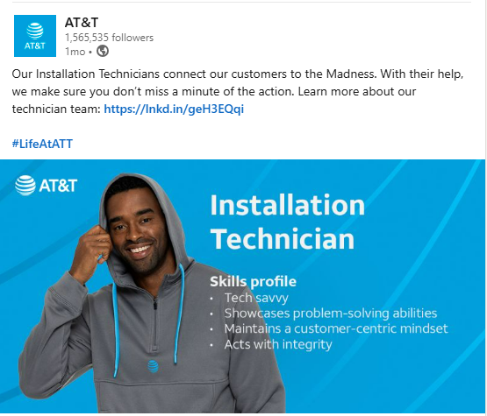
Additional Content Postings
View post here
View post here
View post here
View post here
View post here
2 Social Media Strategy / © 2025 AT&T Intellectual Property - AT&T Proprietary (Internal Use Only)

