Slide 1
Kyrgyz Republic
FORMATIVE AND CLASSROOM OBSERVATION APPS’ ROLE IN IMPROVING TEACHING AND LEARNING
CIES 2023
Ulanbek Mambetakunov, Ministry of Education and Science Kyrgyz Republic
Aikynai Iusupova, Reading Specialist, RTI International, USAID Okuu Keremet! Project
Notes:
Good afternoon, dear participants of the CIES conference! We are very happy to welcome you to our presentation “FORMATIVE AND CLASSROOM OBSERVATION APPS’ ROLE IN IMPROVING TEACHING AND LEARNING“.
Let me briefly introduce myself- My name is Ulanbek Mambetakunov, Ministry of Education and Science of the Kyrgyz Republic and my partner Aikynai Iusupova, Reading Specialist, RTI International, USAID Okuu Keremet! Project

Slide 2
Today’s presentation
Education system in the Kyrgyz Republic
Okuu Keremet! project description
Technology in service of instructional improvements
Coaching App- SabakApp
Formative Assessment App – BaalooApp
Implementation challenges
Next steps
Notes:
Our presentation will focus on the following topics: Education System in the Kyrgyz Republic, Okuu Keremet! project description, Technology in service of instructional improvements, Coaching App- SabakApp, Formative Assessment App – BaalooApp, Implementation challenges and Next steps.

Slide 3

Education in the Kyrgyz Republic
Education is one of the priority strategic areas that determine the development of Kyrgyz Republic. The country's sustainable development depends primarily on the quality of human resources, which, in turn, urgently requires the creation of a modern education system in the country. In today's world, the latter can no longer be implemented without the use of modern digital tools (State program "Digital Kyrgyzstan 2019-2023).
Digital technology is a tool for effectively delivering information and knowledge to the students, creating learning materials and an effective way of teaching, and building a new educational environment.
Technology increases educators’ opportunities to use data for decision making at all levels. Data-driven decision-making is an important process in the improvement of teaching and learning outcomes.

Slide 4

USAID Okuu Keremet! (Learning is Awesome) Project
USAID-funded five-year (2019-2024);
Benefiting more than 450,000 primary grade students, 75% of country’s schools (1,682);
Improve reading and math instruction in G 1-4;
Improve formal and non-formal learning environments;
Strengthen primary education system.
IT solutions in education:
Coaching App – SabakApp
Formative Assessment App - BaalooApp
Notes:
USAID funded “Okuu Keremet!” project is designed to help improve learning outcomes in reading and math among 300,000 students in grades 1-4 in 1,686 target schools in Kyrgyzstan.
The Objectives are:
1.IMPROVE instructional quality in reading and mathematics in primary grades 1-4
2.IMPROVE formal and non-formal learning environments – by providing students with out-of-school materials and activities to reinforce learning such as SRM, community activities, communications outreach, libraries...
3.STRENGTHEN education system in the primary school – quality for every child.
o To improve primary grade students’ performance in target schools, the Project supported to develop two user-friendly applications: SabakApp (classroom observation) and BaalooApp (formative assessment) in four languages (Kyrgyz, Russian, Uzbek and Tajik).
SabakApp and BaalooApp were developed on Tangerine- open-source electronic data collection software designed for use on mobile devices, including Android tablets and smartphones.
Regular use of these Apps will allow primary school teachers to improve their instructions in reading and math that will result in stronger early grade students’ performance.

Slide 5

Coaching App – SabakApp
an App for classroom observation in reading and math;
real-time feedback on performance
advice on mentoring support and modeling;
used by school coaches, trainers, external coaches, system staff, officials, etc.;
syncs all data into dashboard to allow across the system performance views;
to date, 40,000 observations and mentoring support held.
Notes:
SabakApp is a coaching application tool for classroom observation in reading and math to support teachers to improve their instructional performance. This App enables to conduct classroom observation, use data to provide real-time focused feedback to teachers’ performance, and advice on mentoring support and modeling . It can be used by school mentors, trainers, external coaches, system staff, and officials.
All data from the lesson observations syncs into a dashboard to allow across the system performance views - provides information on which schools to target. To date, more than 14,500 teachers were provided with focused mentoring support at teacher, school and district levels.

Slide 6
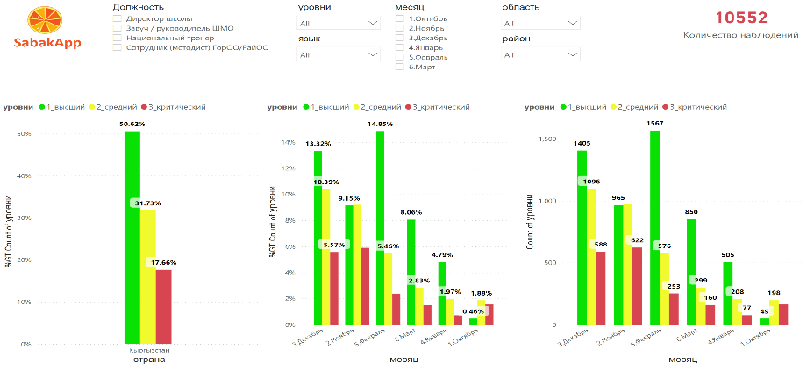
Classroom Observation Results for Reading (2021- 2022)
Notes:
• On the slide you can see the data on teacher performance in reading across the country. This data the project regularly provides to each district to analyze them and take decisions at different levels.
• The dashboard tracks teachers’ progress by region, language, month, school, etc,

Slide 7
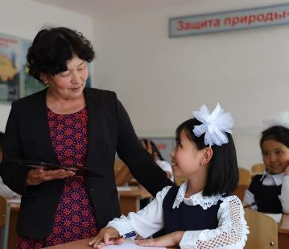
Coaching App – Benefits
“Thanks to the feedback from the mentor, I began to better use the strategy "Explanation and justification” (Nurmamatova Ainura- a teacher, Nurbaev School #3, Uzgen district).
“Using SabakApp tool is much faster than devoting so much time to handwriting observations. Moreover, observations can be more accurate than if I sat down to write out my notes at the end of the day”. – a school principal (Omurova Asylkan, Alamedin district).
“I created a database of teachers and schools in my district so I can use it in my work effectively to provide mentoring support to the teachers and school administrators”. – district level official (Lira Sydykova, methodologist of Sokuluk DED).
Notes:
As a result of the use of this application more than 40% of the primary school teachers got positive timely feedback from their mentors to enhance their performance and were provided with focused mentoring support at individual, school, and district levels by the school and district leaders.
At teacher level- teachers are improving their instructional practices in reading and math, the learning environment in the classroom, the teacher-student interaction improved, the interaction between them became more trusting; teachers feel that they are more valued, became more confident and motivated in teaching students…
At school level- professional learning community within the school was created, the culture of conducting lesson observations by the school administration and HMU, provision of timely and positive feedback has improved, supportive environment at schools was created, the interaction among primary school teachers, the head of the methodological unit (MU), and the school administration has improved…
At district level- methodologists of DEDs have increased their capacity building on mentoring, become more aware of their responsibilities as a mentor (Job description): what, where, how to do?, they improved the skills in data management, collaborative analysis of them, planning, and decision making to provide addressed mentoring support to primary school teachers and IST team at district level….

Slide 8
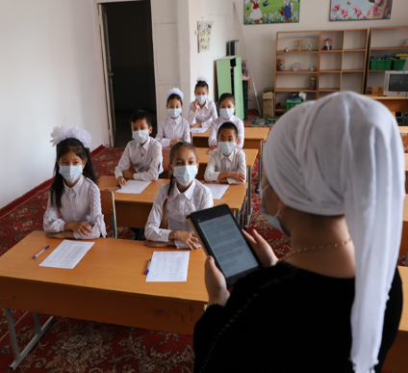
Formative Assessment App - BaalooApp
Supports teachers to use differentiated instruction for their students;
Used by teachers and school-based coaching team;
Data shared with children, teachers, and parents;
Conducted quarterly;
Approved by the Academic Council of the Kyrgyz Academy of Education and recommended for use in 1682 target schools.
Notes:
BaalooApp is a formative assessment application developed to support primary school teachers to identify strengths and weaknesses in student performance, to use differentiated instruction for their students; to provide individual descriptive and actionable feedback to students; and regularly reflect and adapt their own instruction with the aim to improve student learning outcomes.
It is used by teachers and school-based coaching team. More than 14 000 teachers, 3400 school administration and 62 methodologists from DEDs were taught how to use this application in reading and math.
Data shared with children, teachers, and parents.
Teachers conduct formative assessment quarterly.
BaalooApp on reading and math both were approved by the Academic Council of the KAE and was recommended to use in 1687 target schools.

Slide 9
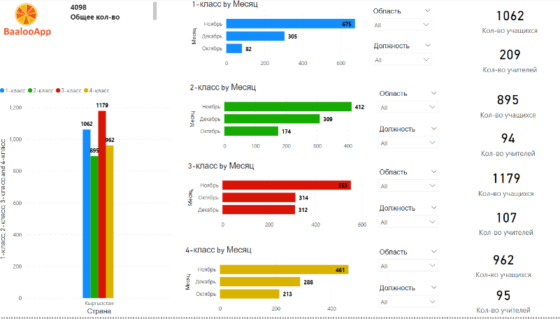
BaalooApp results for Math
Notes:
The slide demonstrates the data on formative assessment by class, month, number of students participated, number of teachers conducted the assessment.

Slide 10
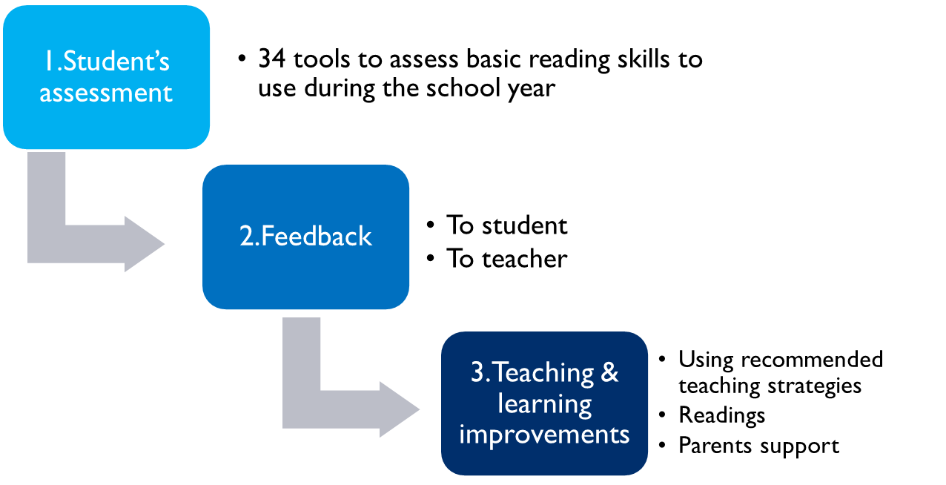
How it works- BaalooApp
Notes:
There are three important aspects we want to promote by using App: using variety of assessment tools to measure learning outcomes achievement according curriculum, specific and timely feedback to students and teachers, reflection and implementing recommendations for learning and teaching improvement.

Slide 11
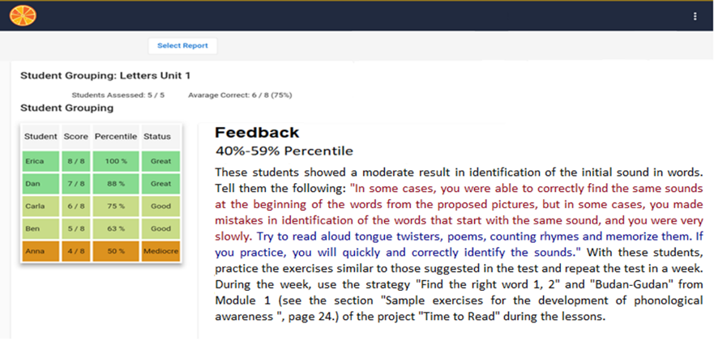
Feedback- BaalooApp (reading)
Notes:
One of the key aspects of BaalooApp is the feedback. The feedback provides 3 pieces of information.
1) It summarizes the results for a student or group of students.
2) It suggests how to formulate the results and share the feedback with these students.
3) It provides instructional suggestions about teaching strategies or next tasks for the teacher and student to help improve teaching and learning.

Slide 12
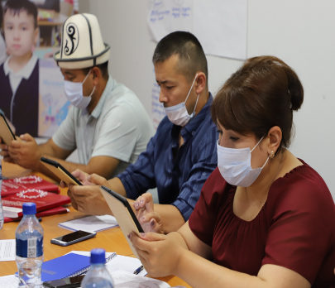
Formative assessment App- benefits
“The use of formative assessment with BaalooApp made the teacher's job easier, in the sense that it is quick” – teacher.
“Enables me to track students' progress toward their learning goals and helps the teacher adjust the learning process at early stage. In doing so, the student becomes more responsible for their learning” –teacher
Other benefits:
Students freely express their opinions
Teachers using higher order questions – how and why
Improved digital literacy
Differentiated instruction becoming the norm
Notes:
The use of BaalooApp brought a lot of positive improvements to students and teacher performance according to teachers’ perceptions:
They are:
supportive learning environment was created and improvement of learning outcomes of the students (1-4 grades),
students motivation enhanced, they become more active and responsible for their learning,
students freely express their opinions and can ask questions,
teachers improves their digital competency,
teachers learnt to adjust instruction to ensure that all students are keeping pace with the learning goals,
teachers used more higher-order questions to students…

Slide 13
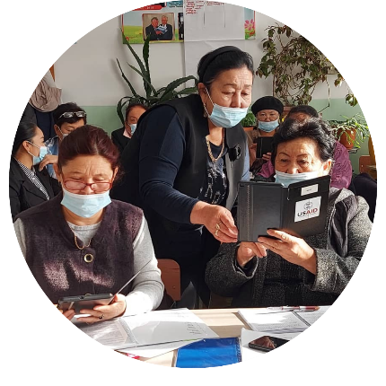
Implementation Challenges
SabakApp
Low digital literacy skills, in addition to a need to continue building up reading and math skills;
Smartphones are not compatible with the Apps;
Support staff too busy to take on yet another tool…
BaalooApp
Large classes
Low digital literacy skills
No internet in schools
Time consuming
…
Notes:
Along with the successes in the use of Applications there are some challenges. They are as following:
SabakApp:
- turnover among trained HNU, IST team and DEDs,
- low capacity building of some IST team and DEDs on the content of reading and math modules,
- low technical skills on the use of the Application (updating the program, synchronization of the data, how to register…)
- internet connection,
- some teachers do not have mobile telephones or if have they do not support that program
- how to work with data effectively,
- overload of IST team and DEDs
BaalooApp:
- too big classes,
- low technical skills on the use of the Application (updating the program, synchronization of the data, how to register…)
- internet connection,
- some teachers do not have mobile telephones or if have they do not support that program
- how to work with data effectively,
- overload of teachers,
- takes time for preparation,
- use of the formative assessment tools without careful planning

Slide 14
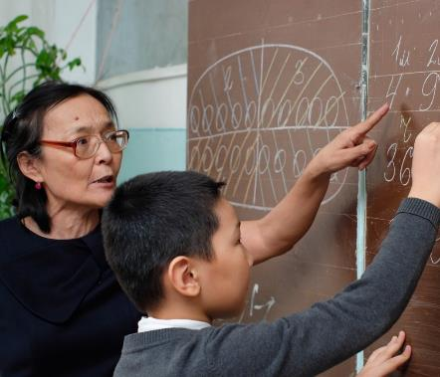
Next steps:
Benefits outweigh challenges.
Continue with training on reading and math, so that Apps continue to make even more sense.
Continue to refine the tools.
Continue dialogue with the MOE to use these Apps as formal tools to improve quality of instruction.
Notes:
Formative and classroom observation apps’ role in improving teaching and learning is great. And we should admit that benefits outweigh the challenges.
The project Okuu Keremet will continue with training on reading and math, so that apps continue to make even more sense.
Continue to refine the tools
Continue dialogue with the MOE to use these app as formal tools to improve quality of instruction
I'd like to finish our presentation by thanking you all for your kind attention! Thank you!

Slide 15

Thank you for your attention!

