Slide 1
SDN (Software Defined Networking) on
Seed Emulator
Akib Jawad Nafis

Slide 2
What it is? and Why?
A different type of network architecture
Aiming to:
  Optimize management and increase efficiency
  Separate network logic from the hardware
Computer
Application
Operating System
Hardware
Network
Application (Routing, ACL)
Controller with topology
Hardware (Switch)
Notes:
Making network like a regular computer

Slide 3



Networking Without SDN
L2: ARP Protocol
Forwarding logic
L1: Physical Layer
L3: Routing Protocol
Forwarding Logic
Control Plane
Data Plane
L2: ARP Protocol
Forwarding logic
L1: Physical Layer
L2: ARP Protocol
Forwarding logic
L1: Physical Layer
L3: Routing Protocol
Forwarding Logic
L4: Transport
L5: Session
L6: Presentation
L7: Application
Configuration is cumbersome for large network

Slide 4
Networking With SDN
Control Plane
L3: Routing Protocol
L2: ARP protocol
Forwarding logic
L1: Physical Layer
Forwarding logic
L1: Physical Layer
OpenFlow Protocol
OpenFlow Protocol
SDN Controller
L2: ARP Protocol
Forwarding logic
L1: Physical Layer
L3: Routing Protocol
Forwarding Logic
L4: Transport
L5: Session
L6: Presentation
L7: Application

Slide 5
Forwarding Logic in SDN Switch
T0: VLAN Tagging
T1: MAC Learning
T2: IP forwarding(fib)
Matching Criteria | Actions
default | drop
Matching Criteria | Actions
default | goto_table:4
Matching Criteria | Actions
default | drop
T3: VIP processing
T4: Output MAC processing
T5: Flooding
Matching Criteria | Actions
default | drop
Matching Criteria | Actions
default | goto_table:5
Matching Criteria | Actions
default | drop
*VIP: Virtual IP implemented
in controller

Slide 6
Packet Flow in SDN: Topology
SDN Controller
VLAN100 IP:10.100.0.254
VLAN200 IP:10.200.0.254
10.100.0.254
10.200.0.254
VLAN100
VLAN200
10.100.0.1
10.200.0.1
10.100.0.1
10.200.0.1

Slide 7
Packet Flow: Topology Setup
T0: VLAN Tagging
T1: MAC Learning
T2: IP forwarding(fib)
Matching Criteria | Actions
in_port=“p1” | set_vlan_id=100, goto_table:1
In_port=“p2” | set_vlan_id=200, goto_table:1
default | drop
Matching Criteria | Actions
arp,vlan=100 | goto_table:3
arp,vlan=200 | goto_table:3
ip,vlan=100, dl_dst=aa:bb:cc:dd:ee:01 | goto_table:2
ip,vlan=200, dl_dst=aa:bb:cc:dd:ee:02 | goto_table:2
default | goto_table:4
Matching Criteria | Actions
ip,vlan=100, nw_dst=10.100.0.254 | goto_table:3
ip,vlan=200, nw_dst=10.200.0.254 | goto_table:3
ip,vlan=100, nw_dst=10.100.0.0/24 | goto_table:3
ip,vlan=200, nw_dst=10.100.0.0/24 | goto_table:3
ip,vlan=100, nw_dst=10.200.0.0/24 | goto_table:3
ip,vlan=200, nw_dst=10.200.0.0/24 | goto_table:3
default | drop
T3: VIP processing
Matching Criteria | Actions
arp,dl_dst=ff:ff:ff:ff:ff:ff, arp_tpa=10.100.0.254 | CONTROLLER:64
arp,dl_dst=ff:ff:ff:ff:ff:ff, arp_tpa=10.200.0.254 | CONTROLLER:64
ip,dl_dst=aa:bb:cc:dd:ee:01 | CONTROLLER:194
ip,dl_dst=aa:bb:cc:dd:ee:02 | CONTROLLER:194
default | drop
T4: Output MAC processing
T5: Flooding
Matching Criteria | Actions
default | goto_table:5
Matching Criteria | Actions
dl_vlan=100, dl_dst=ff:ff:ff:ff:ff:ff | pop_vlan,output:p1
dl_vlan=200, dl_dst=ff:ff:ff:ff:ff:ff | pop_vlan,output:p2
default | drop

Slide 8
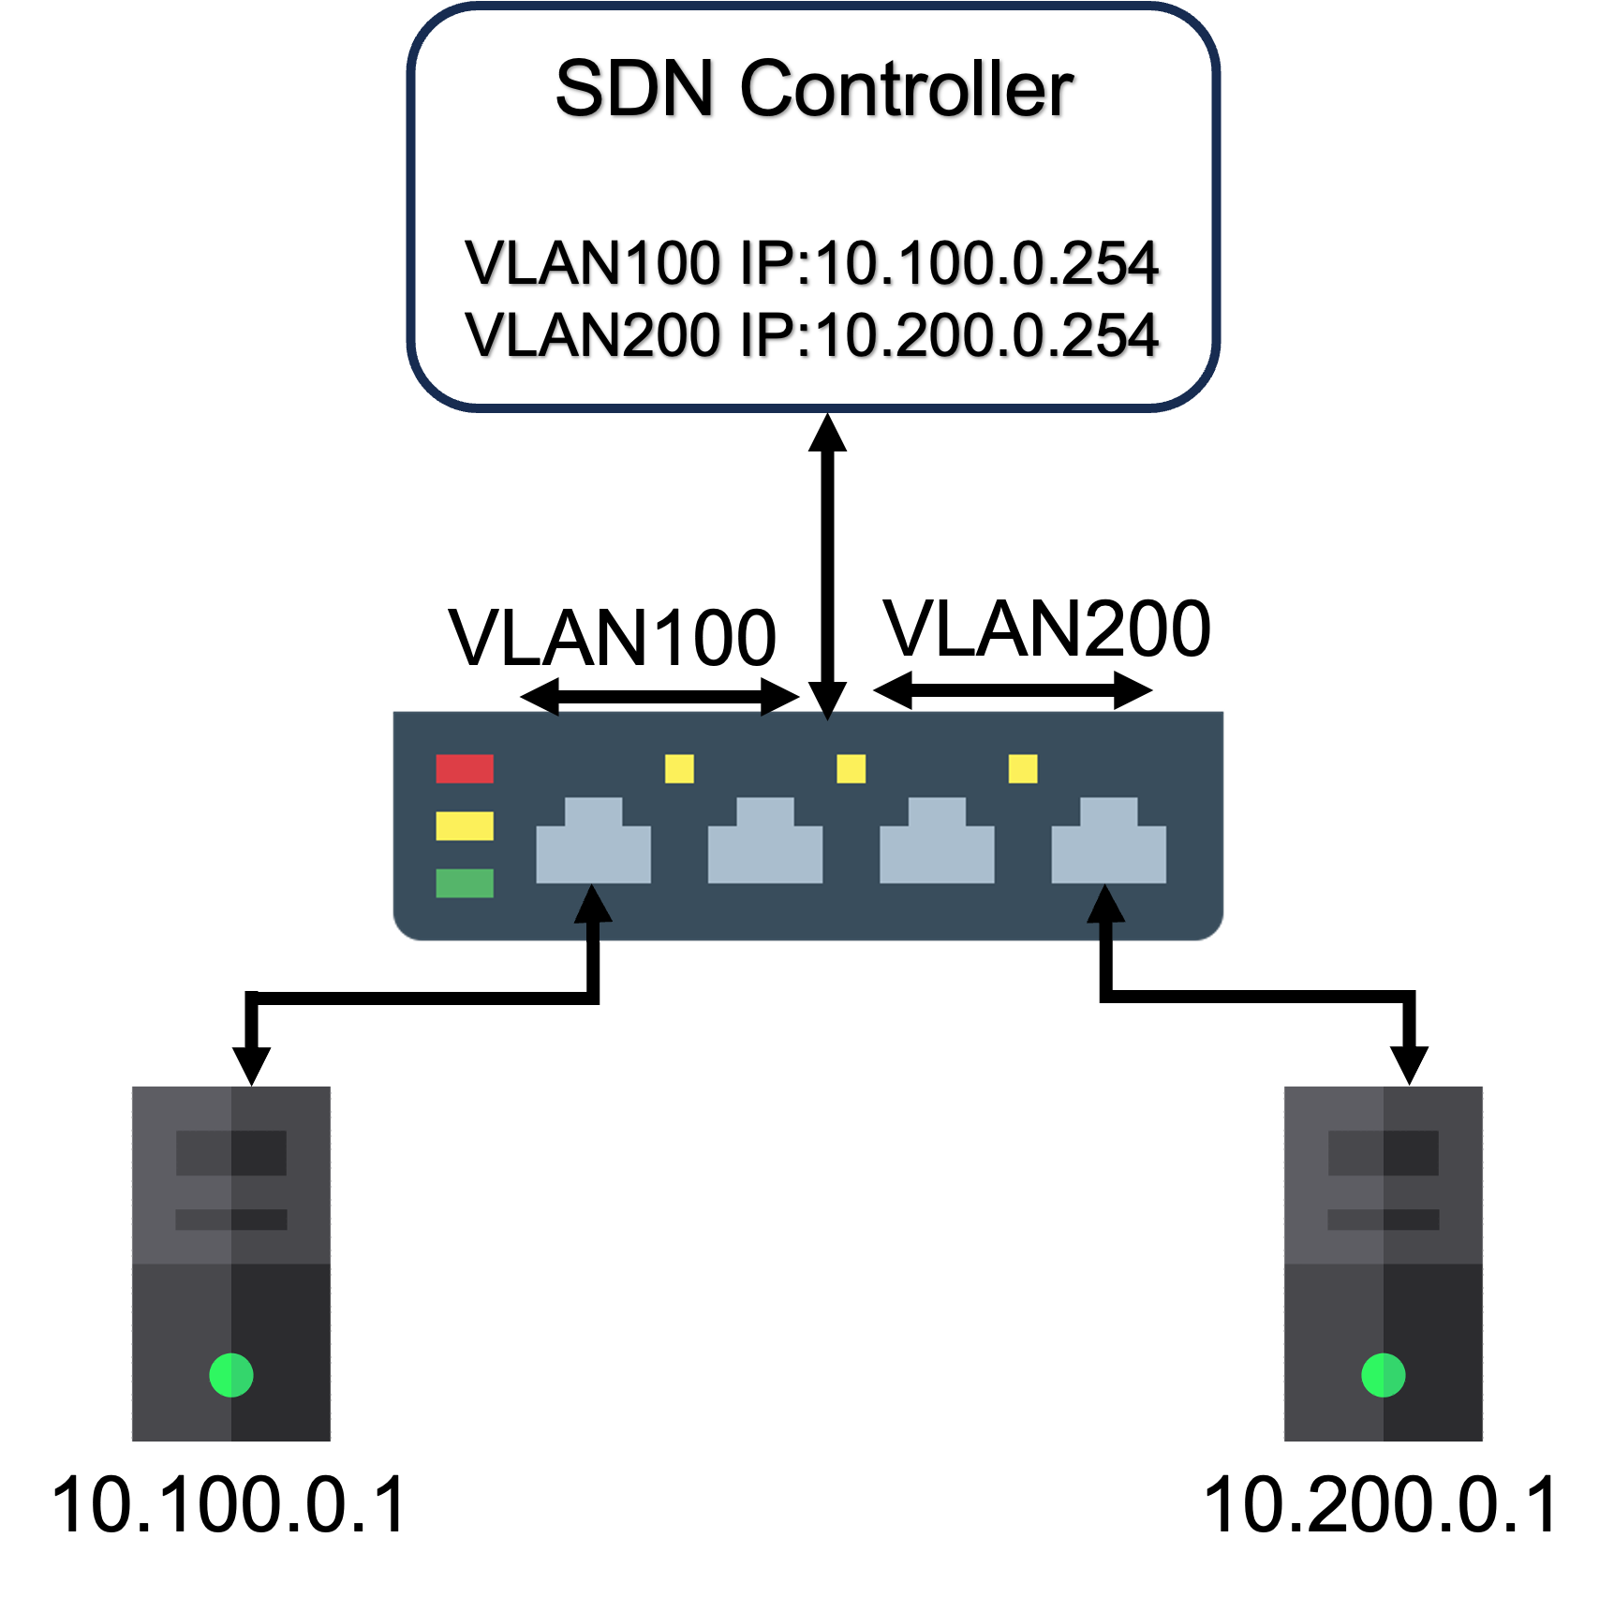
Packet Flow: Sending ARP to Router
T1: MAC Learning
T2: IP forwarding(fib)
Matching Criteria | Actions
arp,vlan=100 | goto_table:3
arp,vlan=200 | goto_table:3
ip,vlan=100, dl_dst=aa:bb:cc:dd:ee:01 | goto_table:2
ip,vlan=200, dl_dst=aa:bb:cc:dd:ee:02 | goto_table:2
in_port=p1,dl_vlan=100,dl_src=7a:76:3b:2f:c7:f7 | goto_table:4
default | goto_table:4
Matching Criteria | Actions
ip,vlan=100,nw_dst=10.100.0.254 | goto_table:3
ip,vlan=200, nw_dst=10.200.0.254 | goto_table:3
dl_vlan=100, nw_dst=10.100.0.1 | set_vlan:100,set_eth_src:aa:bb:cc:dd:ee:01, set_eth_dst:7a:76:3b:2f:c7:f7,dec_ttl,goto_table:4
dl_vlan=200, nw_dst=10.100.0.1 | set_vlan:100,set_eth_src:aa:bb:cc:dd:ee:01, set_eth_dst:7a:76:3b:2f:c7:f7,dec_ttl,goto_table:4
ip,vlan=100,nw_dst=10.100.0.0/24 | goto_table:3
ip,vlan=200,nw_dst=10.100.0.0/24 | goto_table:3
ip,vlan=100,nw_dst=10.200.0.0/24 | goto_table:3
ip,vlan=200,nw_dst=10.200.0.0/24 | goto_table:3
default | drop
ARP Reply
T4: Output MAC processing
ARP Request
Matching Criteria | Actions
vlan=100,dl_dst=7a:76:3b:2f:c7:f7 | pop_vlan, output:pl
default | goto_table:5

Slide 9
Packet Flow: Sending IP Packet to Host-2
T1: MAC Learning
T2: IP forwarding(fib)
Matching Criteria | Actions
arp,vlan=100 | goto_table:3
arp,vlan=200 | goto_table:3
ip,vlan=100, dl_dst=aa:bb:cc:dd:ee:01 | goto_table:2
ip,vlan=200, dl_dst=aa:bb:cc:dd:ee:02 | goto_table:2
in_port=p1,dl_vlan=100,dl_src=7a:76:3b:2f:c7:f7 | goto_table:4
in_port=p2,dl_vlan=200,dl_src=be:e8:e2:23:c1:77 | goto_table:4
default | goto_table:4
Matching Criteria | Actions
ip,vlan=100,nw_dst=10.100.0.254 | goto_table:3
ip,vlan=200, nw_dst=10.200.0.254 | goto_table:3
dl_vlan=100, nw_dst=10.100.0.1 | set_vlan:100,set_eth_src:aa:bb:cc:dd:ee:01, set_eth_dst:7a:76:3b:2f:c7:f7,dec_ttl,goto_table:4
dl_vlan=200, nw_dst=10.100.0.1 | set_vlan:100,set_eth_src:aa:bb:cc:dd:ee:01, set_eth_dst:7a:76:3b:2f:c7:f7,dec_ttl,goto_table:4
dl_vlan=100, nw_dst=10.200.0.1 | set_vlan:200,set_eth_src:aa:bb:cc:dd:ee:02, set_eth_dst:be:e8:e2:23:c1:77,dec_ttl,goto_table:4
dl_vlan=200, nw_dst=10.200.0.1 | set_vlan:200,set_eth_src:aa:bb:cc:dd:ee:02, set_eth_dst:be:e8:e2:23:c1:77dec_ttl,goto_table:4
ip,vlan=100,nw_dst=10.100.0.0/24 | goto_table:3
ip,vlan=200,nw_dst=10.100.0.0/24 | goto_table:3
ip,vlan=100,nw_dst=10.200.0.0/24 | goto_table:3
ip,vlan=200,nw_dst=10.200.0.0/24 | goto_table:3
default | drop
ARP Request
ARP Reply
IP Packet
T4: Output MAC processing
Matching Criteria | Actions
vlan=100,dl_dst=7a:76:3b:2f:c7:f7 | pop_vlan, output:pl
vlan=200,dl_dst=be:e8:e2:23:c1:77 | pop_vlan, output:p2
default | goto_table:5

Slide 10
Routing with Non-SDN Network
SDN Controller
BGP Router
VLAN100 IP:10.100.0.252
Data-plane connection to expose controller’s BGP router for peering.
VLAN100
10.100.0.253
10.100.0.1
10.100.0.254
BGP Router

Slide 11

Emulating SDN on SEED-Emulator
SDN Controller
(Faucet)
Control Plane
Forwarding logic
L1: Physical Layer
OpenFlow Protocol
Not supported by docker!
OVS-Bridge
Notes:
Goal was to incorporate SDN in the SEED-Emulator
SEED-Emulator uses Docker to create network
Docker’s network creation is based Linux bridge

Slide 12
Replicate What Docker Network Driver Does
• How Docker creates bridge network?
sudo ip link add name {bridge-name} type bridge
sudo ip link set dev {bridge-name} up
How Docker connects container to the bridge?
sudo ip link add veth-br type veth peer name veth-container
sudo ip link set dev veth-br master {bridge-name}
sudo ip link set dev veth-br up
sudo ip link set dev veth-container netns {container-name}
sudo ip link set veth-container up

Slide 13
Replicate What Docker Network Driver Does
• How to creates SDN enabled bridge with OpenVSwitch?
sudo ovs-vsctl add-br br1 \
-- set bridge br1 other-config:datapath-id=0000000000000001 \
-- set bridge br1 other-config:disable-in-band=true \
-- set bridge br1 fail_mode=secure \
-- set-controller br1 tcp:127.0.0.1:6653
How to connect containers to the ovs bridge?
sudo ovs-docker add-port br1 eth0 host-a1 \
--ipaddress=10.150.1.1/24 \
--gateway=10.150.1.252
*ovs-docker is a script provided with OpenVswitch. It executes the same sequence of command we
have presented earlier. The script is useful, but it has less flexibility.

Slide 14
Mini-Internet with SDN: Demo Topology
AS-150
ix-100
10.150.1.0/24
BGP Router
AS-2
sdn0
10.150.1.1/24
10.150.0.0/24
net0
AS-3
10.150.1.2/24
10.150.0.72/24
10.150.0.71/24

Slide 15
Mini-Internet with SDN: Demo
Experiment Files: ‘seed-emulator/examples/sdn/’
Git-Repo: https://github.com/akibjawad/seed-emulator/
Git Branch: https://github.com/akibjawad/seed-emulator/tree/sdn_support
Merge Request: https://github.com/seed-labs/seed-emulator/pull/206

Slide 16


Icon Credit: https://www.freepik.com/

