Slide 1
Contributing to Hugging-face transformers library

Slide 2
Operation of LLMs & prompting
Model
This
is
a
This
is
a
dog
List of tokens
List of tokens
apply_chat_template()
Tokenizer
“role”: “user”
“content”: [{type: text, text: "this is a”}]
“role”: “assistant”
“content”: [{type: text, text: "this is a dog”}]

Slide 3
Prompting multimodal models
This
is
a
F1
F2
F3
model-name/
├── config.json
├── tokenizer.json
├── tokenizer_config.json
├── special_tokens_map.json
├── pytorch_model.bin/ safetensors
├── processor_config.json
├── feature_extractor.json
├── README.md
List of tokens
Features from the video
apply_chat_template()
Processor
apply_chat_template()
“role”: “user”
“content”: [
{type: text, text: ”what do you see in the video?”}
{type: video, url: “https://test-videos.com/..}
]

Slide 4
Allowing video object in prompts
“role”: “user”
“content”: [
{type: text, text: ”what do you see in the video?”}
{type: video, url: “https://test-videos.com/.. }
]
apply_chat_template()
url: “https://test-videos.com/..
video: [[123,1,4],[2,0,1],[1,2,3]]
Processor

Slide 5
Implementation pipeline
Model
Processor
Tokenizer
Qwen2VL
Model
Processor
Tokenizer
Llama3
Model
Processor
Processor
Tokenizer
Core Modules
Core Modules
Utils
Auto
Utils

Slide 6

Pull Request #39494
Available on transformers 4.55.0
Additionally, this PR also fixes hardcoded values used for testing (in assertions) apply_chat_template_videos for models like
Internvl
qwen2_vl
qwen2_5_vl
qwen2_5_omni.

Slide 7
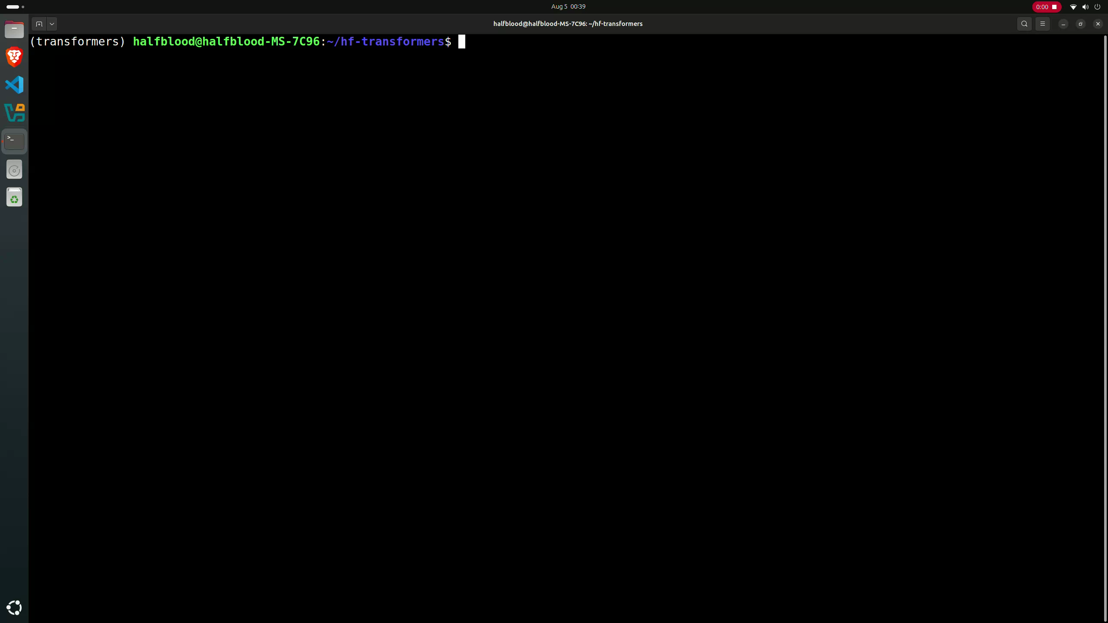
Demo 1: Testing correctness

Slide 8
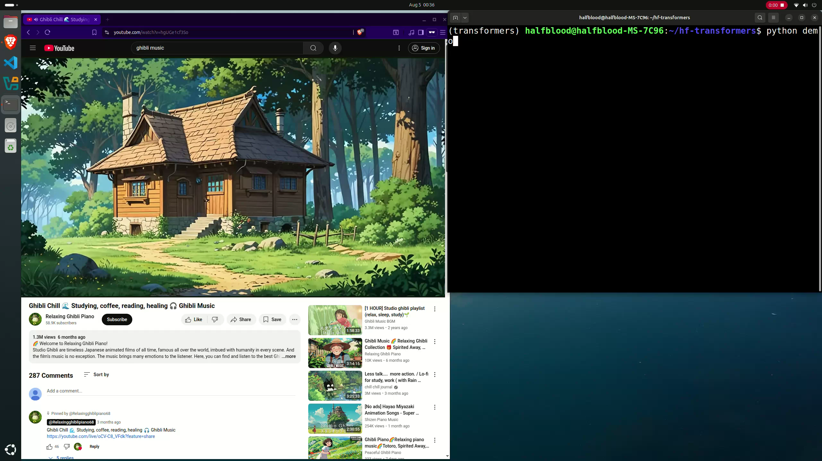
Demo 2: Performance measurement

Slide 9

Questions

