Slide 1


VetIoT: On Vetting IoT Defenses Enforcing Policies at Runtime
Akib Jawad Nafis*, Omar Haider Chowdhury⁺, and Endadul Hoque*
*Syracuse University, ⁺Stony Brook University
Notes:
Good afternoon, This is Akib Jawad, a PhD Student of EECS, Syracuse University. Today, I would like to present my work on the evaluation of policy enforcing IoT security mechanisms.
Thanks to Dr. Chowdhury from Stony Brook University and my advisor Dr. Hoque from Syracuse University for collaborating with me in this project.

Slide 2

Soaring Demand for Smart Homes
78% of potential home buyers would pay extra for a smart home
82% of renters want at least one smart device or system in their home
src: https://explodingtopics.com/blog/smart-home-stats
Notes:
During the last decade, there is a noticeable increase in the adoption of IoT systems such as Smart Homes.
According to a recent survey, 78% of potential home buyers would pay extra for a smart home.
Similar pattern has been observed among the renters.
82% of renters want at least one smart device or system in their home.
It’s safe to say that Smart Home Systems have evolved into a meaningful upgrade for many residents.

Slide 3




Smart Home Systems
Programmable IoT Platform
Smart
Apps
Web UI
Notes:
Under the hood, Smart Home Systems are powered by programmable IoT Platforms.
These platforms maintains communications with IoT devices and provides multiple ways to interact with those IoT device.
Users can manually interact those IoT devices via Web UI, or they can automate the interaction with applications. Those applications are called Smart Apps.

Slide 4








Smart Home Systems
Programmable IoT Platform
Smart App
Trigger:
Front Door Open
Smart
App
Action:
Corridor light On
Notes:
In the smart home domain, there are multiple programmable IoT platforms such as SmartThings, OpenHAB, HomeKit etc.
All those platforms have their own method to define Smart App.
In general, these smart apps follow trigger, action paradigm:
A trigger is a logical condition that initiates the execution of the smart app and action segment describes some changes in the smart home system.
For example, this Smart App will trigger when front door opens, and in its action segment, it will turn on corridor light.
Often time, a smart home user will collect smart apps from community forums that can be an unvetted source.

Slide 5





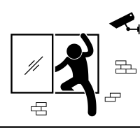


Smart Home Defenses
Malicious
Interference
High Risks Involved
Several policy enforcing defense mechanisms exist
Notes:
Hence, Smart Apps can be malicious.
Another interesting thing is, even if individual Smart Apps are not malicious, interaction among multiple Smart Apps can lead to unexpected scenarios such as breaking and entering.
To protect users from these unexpected scenarios, researchers proposed multiple smart home defense mechanisms.
One category of Smart Home Defense enforce safety and security policy at runtime.

Slide 6


Policy Enforcing Defense
IoT Defense
Internal to platform
ExPAT (SACMAT ‘19)
PatrIoT (RV ‘20)
Policies
Deny unlocking front door, if user is not at home
Policy Enforcer
Smart
App
Motion Detected
Unlock Front Door
Smart Home Platform
Notes:
You might be wondering how these policy enforcing smart home system works. Consider a smart home with a smart app that unlocks the front door when motion is detected.
When a user install an IoT defense, it will modify the Smart App so that before taking any action smart app will consult IoT defense.
Based on the included policies, IoT defense will respond to the smart app with a decision to either allow the action or deny the action.
Some IoT defenses implement this policy enforcement mechanism on of the IoT platform itself.
This category of policy enforcing IoT defense includes ExPAT and PatrIoT.

Slide 7
Policy Enforcing Defense
IoT Defense
External to platform
IoTGuard (NDSS ‘19)
Policies
Deny unlocking front door, if user is not at home
Policy Enforcer
Smart
App
Motion Detected
Unlock Front Door
Smart Home Platform
Notes:
On the contrary, some IoT defense implements the policy enforcement mechanism on a server that is different from the IoT platform,
This category includes IoTGuard.

Slide 8




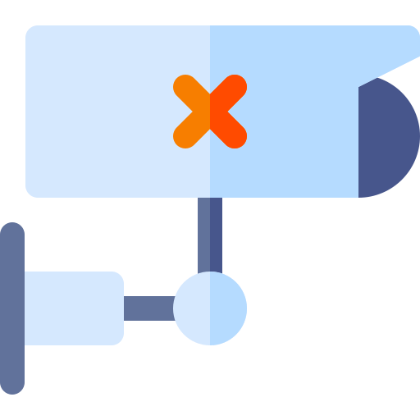
Defenses are Under-Evaluated
Evaluated with only a few hand-crafted scenarios
Skipping hundreds of untested scenarios
Notes:
Regardless of the design, there is a problem with the evaluation of those policy enforcing IoT defenses.
During proposal, these defenses are evaluated with only a small number of handcrafted scenarios.
As a result, there remains hundreds of untested scenarios that can slip through the IoT defense and lead to unsafe situation in a smart home.

Slide 9




Bypassing Policy Enforcement
External to platform
IoTGuard
IoT Defense
Policies
Deny unlocking front door, if user is not at home
Policy Enforcer
Smart
App
Motion Detected
Unlock Front Door
HomeMode=OFF
Smart Home Platform
Notes:
For example, Here is a smart home system with A smart app: When motion is detected, unlock the front door, and an IoT defense with the policy: “deny unlocking front door when user is not at home”. Now consider a scenario, user leaves the home, Smart home platform sets the variable “HomeMode=OFF”. After that, user’s pet moved a little which triggers the motion sensor which in turn will start executing the the smart app. At this stage, the smart app will consult the IoT defense about the security of unlocking the front door. IoT defense has a policy that says it should deny unlocking front door when user is not at home. But IoT defense does not know whether user is at home or not. Because all information from the smart home platform is not exported to the policy enforcement server. As a result, IoT defense might mistakenly allow the action to unlock the front door. Due to evaluation with small number of test scenarios, developers of policy enforcing IoT defenses might miss these kind of corner cases.

Slide 10








Manual Evaluation Methodology
Setup / Initialize
testbed
Inspect
Outcome
Test
Scenario?
Execute Scenario
Notes:
Reason for not evaluating with large number of test scenarios lies on the standard evaluation methodology. To evaluate an IoT defense, a developer needs to: set up IoT testbed by interacting with platform UI, come up with test scenarios by using their expertise, in the next step, they need to execute that scenario by interacting with the platform interface, and finally, the developers need to inspect manually whether their proposed defense were successful in protecting the smart home from that specific test scenario.
To evaluate with multiple test scenarios, they need to re-initialize the IoT testbed before testing each scenario and repeat the process.
Number of manual steps in this approach is making the evaluation with large number of test scenarios inconvenient.

Slide 11
Automated
Manual Evaluation Methodology
VetIoT
Setup / Initialize
testbed
Inspect
Outcome
Test
Scenario?
Execute Scenario
Notes:
Therefore, in this paper we automated the process of evaluating an IoT defense using a platform called VetIoT.

Slide 12
VetIoT: Automatic Evaluation Platform
VetIoT
Test
Config
Setup
Config
Setup / Initialize
testbed
Inspect
Outcome
Reports
Test
Scenario?
Target IoT
Defense
Execute Scenario
Notes:
Given an IoT defense mechanism and setup configuration,
VetIoT automatically instantiates the IoT testbed, create random test scenario, execute test scenario and inspect outcome.
VetIoT will generate reports for each test scenario which indicates how the defense mechanism performed against the test scenario.

Slide 13
VetIoT Architecture
Notes:
Architecture of VetIoT follows the evaluation methodology closely. VetIoT automates 4 steps of evaluation methodology with 4 modules.
Testbed generator module of VetIoT automates the step to setup/initialize testbed. VetIoT interacts with the IoT platform using REST API to automate this process. VetIoT replaces test scenario generation process with a random event sequence generator. An event sequence in an IoT testbed is considered a test scenario. Upon receiving an event sequence, VetIoT will feed the event sequence to the platform using REST API. Finally, VETIOT replaces manual inspection of the test outcomes with a comparator. This comparator reports how the defense performed against a test scenario.
Automating first 3 steps of the process was straightforward. Automating the process of Outcome Inspection has a challenge. Because none of the IoT defense returns any indication of success or failure in protecting smart home from an unexpected scenario.

Slide 14
Automated Outcome Inspection
Two phase execution:
  Disabling Defense
  Enabling Defense
Notes:
VetIoT overcomes this challenge with a 2-Phase execution method.
To detect the influence of an IoT defense, VetIoT executes each test scenario twice:
During phase 1, VetIoT keeps the IoT defense disabled, executes the test scenario, and generates a baseline final system state.
In the next phase (phase-2), VetIoT executes the same test scenario again. But this time it will keep the IoT defense enabled and generates the final system state S-prime.
At the end of 2-phase execution, VetIoT’s comparator compares the final system state of phase-1 (dubbed baseline) with the final system state of phase-2(dubbed S-Prime).

Slide 15


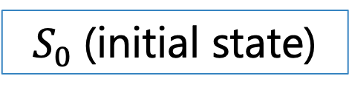
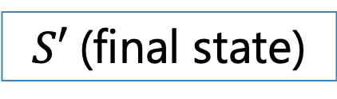
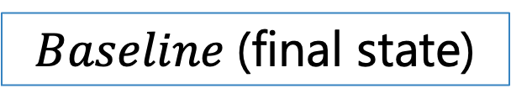
Comparator of VetIoT
A Heuristic Algorithm
$$Baseline \text{(}\text{final} \text{state}\text{)}$$
$$S′ \text{(}\text{final} \text{state}\text{)}$$
$$Baseline?=S′$$
Yes
No violation
No
$$S_{0} \text{(}\text{initial} \text{state}\text{)}$$
$$S_{0} ?=S′$$
No
Indeterminate
Yes
Not Sure!
Defense worked!
Policy violation
Notes:
For comparison VetIoT uses a heuristic algorithm.
If final state with defense is equal to final state without defense, VetIoT can confirm that having IoT defense did not make any difference for this test scenario. VetIoT marks the scenario as a No violation.
If final state with defense is not equal to final state without defense, VetIoT will check whether final state with defense is equivalent to initial system state( which is dubbed S_o).
If final state with defense is equal to initial state, VetIoT can confirm that the IoT defense was trying to prevent a change in the the smart home. Meaning IoT defense detected a policy violation for this test scenario and protected smart home by denying the action.
If final state with defense is not equal to initial state, VetIoT cannot confirm whether IoT defense was successful in preventing an unexpected scenario. VetIoT marks those test scenarios as indeterminate.

Slide 16
Evaluation of VetIoT
Can VetIoT evaluate IoT defenses automatically and empirically?
Test Subjects
Testing Approaches
ExPAT
PatrIoT
Fidelity
Stress
IoTGuard
Differential
Evaluation Metric: Number of policy violations
  Detected by IoT defense that are confirmed by VetIoT (i.e., Defense Worked)
Notes:
We evaluated VetIoT based on this research question: “Can VetIoT evaluate IoT defenses automatically and empirically?”
As a test subject we selected three policy enforcing IoT defenses from the literature: ExPAT, PatrIoT and IoTGuard.
We evaluated each IoT defense with 3 testing approaches: Fidelity testing, Stress testing and Differential Testing.
With fidelity testing we evaluate VetIoT’s fidelity to reproduce previous results automatically.
With stress testing we asses an IoT defense against new test scenarios. With differential testing we compares how multiple IoT defense performs against same test scenarios
As evaluation metric we used the number of cases where VetIoT’s comparator can confirm that “IoT Defense Worked”.
Those are scenarios where VetIoT can confirm that IoT defense successfully detected an unexpected scenario and protect the smart home from the unexpected scenario.

Slide 17
Fidelity Testing
VetIoT reproduced results mentioned in the paper of these IoT defenses automatically.
Security Mechanism | Number of Experiments
ExPAT (SACMAT ‘19) | 8
PatrIoT (RV ‘20) | 5
IoTGuard (NDSS ‘19) | 4
Notes:
This is the result of Fidelity testing.
In this experiment, VetIoT tried to reproduce experimental results mentioned in the paper of these IoT defenses automatically.
VetIoT successfully reproduced results of three papers ExPAT, PatrioT and IoTGuard automatically.

Slide 18
Differential Testing
Assess how an IoT defense fares against other IoT defenses for the same test-scenario.
For example, on test suite 5:
Unexpected scenarios: 13
ExPAT: 15
PatrIoT: 15
IoTGuard: 12
Notes:
This is the result of differential testing 3 IoT defenses with VetIoT.
In this experiment, VetIoT evaluates three IoT defenses with the same test-scenarios.
Goal of this experiment was to compare how IoT defenses perform against the same test-scenarios.
We found that, even for the same scenario, each IoT defense performs differently due to design of the IoT defense.
For example, on test suite 5, there were 13 unexpected scenarios,
ExPAT and PatrIoT detected 15 unexpected scenarios and IoTGuard detected 12 unexpected scenarios.
In this instant, due to their design ExPAT and PatrIoT seem to behave in a too restrictive manner.
On the other hand, in this same test suite IoTGuard seem to behave in a less restrictive manner.

Slide 19





Case Study: Efficacy Depends on Policy Selection
Policies
Window can be opened only if AC is off
IoT Defense(PatrIoT
Or IoTGuard)
Policy Enforcer
IoT Defense(ExPAT)
Smart
App
SleepMode ON
TV OFF
Window=OPEN
AC=ON
Smart Home Platform
Notes:
Here is one of the case from our differential testing experiment. It explains how design choice (policy selection algorithm) in IoT defenses effect it’s performance.
In this scenario, a smart home has a
smart app: that turns off TV when user goes to sleep.
Policy: Window can be opened only if AC is off.
IoT Defense: We will enforce the same policy with 3 IoT defenses. First, we choose ExPAT to enforce this policy.
Now let’s consider a test scenario: User opens the window,
then user turns on AC, After that user goes to sleep. At this stage smart home platform detects that SleepMode is on and it will execute the smart app to turn off the TV. Since user did install IoT defense ExPAT, before taking the action it will consult the IoT defense. In this scenario, ExPAT notices a policy violation. According to the policy, Window can be opened only if AC is off. But the smart home has both window open and ac on. Detecting the policy violation, expat will deny the action to turn off TV. Even though that policy is not related to the action smart app is trying to take.
For same test scenario, both PatrIoT or IoTGuard do not block the action to turn off TV. Because both IoTGuard and PatrIoT select policy based on the action. In the contrary expat does not have any policy selection algorithms. For this reason, expat mistakenly enforces policy even when the action is not related to the policy.

Slide 20
Summary
We present VetIoT, a platform for
Conducting IoT experiments automatically
Empirically evaluating and comparing IoT defenses
Fine-tuning new IoT defense solutions
VetIoT is available at https://github.com/syne-lab/vetiot
Notes:
In summary, we present VetIoT, a uniform evaluation platform with which
researchers can conduct smart home security experiments automatically,
evaluate IoT defense empirically and fine-tune their proposed IoT defenses.
VetIoT is open-source and available on Github for further usage.

Slide 21

Notes:
Thank you very much for your time.
Feel free to ask any question and clarifications about VetIoT.

Slide 22
References
Smart Home Demand: https://explodingtopics.com/blog/smart-home-stats
Pictures and Icons: https://www.freepik.com
[Expat] Yahyazadeh, Moosa, et al. "Expat: Expectation-based policy analysis and enforcement for appified smart-home platforms." Proceedings of the 24th ACM symposium on access control models and technologies. 2019. https://dl.acm.org/doi/pdf/10.1145/3322431.3325107
[Patriot] Yahyazadeh, Moosa, et al. "Patriot: Policy assisted resilient programmable iot system." Runtime Verification: 20th International Conference, RV 2020, Los Angeles, CA, USA, October 6–9, 2020, Proceedings 20. Springer International Publishing, 2020. https://link.springer.com/chapter/10.1007/978-3-030-60508-7_8
[Iotguard] Celik, Z. Berkay, Gang Tan, and Patrick D. McDaniel. "IoTGuard: Dynamic Enforcement of Security and Safety Policy in Commodity IoT." NDSS. 2019. https://www.ndss-symposium.org/wp-content/uploads/2019/02/ndss2019_07A-1_Celik_paper.pdf

Slide 23
Stress Testing ExPAT

Slide 24
Stress Testing PatrIoT

Slide 25
Stress Testing IoTGuard

