Slide 1
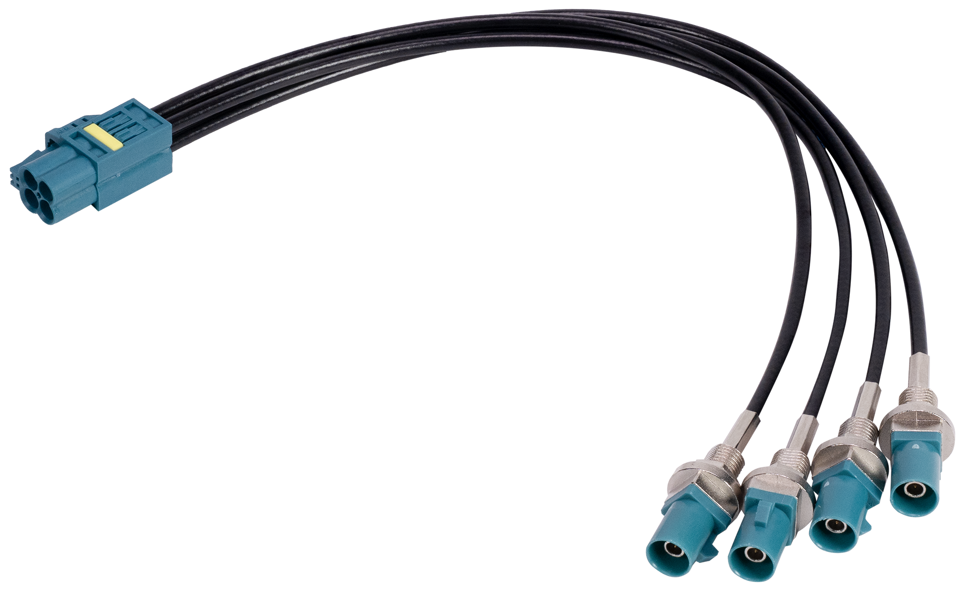
www.avermedia.com/professional
Mini FAKRA to FAKRA Plug x4 Cable
[Preliminary]
This adapter cable is suitable for AVerMedia GMSL board. Through this
cable, Mini FAKRA is converted to standard FAKRA x4 for connecting to
GMSL board (FAKRA to FAKRA cable is required separately), supports
up to 2 sets of cables.
Model | Mini FAKRA Type A to IP67 FAKRA Z-Key Plug x4 Cable
Applicable Product | GMSL board , supports up to 2 cables
Cable Type | TFC RG-174LL Coaxial Cable
Connecter Type | 1x Mini FAKRA Type A 4x IP67 FAKRA Plug Z Key Code panel mount (Color: water blue)
Dimensions | L: 200mm
Waterproof | IP67 (only for FAKRA side)
Temperature | Operating Temperature -40 °C ~ 100 °C
Package | Mini FAKRA to FAKRA plug x4 cable
* All specifications are subject to change without prior notice.
©2024 by AVerMedia Technologies, Inc. All rights reserved.
No part of this document may be reproduced or transmitted in any form, or by any means (Electronic, mechanical, photocopy, recording, or otherwise) without prior written permission of AVerMedia Technologies. Information in this document is subject to change without notice. Made in Taiwan.

