Slide 1
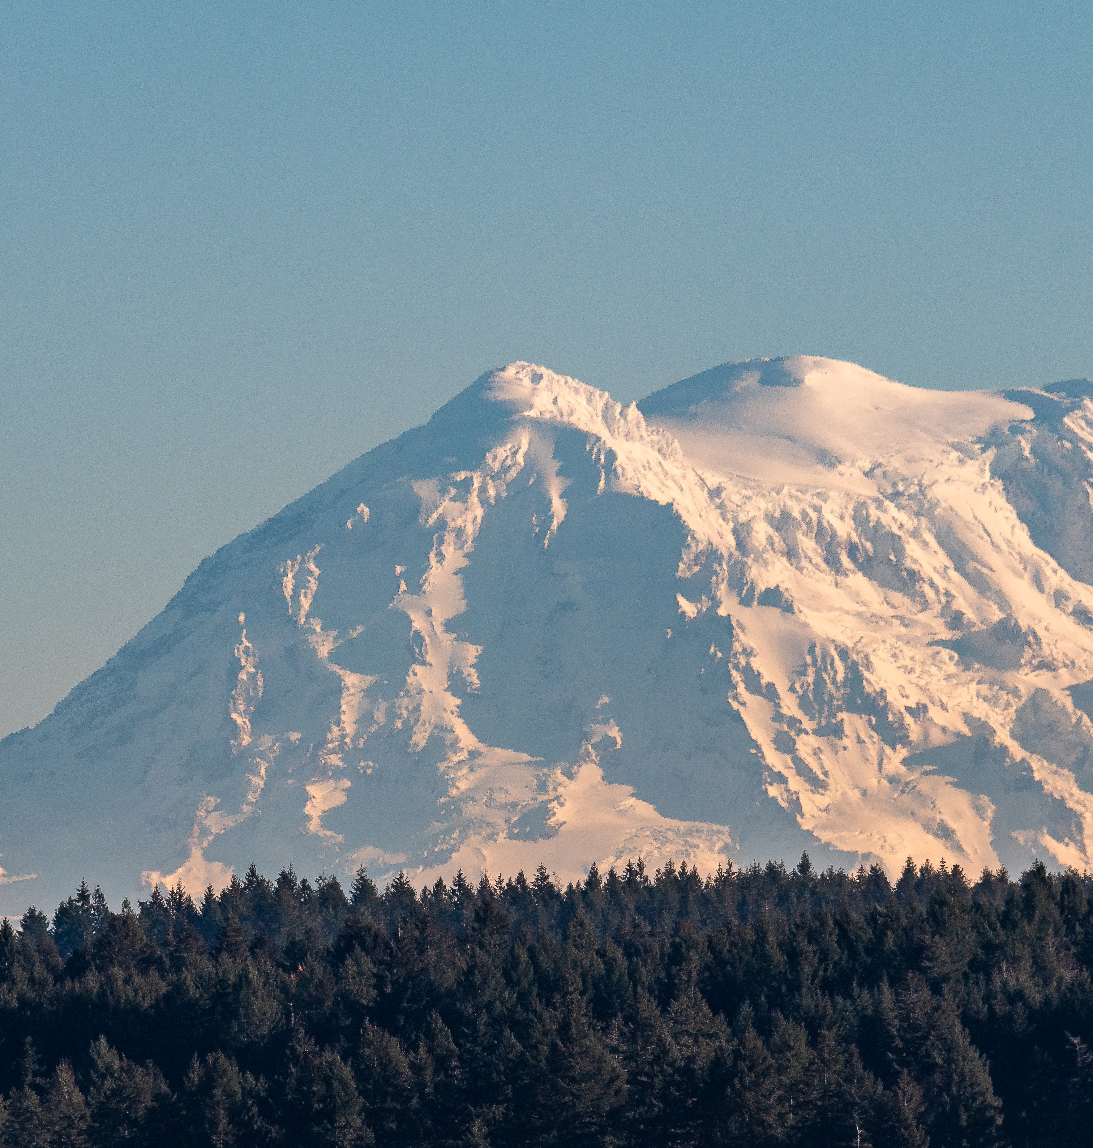
Black Lake Quarry (Littlerock) Rezone and Land Use Amendment
Claire Swearingen
Associate Planner

Slide 2
Background

Slide 3

Applicant Request
Amend the Comprehensive Plan to rezone ~270 acres from R 1/20 to RRI
Current zone: rural residential and resource uses
Requested zone: industrial uses related to rural resources
Background
Notes:
The Black Lake Quarry (Littlerock) Rezone is a request from a property owner to rezone approximately 270 acres at 4741 88th Ave SW from Rural 1/20 (R 1/20) to Rural Resource Industrial (RRI). The current zone allows for mostly residential and resource uses (such as agriculture, mining, and forestry.) The proposed new zone primarily allows industrial uses that support rural resources, with some provisions for other industrial uses. This site does not meet the locational and performance criteria in TCC 20.29.020 that would allow for additional assembly, fabrication, manufacturing, storage, warehousing, and distribution uses.

Slide 4
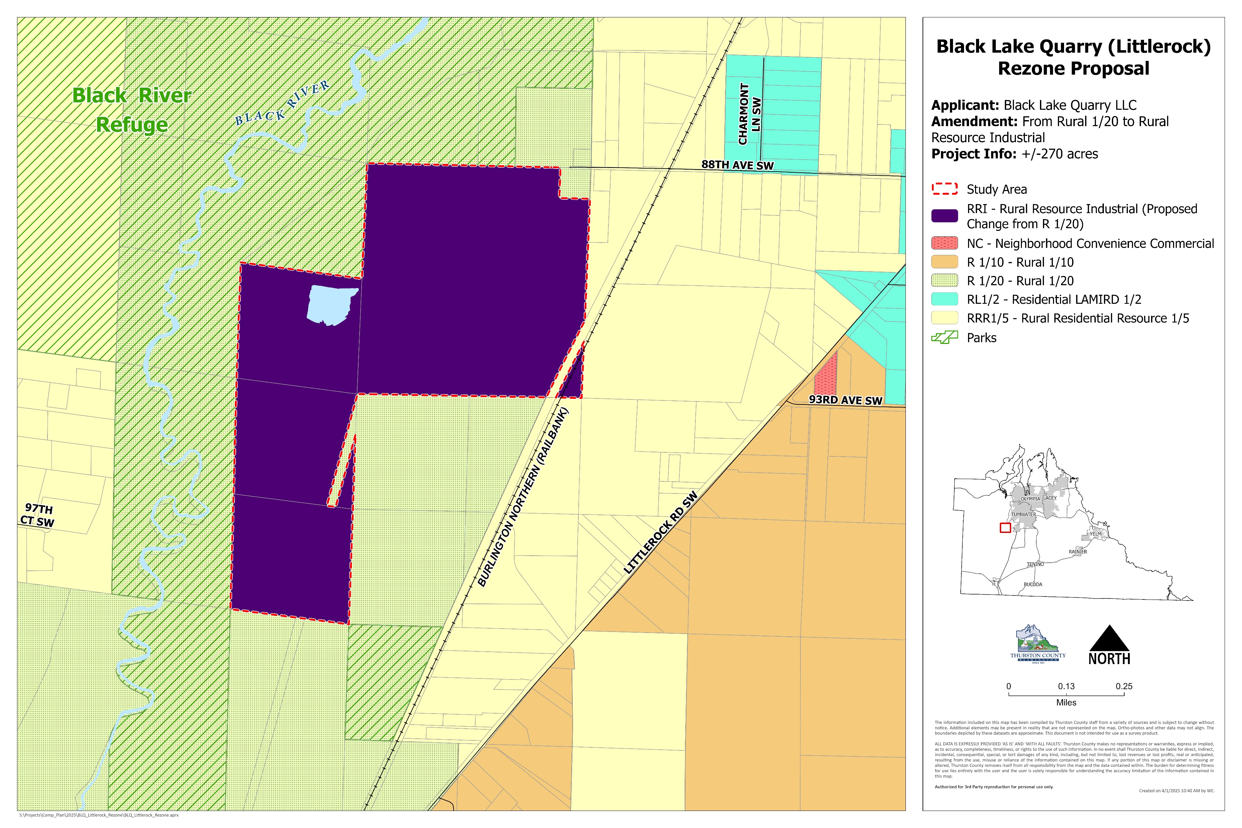


Slide 5
Surrounding Areas and Existing Uses
West: Black River Refuge
Northeast: single-family residential, and one parcel to the east hosts an agriculture use.
The remaining parcels to the southeast and south are undeveloped.
Background
Notes:
The site is currently a functioning gravel surface mine operated by Black Lake Resources. Surrounding uses include open space, residential, and agriculture.
The parcels to the west are a part of the Black River Refuge, and are owned and managed by the U.S. Fish and Wildlife Service. The Black River finds its course through the refuge, and is an important tributary for the Chehalis River.
The parcels to the northeast are developed as single-family residential, and one parcel to the east hosts an agriculture use.
The remaining parcels to the southeast and south are undeveloped.

Slide 6
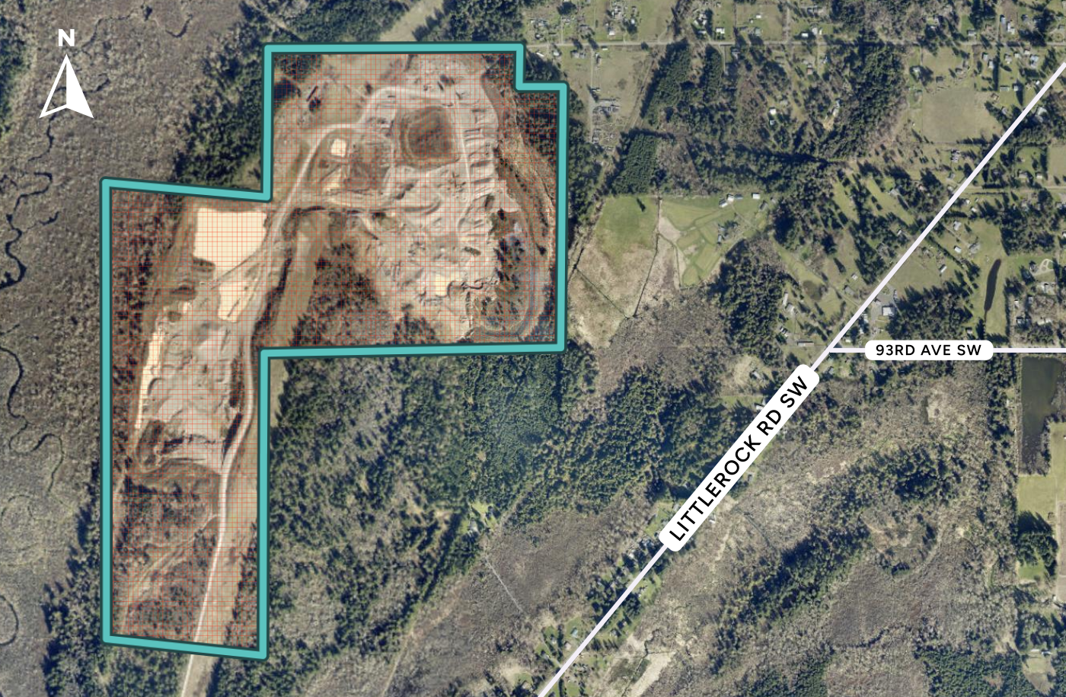
Notes:
Under the requested zoning district (RRI) various resource-related industrial uses would be allowed, and the site may be developed at a higher intensity than its current state. The requested zoning may impact surrounding neighborhoods through increased noise, traffic, and environmental impact, and may provide additional commercial activity. These factors would be considered during the environmental review period of any future land use applications related to new uses, and would also be reviewed if the current use was altered or expanded beyond its currently approved scope.
According to the Thurston County Assessor’s records, parcel 12718310000 has functioned as a gravel pit since at least the late 1980s. According to GeoData photograph archives, this use has expanded across the parcels on the site since 1996. GeoData also shows two mines designated on the site; Littlerock Pit/Quality Rock and Fairview Pit/Quality Rock.

Slide 7

Site Analysis

Slide 8

Access
Site is accessed via a private driveway that connects to Littlerock Road
Open house: neighborhood residents expressed concern about the use of 88th Ave SW
Use of 88th Ave SW is not approved for the current use
Site Analysis
Notes:
According to the most recently submitted 5-year mine review permit, the site is accessed from Littlerock Road at the southern boundary of the southernmost parcel. While 88th Ave SW does extend to the northeast corner of the site, the current use is not approved to use this road for access. Per the comments on the current 5-year mine review, the current mine operation is required to post a “no mine access” sign on this road. If the site is redeveloped, use-specific access needs would be addressed at the time of development application.

Slide 9
Utilities
The site is not part of a Thurston County water or sewer ULID.
According to a Hearing Examiner’s decision from April of 2018, the site is served by an on-site septic system and utilizes groundwater under Water Right G2-30523.
Site Analysis

Slide 10
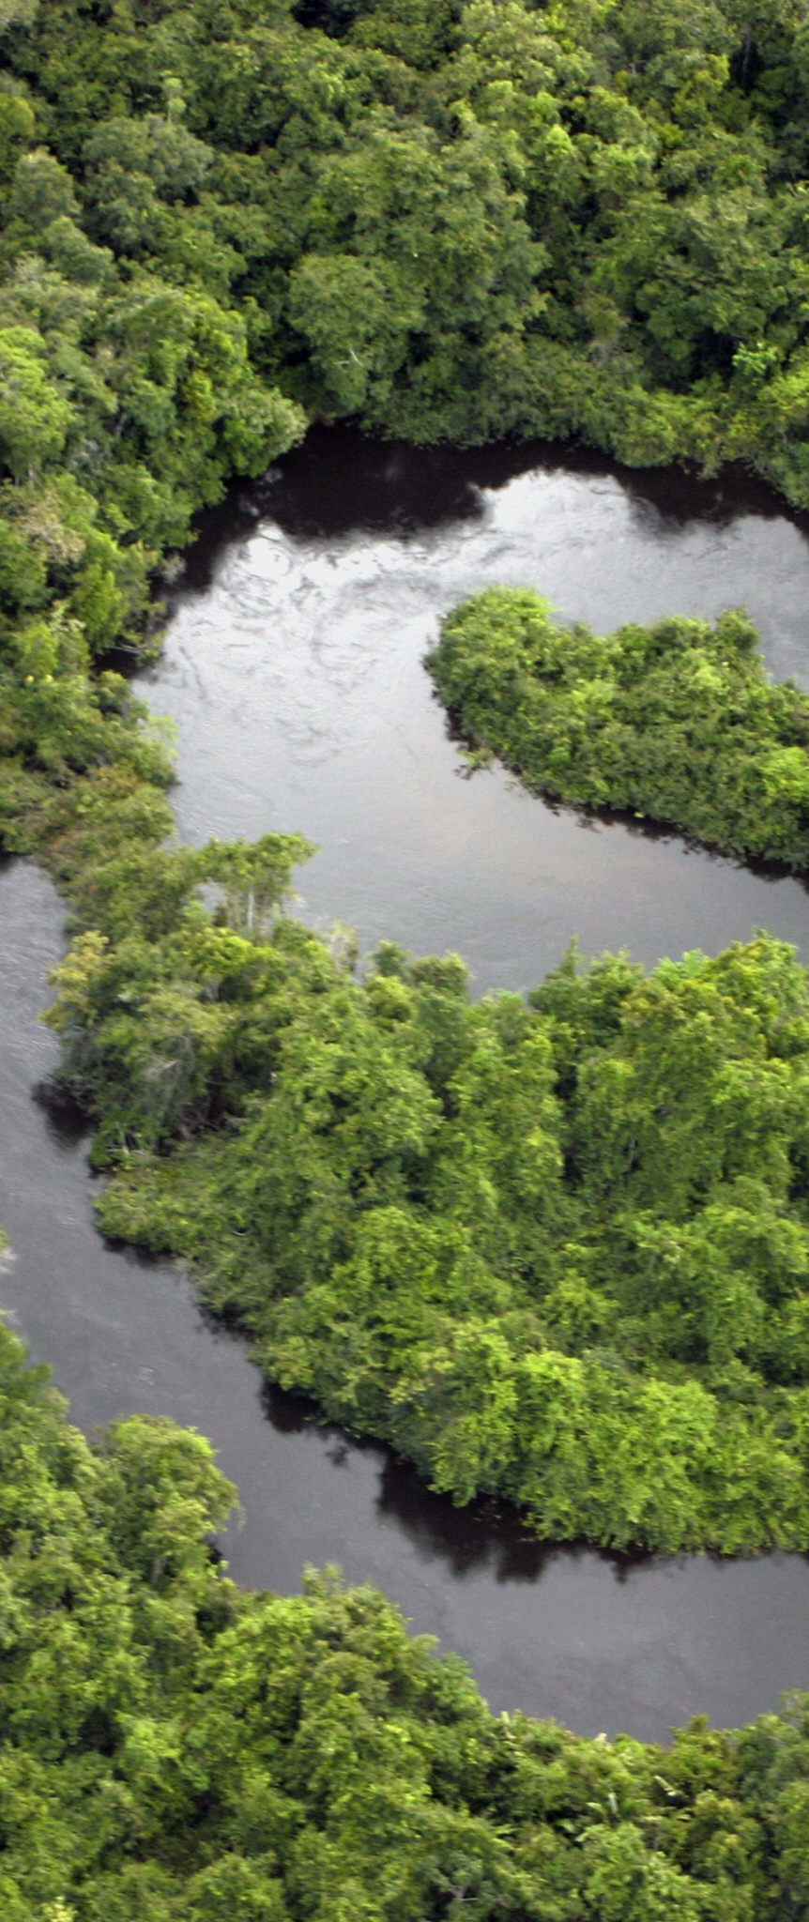
Environment
Many critical areas and potential HCP species areas are mapped on the site
Site is adjacent to the Black River and Black River Unit of the Billy Frank Jr. Nisqually National Wildlife Refuge.
The Black River is an important tributary of the Chehalis River and supports salmon. The refuge contains many rare, unique, and valuable habitat types that support priority species.
Site Analysis
Notes:
The site includes the following environmental areas as mapped in GeoData: steep slopes, frequently flooded areas, high groundwater hazard areas, shoreline areas, hydric soils, prairie soils, mazama pocket gopher soils and areas, Oregon spotted frog areas, wetlands, fish and wildlife habitat conservation areas, knotweed containment sites, noxious weed sites, and critical aquifer recharge areas. The presence of these features, and any bearing on potential uses of the site, would be evaluated during the land use application process for any submitted proposals.
The site is directly adjacent to the Black River and the Black River Unit of the Billy Frank Jr. Nisqually National Wildlife Refuge. This is owned and managed by the U.S. Fish and Wildlife Service (USFWS). According to the USFWS:
The Black River Unit consists of a large, complex mosaic of wetland, riparian , and upland habitats surrounding the low-lying river. These diverse habitats include river and tributary channels, locally rare and unique bog, shrub swamp, riparian forest, emergent marsh, seasonally flooded non-native grassland, dry non-native grassland, and mixed forest…
…Within the boundary of the Unit, there is spawning and rearing habitat and migration corridors for steelhead, cutthroat trout, and coho and Chinook salmon. 150 species of migratory birds, including waterfowl and neotropical songbirds, are found here. The Olympic mudminnow, a state-endemic and state species of concern, survives in the Unit. The federally threatened and state endangered Oregon spotted frog survives here thanks to the complex system of wetlands and connections to the river. Some of the largest Oregon spotted frog population in Washington State are found here.”

Slide 11
SEPA
An environmental determination for the proposed amendment is required and will be completed prior to the Board of County Commissioners public hearing.
Any future project level applications may require SEPA and environmental review unless they are a categorical exemption.
Site Analysis

Slide 12
Public Engagement
April 28th Open House: Noticed through mail, email, and online
Concerns about the site’s compatibility with neighboring residential and open space uses.
Residents noted that wildlife uses the area, including black bears
Neighbors concerned about the current mine using 88th Ave SW as an access point, which is not an approved access for the site.
Concern about the presence of critical areas nearby, including habitat areas for important fish, birds, and other wildlife.
Site Analysis
Notes:
Thurston County noticed the April 28th Open House to the owners and residents of nearby parcels. Notice of the project was also sent to the general planning email list. No paper comment forms were completed at the open house, but conversations with attendees highlighted concerns about the site’s compatibility with neighboring residential and open space uses. Residents of the area discussed local wildlife using the area, including black bears which regularly cross 88th Ave SW. There was also a concern about the current mine using 88th Ave SW as an access point, which is not an approved access for the site. Additionally, participants were concerned about the presence of critical areas nearby, including habitat areas for important fish, birds, and other wildlife. Five written comments have been received through the online comment portal, and these comments are provided in Attachment B of the Staff Report. Staff will continue to provide received comments to the Planning Commission throughout the review of the project.

Slide 13

Thurston County Code and Zoning

Slide 14
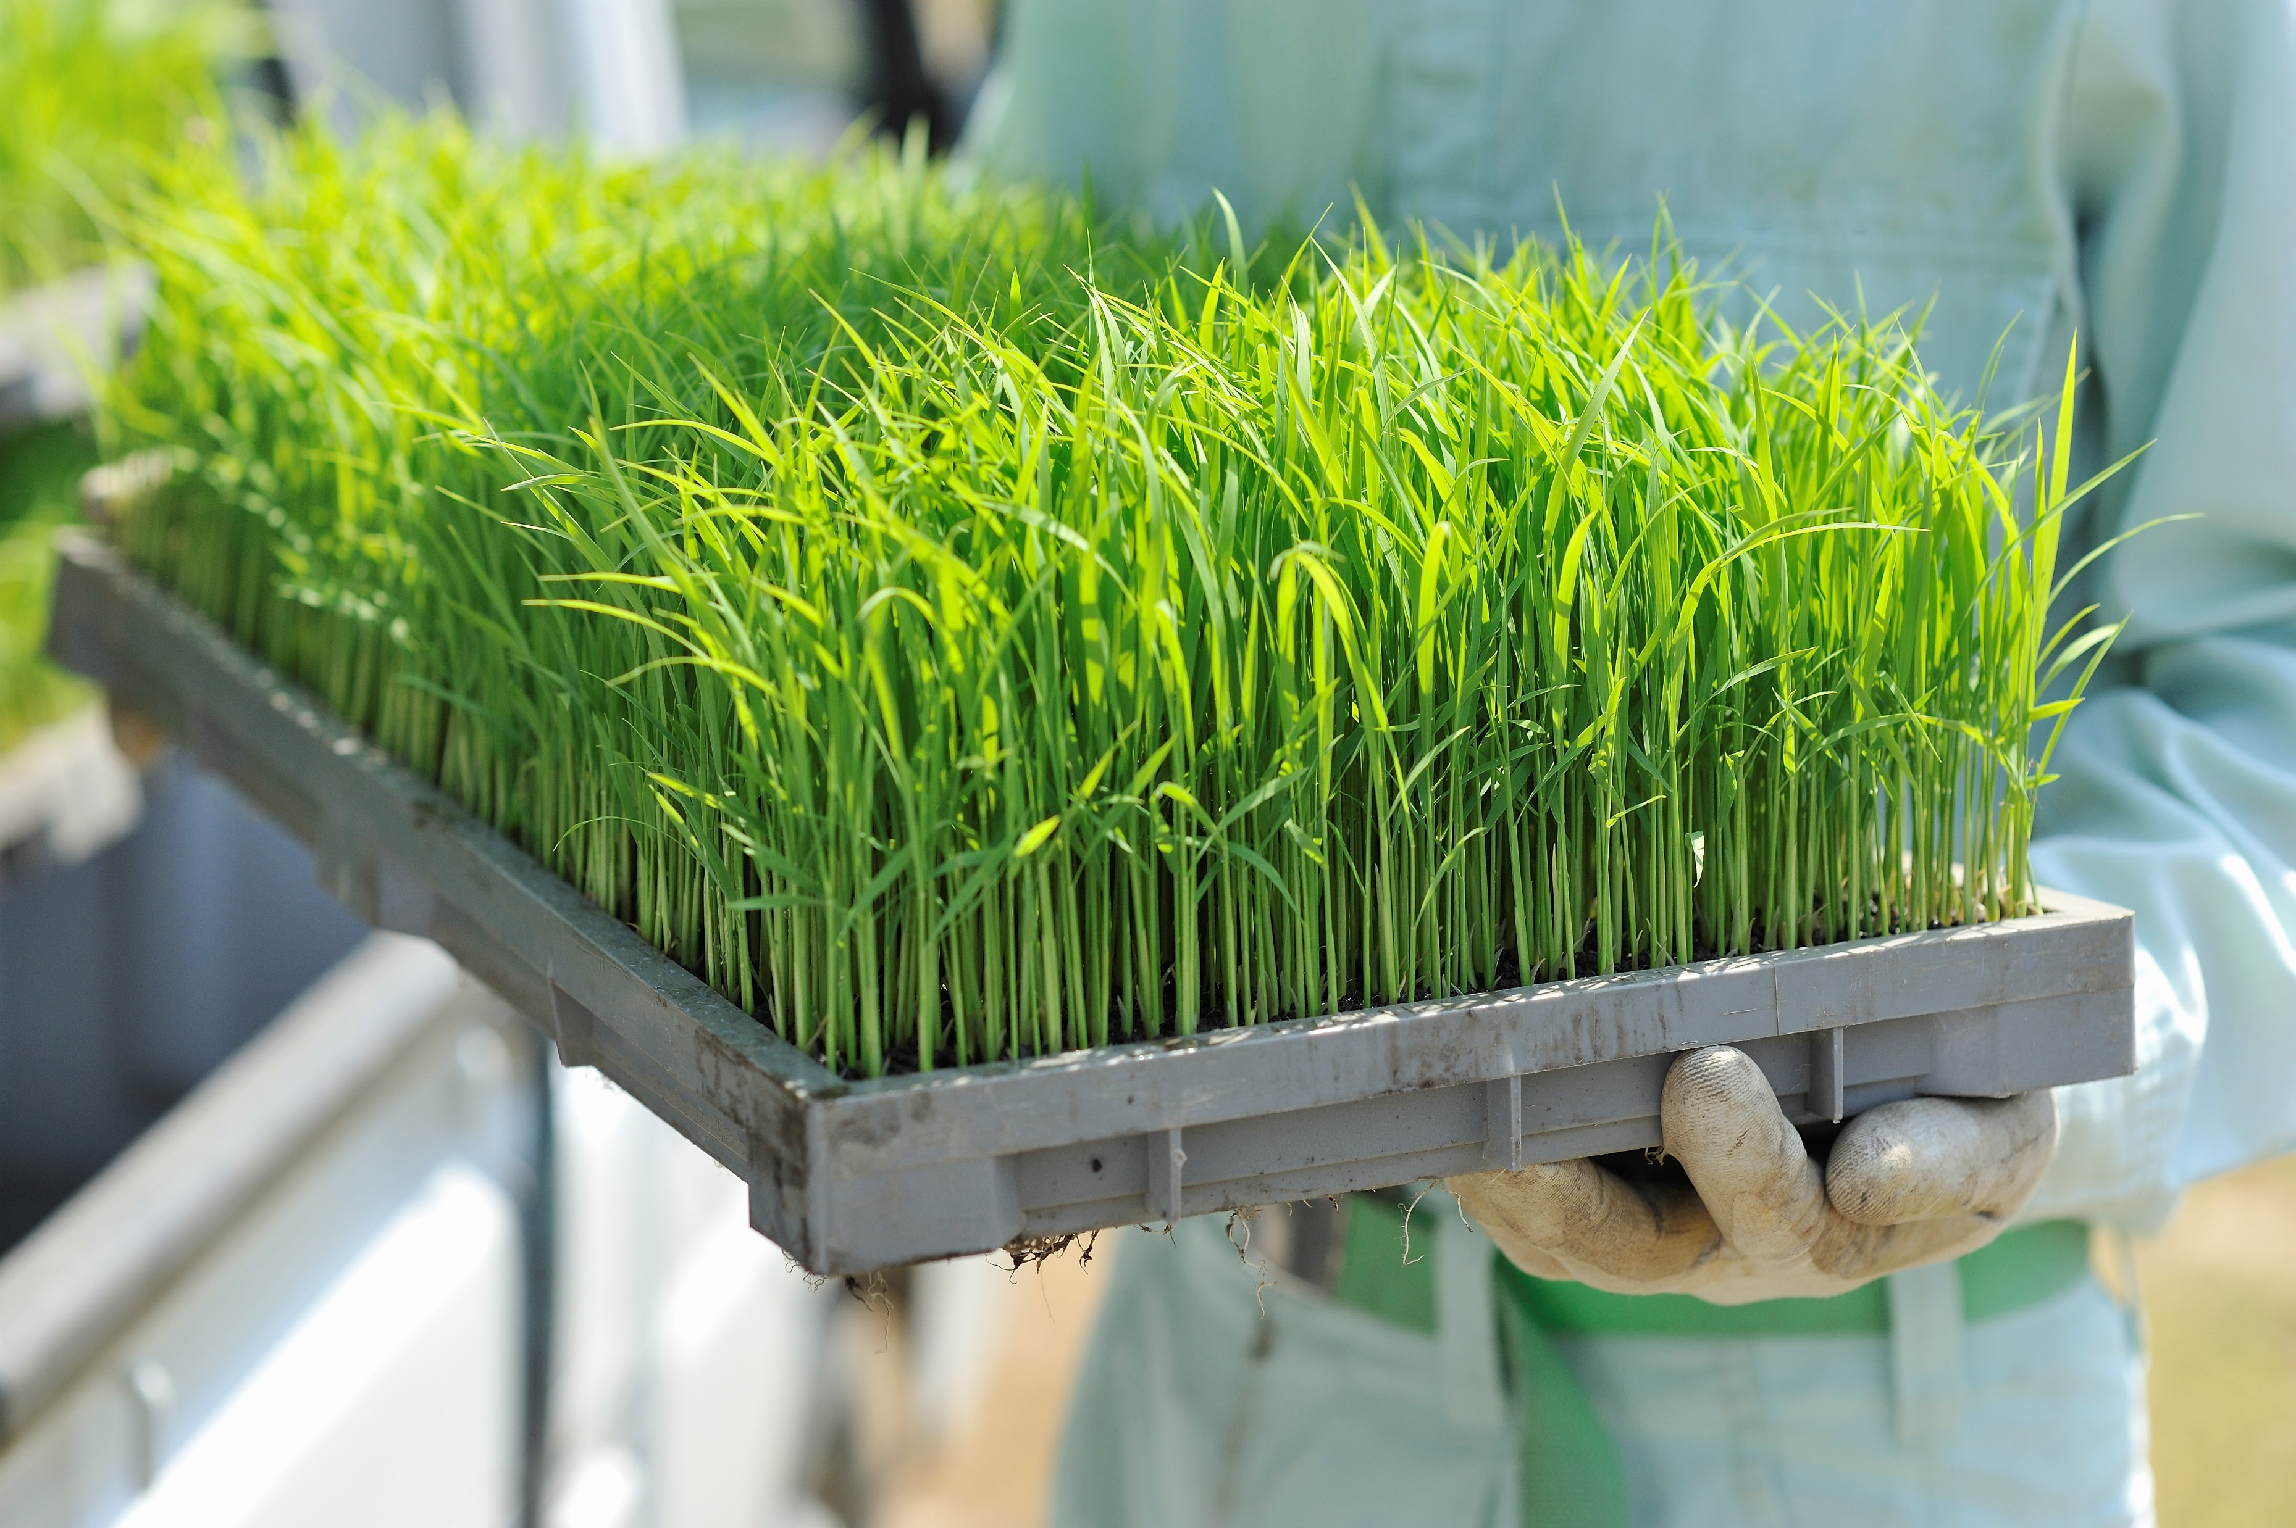
R 1/20 Purpose
Minimize development in environmentally sensitive areas
Protect environment and open space
Provide low density residential uses
Provide rural resource uses
TCC and Zoning
Notes:
The purposes of the R 1/20 district are to protect public health and safety by minimizing development and avoiding incompatible uses in environmentally sensitive and hazardous areas such as the Black River Corridor, the Nisqually Bluff, and parcels completely covered by critical areas; provide greater opportunities for protecting critical areas and creating open space corridors; provide for low density residential uses, agriculture, forestry, conservation and associated uses appropriate for a rural area that do not require urban services; and provide for mining through a special use process

Slide 15
R 1/20 Allowed Uses
Single-family residential
Agriculture, forestry, recreation
Related accessory uses
Schools, public facilities, some recreation, churches, community centers, and mines are allowed through a special use permit
TCC and Zoning
Notes:
Allowed Primary Uses:
Single-family dwellings (limited to one primary residential structure per lot
Agriculture
Forest practices and forest management activities
Outdoor recreation
Accessory Uses (Must be with an allowed primary use):
Home-based businesses
Accessory uses that support timber harvesting like storage, weigh stations, crew quarters, and sawmills
Composting of plants or manure that are produced on-site
Greenhouses for agriculture
Accessory uses for agriculture and forestry for the storage of explosives, fuels and chemicals, which must comply with special regulations
Special Uses:
There are many uses allowed in R 1/20 through a Special Use Permit. These generally include
Schools and other public facilities, including daycare
Recreation-related uses
Churches and community centers
Mining

Slide 16

RRI Purpose
Site industrial uses reliant on rural resources
Storage, processing, fabrication, wholesaling of good associated with natural resources
Protect rural area from industrial impacts
TCC and Zoning
Notes:
The purpose and intent of the rural resource industrial district is to provide areas where industrial activities and uses that are dependent upon agriculture, forest practices and minerals may be located. The district also allows such uses that involve the processing, fabrication, wholesaling and storage of products associated with natural resource uses. The standards in this chapter are intended to protect the rural area from adverse industrial impacts. All industrial uses must be functionally and visually compatible with the character of the rural area.
Controls to provide freedom from nuisance-creating features such as noise, dirt, odor, vibration, air and water pollution, are established together with adequate traffic circulation, buffers and landscaping requirements, to establish compatibility with surrounding rural development and offer protection from industrial blight and impacts.

Slide 17
RRI Allowed Uses
Service and retail
Agriculture, forestry and mineral related industrial uses
Other uses that support or relate to natural resources
TCC and Zoning
Notes:
Service and Retail:
Service uses like restaurants, bars, and service stations
Service, repair, storage and sales for cars, trucks, and machinery
Agriculture Related Uses:
Sales (including wholesale) and storage for feed, fertilizer, and other farm equipment
Farm management services
Veterinary clinics and hospitals
Forestry Related Uses:
Mills for producing wood products
Manufacturing of wood products
Prefabricated wood buildings and components
Mineral Related Uses:
Stone, marble and granite monument works
Manufacturing brick, tile or terra cotta
Manufacturing clay products
Manufacturing concrete products
Other Uses:
Living quarters or unit for caretaker or watchman working on the property
Administrative, educational and similar activities, with a permitted use
Public facilities and utilities (Landfills require a Special Use Permit)
Research labs and commercial testing labs for resource uses
Unclassified uses and railroad rights-of-way

Slide 18
RRI: Additional Uses
This site does not meet the criteria in TCC 20.29.020 (5)(a), which would allow for some non-resource related warehouse, storage, manufacturing, and wholesaling uses.
TCC and Zoning

Slide 19

Comprehensive Plan

Slide 20

Locational Criteria: RRI
Land Capability and Environmental Characteristics:
Capable of supporting industrial development with minimal environmental constraints
No significant adverse effects on surface or ground water
Level and free of critical areas
Comprehensive Plan
Notes:
The subject site does contain several mapped critical areas, and is upland of the “natural” Shoreline designation along the Black River. This Shoreline designation extends onto the subject site.

Slide 21
Locational Criteria: RRI
Natural Resources:
Development should not detrimentally impact agriculture, forestry, aquaculture or other natural resource uses
The area should have minimal potential for natural resource management/utilization.
Comprehensive Plan
Notes:
Most of the land area within the site is designated as mineral lands, but has been mined extensively already. The site is not adjacent to any land designated as long-term agriculture or forestry, and does not contain areas designated for agriculture or forestry.

Slide 22
Locational Criteria: RRI
Utilities:
Appropriate rural utilities for industrial use
Land can support the industrial uses with on-site septic systems and water without adversely affecting surface or groundwater
Transportation:
Rail access or proximity to highway
Direct access to arterial or collector roads
No adverse traffic impacts on surrounding rural areas and uses.
Comprehensive Plan
Notes:
The site is outside any urban service areas for water or sewer, and is served by well water and an onsite septic system. The site is accessed by a long private driveway that connects to Littlerock Rd, a County arterial road. The site is currently not approved to use 88th Ave SW, a small local access road used primarily by residences. The site is not adjacent to an interstate, and the rail line that passes though the site is abandoned according to WSDOT.

Slide 23
Locational Criteria: RRI
Existing Land Uses:
Visually and functionally compatible with rural character
Uses must be dependent on rural setting and resources
No interference with rural uses or resources
Must not affect the visual character of the rural landscape.
Site design should reinforce the boundaries and rural nature of the industrial area.
Comprehensive Plan
Notes:
No specific use or redevelopment of the site is being proposed at this time. Any change in the established use on the site would be required to meet the above criteria, and any other applicable criteria in the Thurston County Code. While the site currently operates as a mineral extraction facility, it is not adjacent to any other designated resource lands.

Slide 24

Locational Criteria: R 1/20
Land Capability and Environmental Characteristics: Lands that are within the Black River Corridor, along the Nisqually Bluff or severely constrained by environmentally sensitive or hazardous areas.
Natural Resources: The area may contain forests, mineral deposits, critical areas and soils suitable for agriculture.
Comprehensive Plan
Notes:
The site is adjacent to the Black River, and contains critical areas, although it is not heavily constrained. The site also contains designated mineral lands which are currently being mined.

Slide 25
Locational Criteria: R 1/20
Public Services: Uses do not require provision of urban services or utilities. Area may be located along arterials, within areas containing pre-existing small-lot development, and/or relatively close to existing centers of employment and/or personal services.
Existing Land Uses: The land is comprised of parcels twenty acres or larger in size. Residences, agriculture, forestry, mineral extraction, open space, or undeveloped land may be present.
Comprehensive Plan
Notes:
The site is outside any urban service areas for water or sewer, and is accessed by a long private driveway that connects to Littlerock Rd, a County arterial road. All the subject parcels are over 20 acres in size. The primary use on the site in mineral extraction, and surrounding uses include residential, agriculture, and open space.

Slide 26

Review Timeline

Slide 27
Option 1:
Set a hearing date for 7/16, no additional study session
Option 2:
Wait to set a hearing date, schedule a second study session for 6/18
Review Timeline

