Slide 1
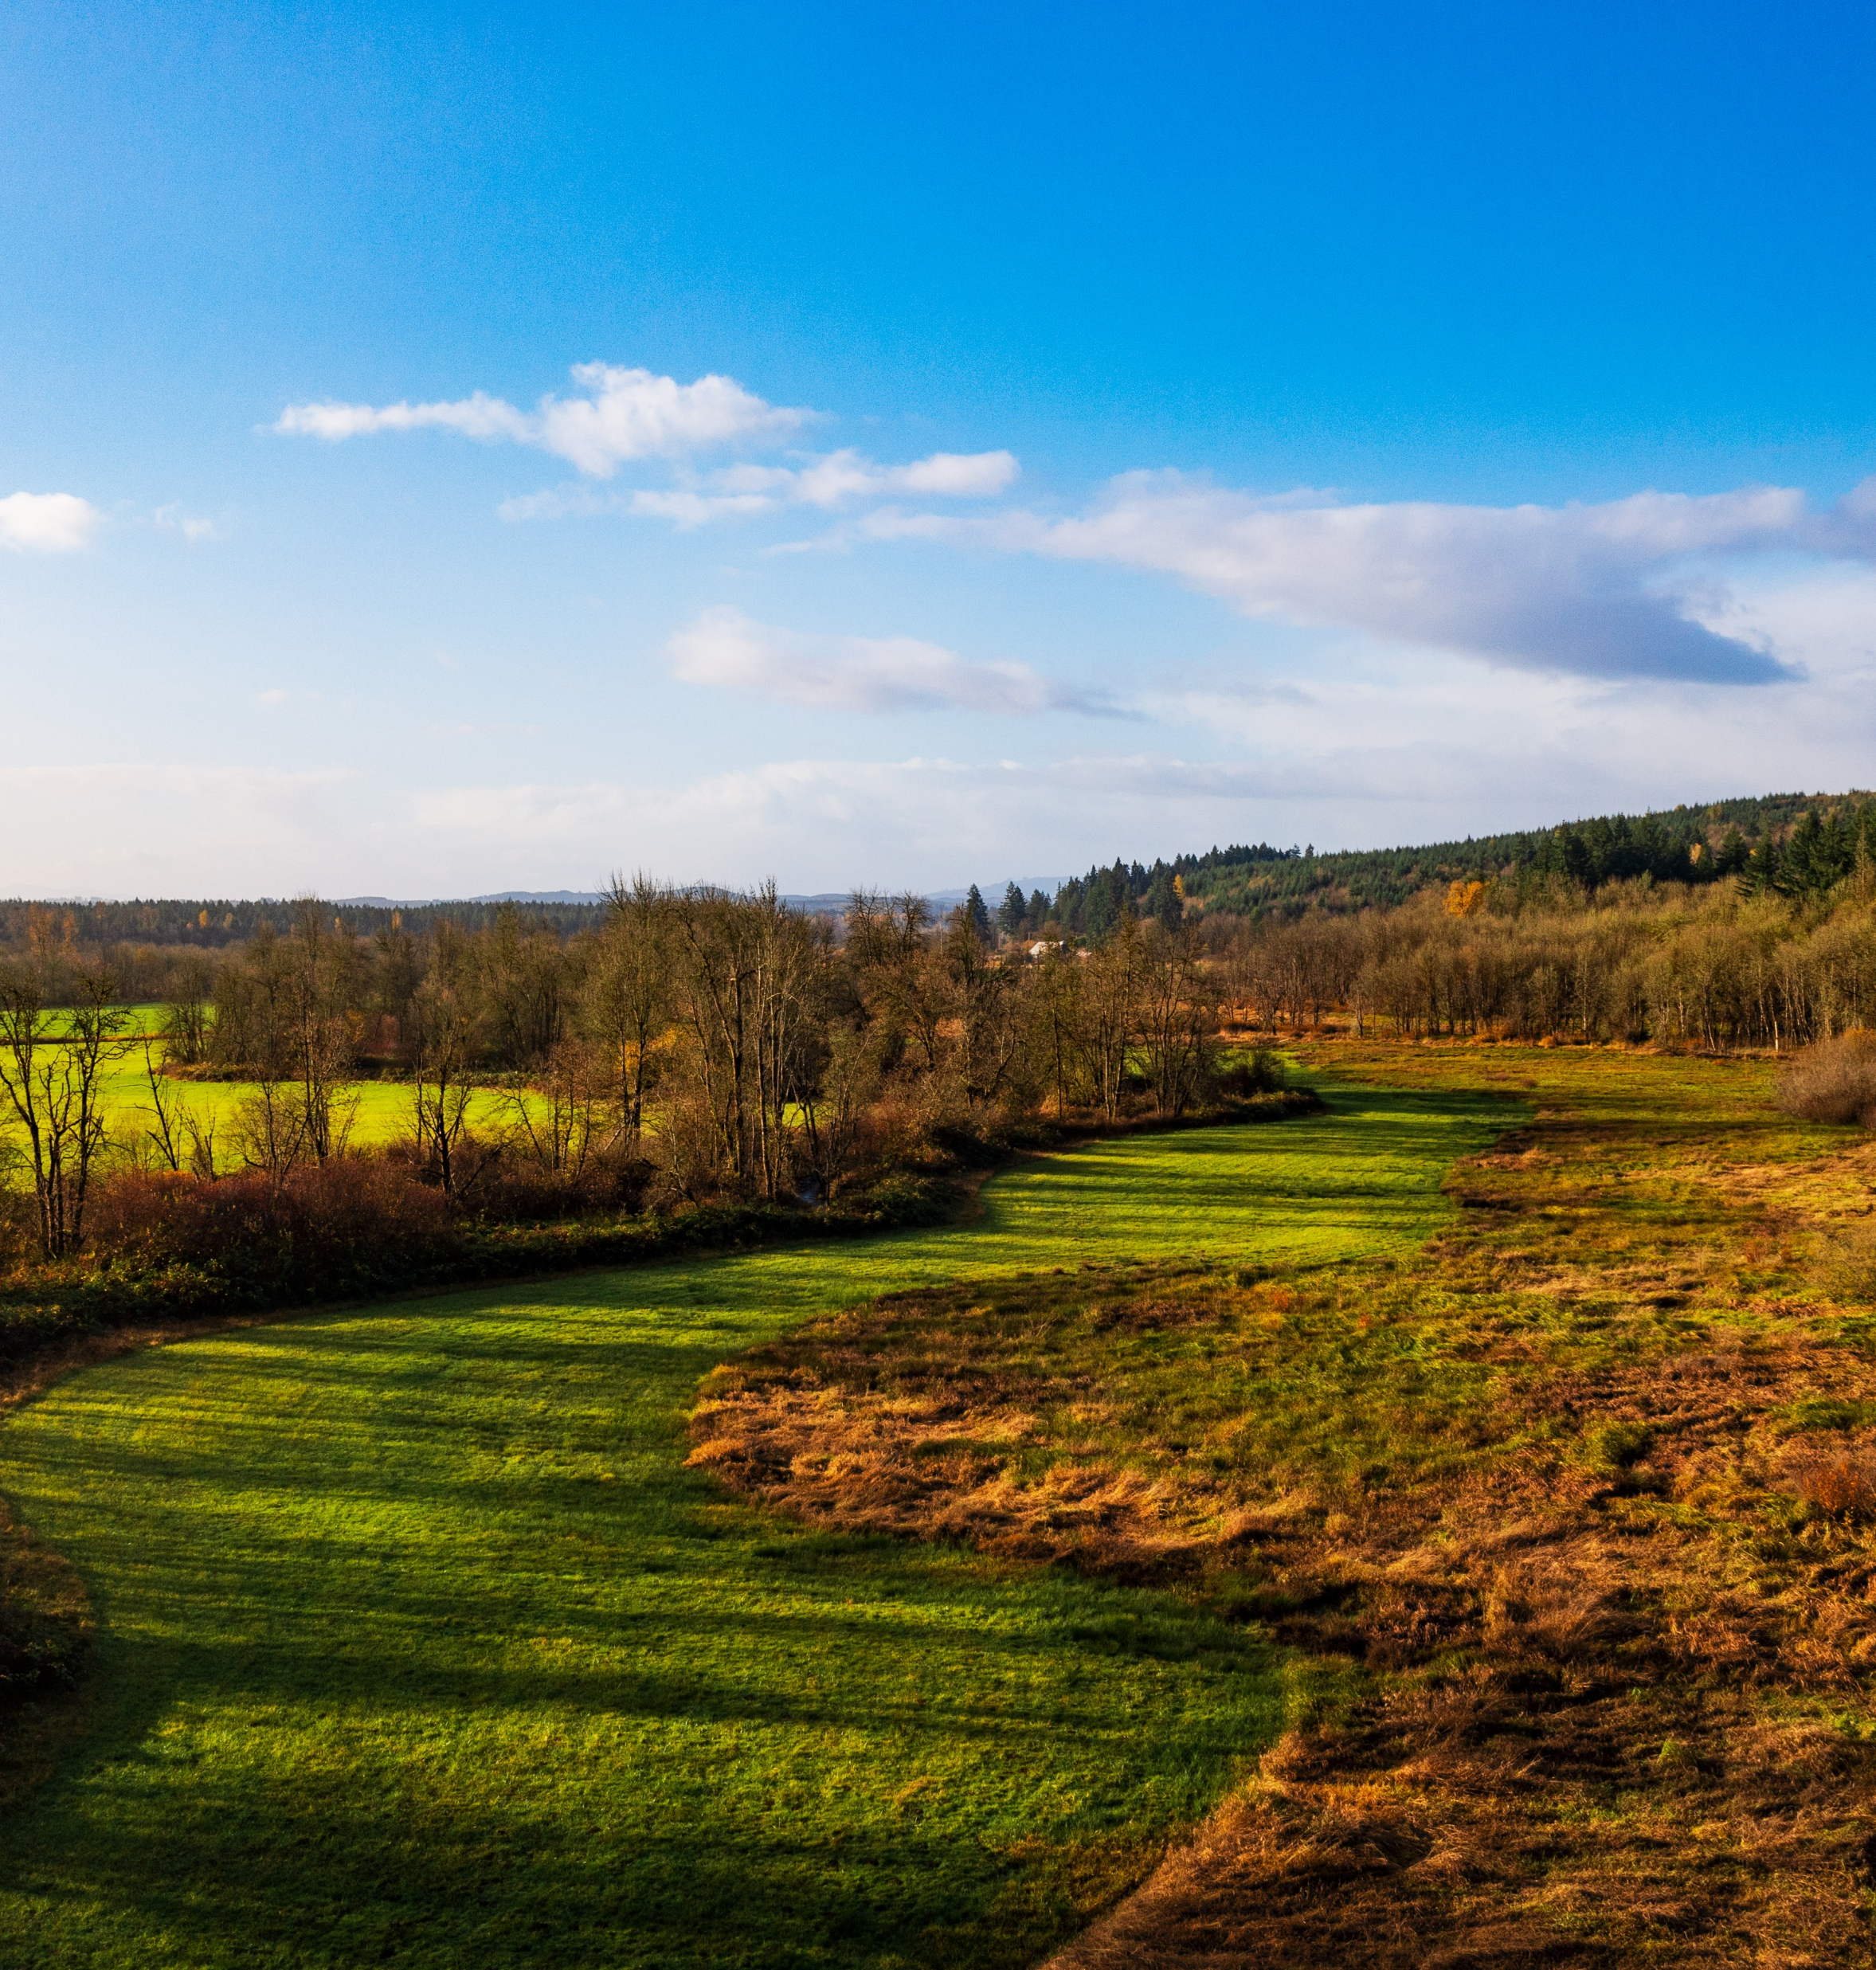
February 4, 2026 Thurston County Planning Commission
CAO Update: Frequently Flooded Areas BAS and Discussion
Claire Swearingen
Associate Planner

Slide 2
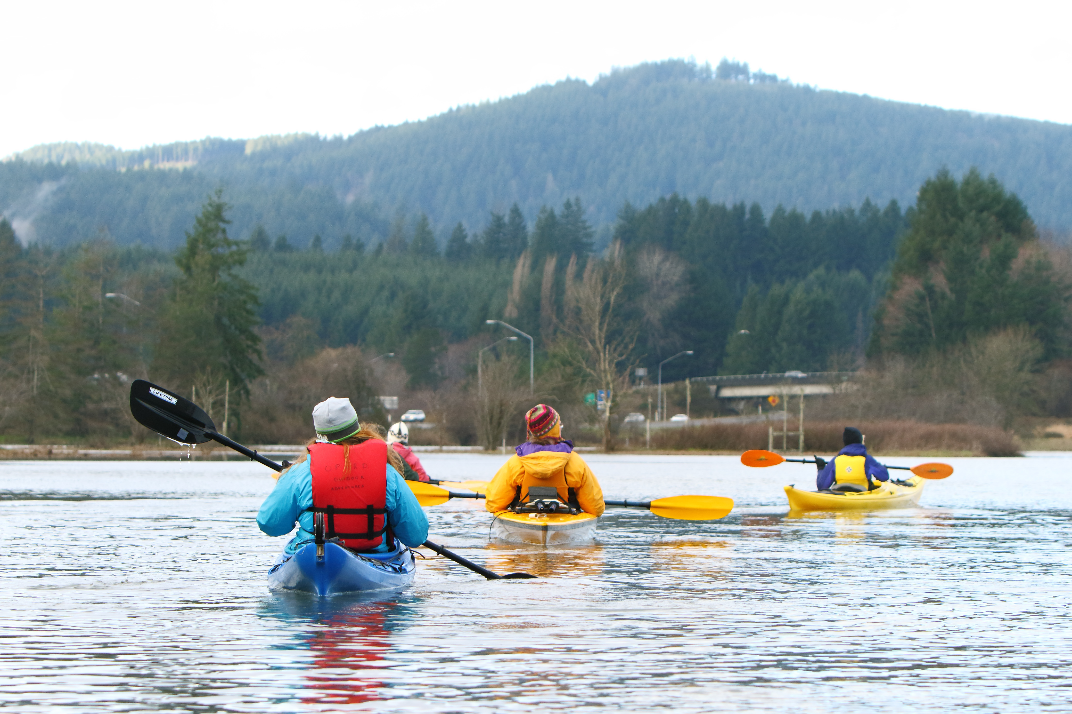
Presentation Outline: Frequently Flooded Areas (FFAs)
Functions, values, and hazards
Climate change
Key protection strategies
Discussion
Intro

Slide 3
Defining FFAs
WAC Definition:
"Frequently flooded areas" are lands in the flood plain subject to at least a one percent or greater chance of flooding in any given year, or within areas subject to flooding due to high groundwater. These areas include, but are not limited to, streams, rivers, lakes, coastal areas, wetlands, and areas where high groundwater forms ponds on the ground surface.
Intro
Notes:
Critical aquifer recharge areas (CARAs) are parts of the environment where soil conditions and other factors help surface waters to infiltrate into groundwater. Because water can infiltrate into the ground easily in these areas, they are important for replenishing groundwater resources, but are also susceptible to contamination. The most sensitive CARAs include areas with very coarse soil types, which allow for quick infiltration with little filtering of contaminants, and areas near wellheads, called wellhead protection areas.

Slide 4
Classifying FFAs
Base Flood
100-year floodplain (1% chance to flood each year)
Shown on FEMA flood maps
FEMA mapped flood areas: baseline requirement for CAO
Other FFAs
Channel Migration Zones (CMZs)
High Groundwater Areas
Flood of Record
Coastal flooding
Intro
Notes:
Protecting groundwater involves understanding the locations and characteristics of aquifers and water quality threats, planning for implementation of protective rules, and monitoring for contamination and other risks. Protecting CARAs ensures that Thurston County has clean water for drinking, and helps support other important habitat like streams, rivers, and lakes.
Pierce County doesn't use classifications but instead refers to specific mapped features and wellhead protection areas, Skagit and Kitsap only use two classifications (Skagit includes seawater infiltration areas), Snohomish designates sole source aquifers and and wellheald protection areas in addition to three levels of CARA sensitivity based on aquifer depth.

Slide 5

Functions and Values
Floodplains and flood events create and enhance fish habitat
Floods transport woody debris to streams
Flood channels protect fish from high flow
Often overlap with FWHCAs, Wetlands, and CARAs
Natural floodplains help discharge flood waters and recharge groundwater
Values
Notes:
Groundwater is a primary source of drinking water in Thurston County, and protecting it from contamination or depletion is important for maintaining human health and safety. If aquifers cannot recharge due to changes on the surface (like increased impervious areas), drinking water wells run dry. If water is contaminated by chemicals from spills or sewage from septic systems, people may become sick. Other factors, like climate change, sea level rise, and water overconsumption can impact the quality and quantity of available groundwater. The Critical Areas Ordinance (CAO) can help when a specific development might impact a CARA, but other programmatic approaches can help mitigate impacts at a larger scale.
Aquifers also help provide a consistent source of cold water to streams, lakes, and rivers, especially in the hot, dry season in the late summer and early fall. Many species of fish, especially salmonids, rely on clean, cold water for spawning habitat. Groundwater can discharge through springs or streambanks year-round, and aquifers keep water cold inside the earth. Human impacts and climate change mean that stream temperatures are rising, and water quantity is low in the dry season. Cold, full streams are important for habitat quality and fish survival, and if aquifers cannot recharge, many aquatic species may not have a healthy habitat. If aquifers are contaminated, those contaminants can make their way to surface waters, and harm the environment and human health.

Slide 6
Flood Hazards and Safety
More costly than all other hazards in WA combined
Cleanup is more expensive than prevention and avoidance
Development in floodplains worsens risk and severity
Values
Notes:
The vulnerability (or risk of contamination) of a CARA is determined by two major factors. The first is the CARA’s susceptibility to contamination, which is determined by the geologic setting of the aquifer. The depth of the aquifer, the soil types and geologic formations above it, and the speed at which the groundwater moves all affect susceptibility. The second is the possibility of contamination. Threats of contamination can come from many kinds of human development, and include things like contaminated runoff, chemical spills, and failing septic tanks. Part of the strategy for protecting CARAs is to ensure that high-risk activities are kept away from susceptible areas, and that proper mitigation efforts are used to reduce risk.

Slide 7
Community Rating System
FEMA program to lower flood insurance costs
Makes flood insurance more accessible
Credits certain planning activities
Mapping and flood data
Managing new development to minimize future flood damage
Reducing flood losses to existing development
Improving emergency preparedness and response
Implementing public information activities
Strong CAO regulations are part of County's high CRS rating
Annual savings of $372,397
Values
Notes:
The vulnerability (or risk of contamination) of a CARA is determined by two major factors. The first is the CARA’s susceptibility to contamination, which is determined by the geologic setting of the aquifer. The depth of the aquifer, the soil types and geologic formations above it, and the speed at which the groundwater moves all affect susceptibility. The second is the possibility of contamination. Threats of contamination can come from many kinds of human development, and include things like contaminated runoff, chemical spills, and failing septic tanks. Part of the strategy for protecting CARAs is to ensure that high-risk activities are kept away from susceptible areas, and that proper mitigation efforts are used to reduce risk.

Slide 8
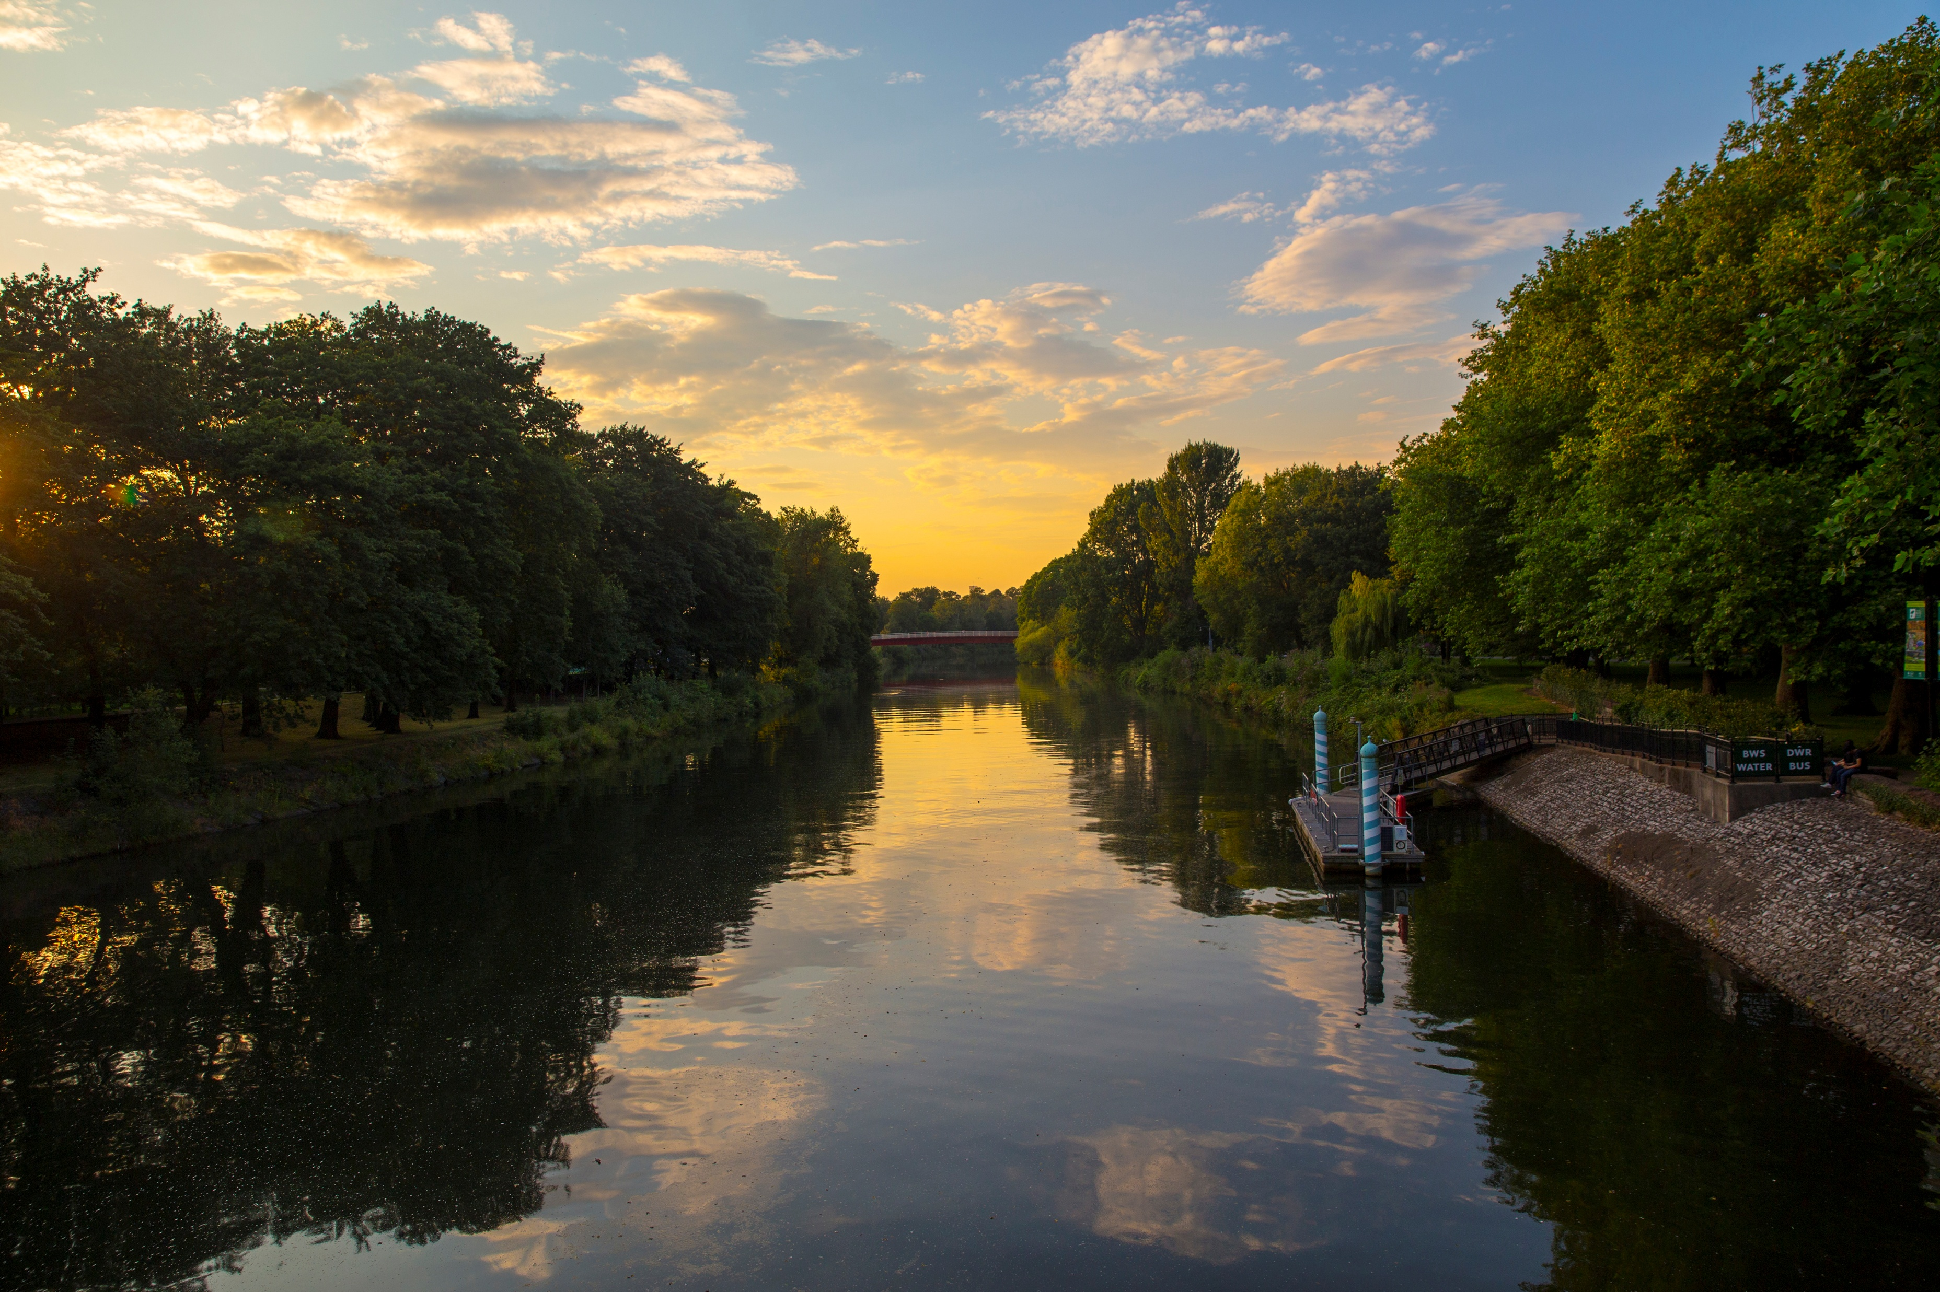
Climate Change
More concentrated, intense rainfall events
Changes in frequency of 100-year and 500-year floods
Sea level rise and storm surges may increase coastal flooding
Climate change may impact CMZs
Climate Change
Notes:
CARAs can be impacted by a variety of factors related to climate change and human development on the landscape. Climate change affects the timing and intensity of precipitation, often resulting in hotter, dryer summers, and more intense rainfall events in the rainy seasons. Intense dry seasons can require people to draw more out of groundwater, especially for watering crops, and disrupt surface water features, like wetlands, which can have a recharging effect on aquifers. Intense rainfall in the wet seasons, combined with increased impervious area from human development, can lead to high peak surface flows and flooding. In this case, more water moves across the surface, and through rivers and streams to the sea, rather than infiltrating into groundwater to be stored. When flooding occurs, floodwaters can become exposed to contaminants and then carry those contaminants to both surface water and groundwater. Sea level rise can also cause saltwater infiltration into aquifers, making the water inside unsuitable for drinking or watering crops. Wildfires can release airborne contaminates that settle into ground and surface waters, and the loss of forest to wildfires increases fast-moving runoff after rain, decreasing the amount of water available to infiltrate into aquifers.

Slide 9
Protection and Permitting Strategies
Larger emergency management framework
Limit, condition, and regulate development in the CAO
No development may cause a net rise in BFE
For rivers and streams connected to Puget Sound: Habitat Assessments required
Engineering and construction standards for building safety
Permitting
Notes:
In its Critical Aquifer Recharge Areas Guidance, the WA Dept. Of Ecology recommends the following steps to regulate development and protect CARAs:
Identify where groundwater resources are located.
Analyze the susceptibility of the natural setting where groundwater occurs.
Inventory existing potential sources of groundwater contamination.
Classify the relative vulnerability of groundwater to contamination events.
Designate areas that are most at risk to contamination events.
Protect by minimizing activities and conditions that pose contamination risks.
Ensure that contamination prevention plans and best management practices are implemented and followed.
Manage groundwater withdrawals and recharge impacts to:
Maintain availability for drinking water sources.
Maintain stream base flow from groundwater to support in-stream flows, especially for salmon-bearing streams.

Slide 10

Key Discussion Points
Mapping and designation resources
FEMA maps required at minimum
FFA Types and Designations
Coastal flood zones, channel migration zones, high groundwater, flood of record and the 500-year floodplain are at County’s discretion to regulate.
Flexibility and Protection
Permit process and report requirements
Discussion
Notes:
• CARA designation and delineation
o In the current county code, CARAs are designated with three levels of sensitivity, and the most sensitive category also includes wellhead protection areas. Language defining and designating CARAs must comply with the definition put forth in WAC 365-190-030 and all requirements of the Growth Management Act.
• Allowed uses
o Currents allowed and prohibited uses are listed in TCC Table 24.10-1. The Planning Commission may recommend changes to allowed, restricted, and prohibited uses.
• Permitting process
o Many uses in CARAs require a Critical Area Review Permit, but no specialized reports are required up-front to submit a permit. Staff may make a determination that reports are needed after initial review. Permitting staff have not recommended any major changes to CARA permitting, besides requests for clarity and consistency with other programs.

Slide 11
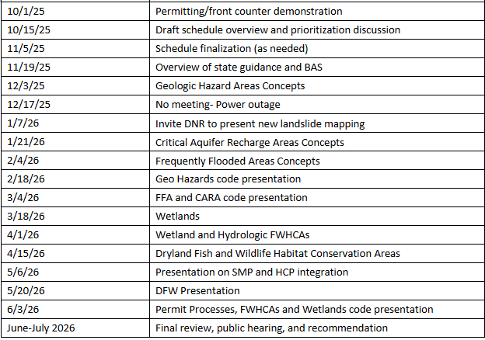
Schedule

Slide 12
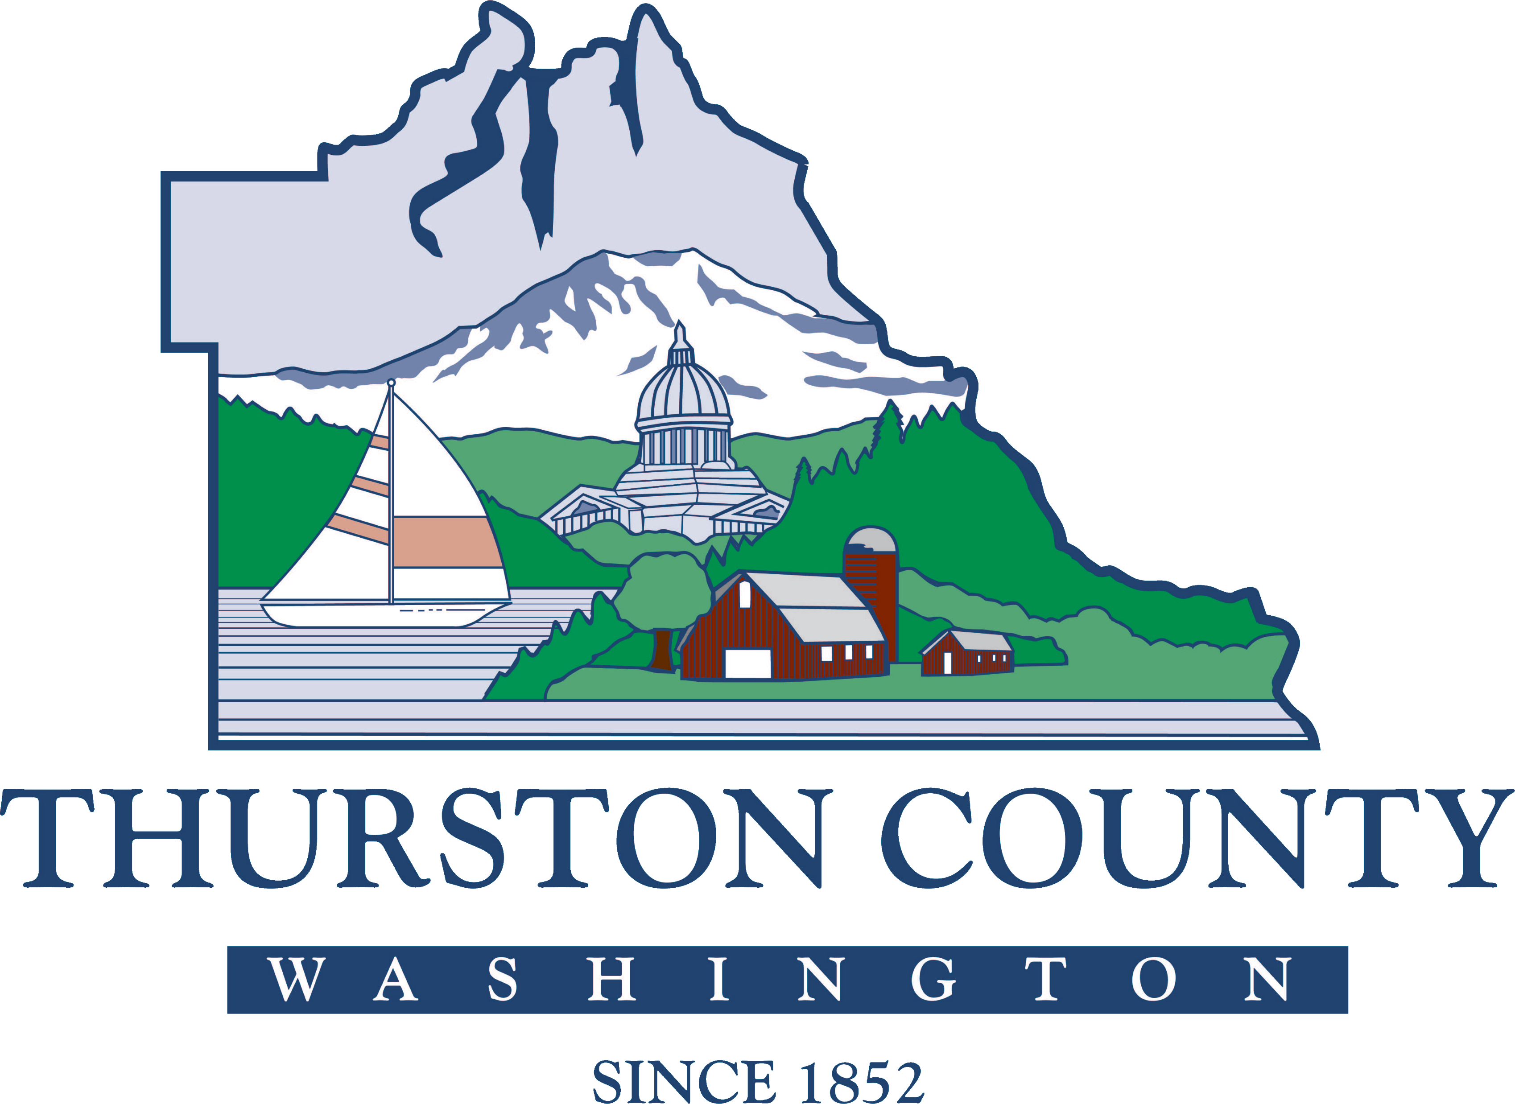
Questions and Comments
Associate Planner Claire Swearingen
(360) 968-9989
claire.swearingen@co.thurston.wa.us
Find future project updates at ThurstonCriticalAreas.org.

