Slide 1


Live COVID-19 Coding and Billing Q&A
Jennifer Bishop, CCS, CCS-P, CIRCC, CHRI
6/9/2020
Jennifer Bishop, CCS, CCS-P, CHRI, CIRCC
VP, Product Content
Ardith Campbell, CPC
Content Product Manager
May 6, 2020
How to Successfully Navigate the New Prior Authorization Process for Hospital Outpatient Departments
A Vitalware Webinar

Slide 2
Disclaimer Statement
This webinar/presentation was current at the time it was published or provided via the web and is designed to provide accurate and authoritative information in regard to the subject matter covered. The information provided is only intended to be a general overview with the understanding that neither the presenter nor the event sponsor is engaged in rendering specific coding advice. It is not intended to take the place of either the written policies or regulations. We encourage participants to review the specific regulations and other interpretive materials as necessary.

Slide 3
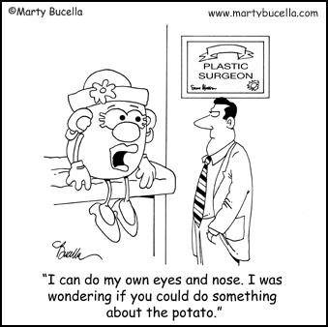
Basics of the New Program

Slide 4
Why Is a Prior Authorization Program Being Implemented?
Providers and patients will know prior to receiving the service whether or not Medicare will pay for the service
MACs will be able to review documentation prior to making the claim determination and can then provide feedback prior to service being performed
Medicare has other prior authorization programs that have worked in the past
The services identified are thought to be at high risk of being inappropriately reimbursed
Notes:
CMS has identified a large increase in the number of OP procedures for these categories over the past 10 years; mostly considered to be cosmetic procedures.
These associated services include, but are not limited to, services such as anesthesiology services, physician services, and/or facility services. Physicians services outside of the OPD will still be paid.

Slide 5
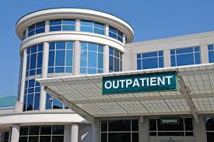
Who Does Prior Authorization Apply To?
Hospital Outpatient Departments Enrolled in the Medicare Fee-for-Services (FFS) Program
Hospital is responsible for obtaining prior authorization
Notes:
Physicians may complete the prior authorization request on behalf of the hospital outpatient department

Slide 6

When Does Prior Authorization Program Begin?
Program begins on July 1, 2020
MACs will begin accepting prior authorization requests on June 17, 2020
Electronic submission of medical documentation (esMD) will be available on July 6, 2020

Slide 7
Which Services Does Prior Authorization Apply To?
Botox Injections
CPT codes 64612 64615 J0585 J0586 J0587 J0588
Panniculectomy
CPT codes 15830 15847 15877, 21235
Vein Ablation
CPT codes 36473 36474 36475 36476 36478 36479 36482 36483
Rhinoplasty
CPT codes 20912 21210 30400 30410 30420 30430 30435 30450 30460 30462 30465 30520
Blepharoplasty
CPT codes 15820 15821 15822 15823 67900 67901 67902 67903 67904 67906 67908 67911
Notes:
20912 Nasal cartilage graft
21210 Repair of nasal or cheek bone with bone graft
21235 Obtaining ear cartilage for grafting
30400 Reshaping of tip of nose
30410 Reshaping of bone, cartilage, or tip of nose
30420 Reshaping of bony cartilage dividing nasal passages
30430 Revision to reshape nose or tip of nose after previous repair
30435 Revision to reshape nasal bones after previous repair
30450 Revision to reshape nasal bones and tip of nose after previous
repair
30460 Repair of congenital nasal defect to lengthen tip of nose
30462 Repair of congenital nasal defect with lengthening of tip of nose
30465 Widening of nasal passage
30520

Slide 8
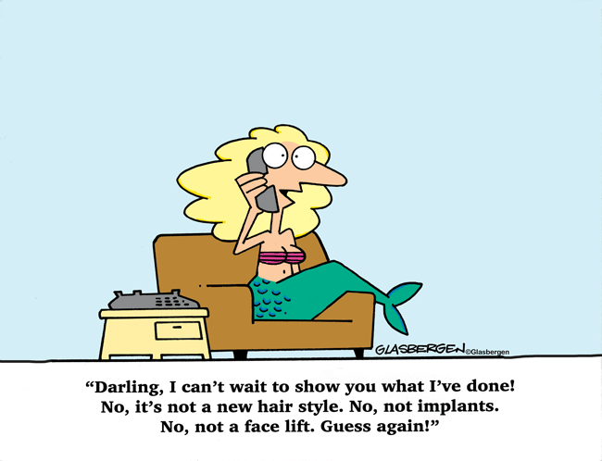
Nitty Gritty Details

Slide 9
Steps in the New Process
Prior Authorization Requests will be submitted to the MACs
Requests can be mailed, faxed, submitted through the MAC’s portal, or submitted through esMD*
MACs will provide an initial determination within 10 business days
Requests may be expedited if patient’s health is deemed to be at risk if procedure is not performed and will receive initial determination within 2 business days
* Will not be available until July 6, 2020

Slide 10
Possible Outcomes Following MAC Review
Provisional Affirmation Decision
Unique Tracking Number (UTN) will be provided
Valid for 120 days from the date the decision is made
Non-Affirmation Decision
UTN will be provided
Any claim associated with a service that requires prior authorization will also be denied – Includes anesthesia, physician’s service, pre-operative testing
MAC will provide information regarding what required documentation is missing or what was deemed to be non-compliant with coverage
Provisional Partial Affirmation Decision
One or more services received provisional affirmation and one or more services received a non-affirmation decision
Notes:
The decision date is counted as the first day of the 120 days

Slide 11
Once an Affirmation Decision is Received
For Electronic Claims
Submit UTN in positions 1-18
For Claims Submitted in Format Other than Electronic
Submit UTN in treatment authorization field (positions 19-32)
Claim should be paid
Could be denied for a technical reason or could be denied if information is found later that was not available at the time of the authorization
Prior authorization will afford some protection from future pre- and post-payment audits
Notes:
CMS reserves the right to review if potential fraud, inappropriate utilization or changes in billing patterns are identified

Slide 12
Options When a Non-Affirmation Decision is Received
Resubmit the Request to the MAC
Include requested information or additional documentation as appropriate
Include UTN provided by the MAC with the non-affirmation decision
Resubmissions are unlimited but decision cannot be appealed in this phase
Provide the service without receiving prior authorization
Claim will be denied
All appeal rights are then available
Notes:
The decision date is counted as the first day of the 120 days

Slide 13
What if Prior Authorization Is Not Obtained?
Claim will be automatically denied
All appeal rights are available
Claims that have an ABN will be stopped for further review
Applies to claims submitted with GA modifier
Validity of the ABN will be reviewed following standard claim review guidelines and timelines
Notes:
The decision date is counted as the first day of the 120 days

Slide 14
Information Required in Request
Initial Submission Documentation
Beneficiary information: Patient Name, Medicare Number, and Date of Birth
Hospital information: Facility Name, PTAN/CCN, Address, and NPI
Physician information: Physician Name, NPI, PTAN, and Address
Requestor Information: Requestor Name, Phone Number, and E-Mail Address
Anticipated Date of Service
HCPCS and Diagnosis Codes
Type of Bill
Units of Service
Whether Request is an Initial or Subsequent Review Request
If Applicable, Reason for Requesting an Expedited Review

Slide 15
Information Required in Resubmission
Resubmission Documentation
All Information Contained in the Initial Submission AND
UTN Associated With the Initial Submission

Slide 16

Exemption for Compliant Providers
CMS May Elect To Exempt Providers Who Demonstrate Compliance
Providers who have submitted at least 10 requests and achieve at least a 90% provisional affirmation rating during a semi-annual assessment may be exempted
Exemption could be withdrawn with 60 days written notice

Slide 17

Things That Aren’t Changing
Dual-Eligible Coverage
A non-affirmation prior authorization decision is sufficient to meet obligation for pursuing other coverage before submitting request for Medicaid coverage
Medicare Coverage and Documentation Requirements
Requirements outlined in LCDs or NCDs will remain the same
ABN Policies and Appeal Rights

Slide 18
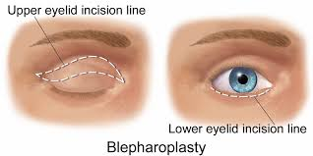
Documentation Requirements for Blepharoplasty
Documented excessive upper/lower lid skin
Supporting pre-op photos
Clinical notes supporting decrease in peripheral or upper field vision
Signed recommendation from a physician or NPP
Documented subjective patient complaints
Visual field studies/exams

Slide 19
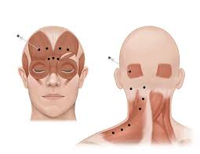
Documentation Requirements for Botox Injections
Support for the medical necessity of the injection
A covered diagnosis code
Dosage and frequency of planned injections
Specific site(s) to be injected
A statement that traditional methods of treatments have been tried and have been unsuccessful
Support for EMG performed in conjunction with injection
Support of the clinical effectiveness of the treatment (for continuous treatment)
Notes:
Special requirements for migraine headaches

Slide 20
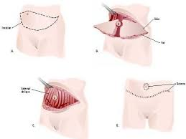
Documentation Requirements for Panniculectomy
Documentation of stable weight loss with BMI less than 35
Description of the pannis and underlying skin
Description of conservative treatment tried and the results
Documentation that the panniculus causes chronic intertrigo, candidiasis or tissue necrosis that recurs over 3 months and is unresponsive to medications
Copies of consultations and operative reports
Pre-op photograph (if requested)

Slide 21
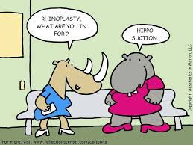
Documentation Requirements for Rhinoplasty
Documentation, with evaluation and management, supporting medical necessity of the service to be performed
Radiologic imaging
Photographs documenting the nasal deformity
Documentation supporting unresponsiveness to conservative medical management

Slide 22
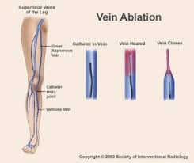
Documentation Requirements for Vein Ablation
Doppler ultrasound
Documentation of the presence or absence of DVT, aneurysm and/or tortuosity
Documented incompetence of the venous valves consistent with the patient’s symptoms and findings
Photographs if the clinical documentation received is inconclusive
A history and physical exam supporting the diagnosis of symptomatic varicose veins and the failure of an adequate (at least 3 months) trial of conservative management

Slide 23
Contact Information
MAC | States Covered | Jurisdictions Covered | Address | Fax | Website
WPS | IA, IN, KS, MI, MO, NE | J5/J8 | WPS GHA – Medical Review PO Box 7953 Madison, WI 53707-7953 | (608) 223-7553 | wpsgha.com
CGS | KY, OH | J15 | GCS Administrators, LLC J15 Part A Prior Authorization Requests PO Box 20203 Nashville, TN 37202 | (615) 782-4486 | cgsmedicare.com/parta/mr/opd.html
NGS | CT, IL, MA, ME, MN, NH, NY, RI, VT, WI | J6/JK | National Government Services PO Box 1708 Indianapolis, IN 46207 | (317) 841-4528 | ngsmedicare.com
Noridian | AK, AZ, CA, HI, ID, MT, ND, NV, OR, SD, UT, WA, WY, AS, GU, MP | JE/JF | Noridian JE (JF) Part A PO Box 6782 Fargo, ND 58108 | (701) 277-2903 | https://med.noridianmedicare.com/web/jea/cert-reviews/pre-claim/prior-authorization-for-certain-opd-services

Slide 24
Contact Information
MAC | States Covered | Jurisdictions Covered | Address | Fax | Website
Palmetto | AL, GA, NC, SC, TN, VA, WV | JJ/JM | Palmetto GBA Part A – Prior Authorization PO Box 100212 Columbia, SC 29202 | (803) 462-7313 | palmettogba.com
Novitas | AR, CO, DC, DE, LA, MD, MS, NJ, NM, OK, PA, TX | JH/JL | Novitas Solutions JH/JL Prior Authorization Requests PO Box 3702 Mechanicsburg, PA 17055 | (877) 439-5479 | novitas-solutions.com/webcenter/portal/MedicareJL/pagebyid?contentId=00229103
First Coast | FL, PR, VI | JN | First Coast Services Options, Inc. JN Prior Authorization PO Box 3033 Mechanicsburg, PA 17055 | (855) 815-3065 | https://medicare.fcso.com/landing/0463251.asp

