Slide 1

In accordance with Federal law and U.S. Department of Agriculture’s policy, this institution is prohibited from discriminating on the basis of race, color, national origin, sex, age, religion, political beliefs, or disability.

Slide 2

Increasing Fruit and Vegetable Consumption
Lesson 3
Insert your organization logo here
Notes:
Today we are going to add color to your plate while increasing your fruit and vegetable consumption.

Slide 3




Welcome Back!
Time for a tech check
OR
Notes:
Instructor Side Note: Greet participants by name when they join and make sure you are pronouncing their name correctly.
Make sure attendees can see/hear, know how to mute/unmute, use video and chat box, rename display name as necessary
[Flipped Model Script] Hello, Welcome back! Lets go ahead and start the day off with a tech check! Are you able to hear and see the slides okay? Are you using a computer or a phone to access the information? If your having trouble - please contact your Food Smarts Educator for assistance.

Slide 4

BRAIN BREAK!
Notes:
Lesson 3 Icebreaker Option: Participants may gather any produce items (fresh, canned, or frozen) from their kitchen. See who can bring the produce item back to the screen the quickest. What did participants bring back?
You may include any icebreaker you would like here. Up to educators discretion.

Slide 5

Group Agreements
Take care of yourself/your needs
What is shared, stays here
No judgement
Be respectful
Keep video on when possible
Notes:
These are ideas that will be in place for all of our classes, so that we can create a safe learning environment for all. Here are a few to get us started, but we can modify or add to this list-
Take care of yourself and your needs
Confidentiality- what is shared here will stay here
No judgement- we all have had different experiences and this is an opportunity to learn from one another
Be respectful of those in the group and yourself
Keep video on when possible- so we can get to know each other

Slide 6
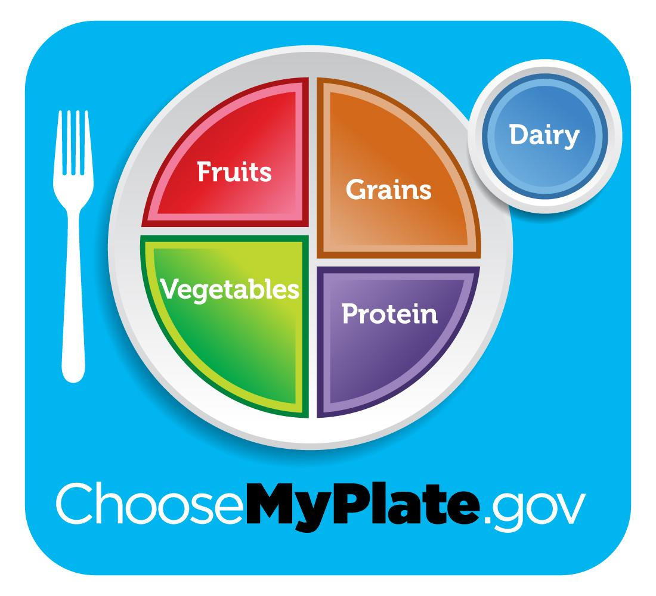
Let’s Review!
What are the 5 food groups shown on the USDA MyPlate graphic?
Notes:
Click screen to make answer appear
Answer: Dairy, Grains, Fruits, Vegetables, and Protein

Slide 7
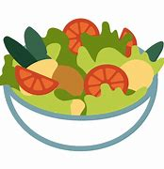
Overview
Activity: My Family’s Eat the Rainbow
Food’s health benefits by color
Recipe demo: [insert recipe title here]
Closing
Notes:
[Flipped Model Script] Welcome to lesson three, one of our favorite lessons. Today we will…..
Have a discussion on our families favorite color of foods through an Eat the Rainbow food activity. Be prepared to share some of your favorite food stories.
We will also learn about all of the health benefits of different fruit and vegetable food colors!
Next, we will take a look at a few food demonstrations that create colorful meals!
Let’s get started!

Slide 8
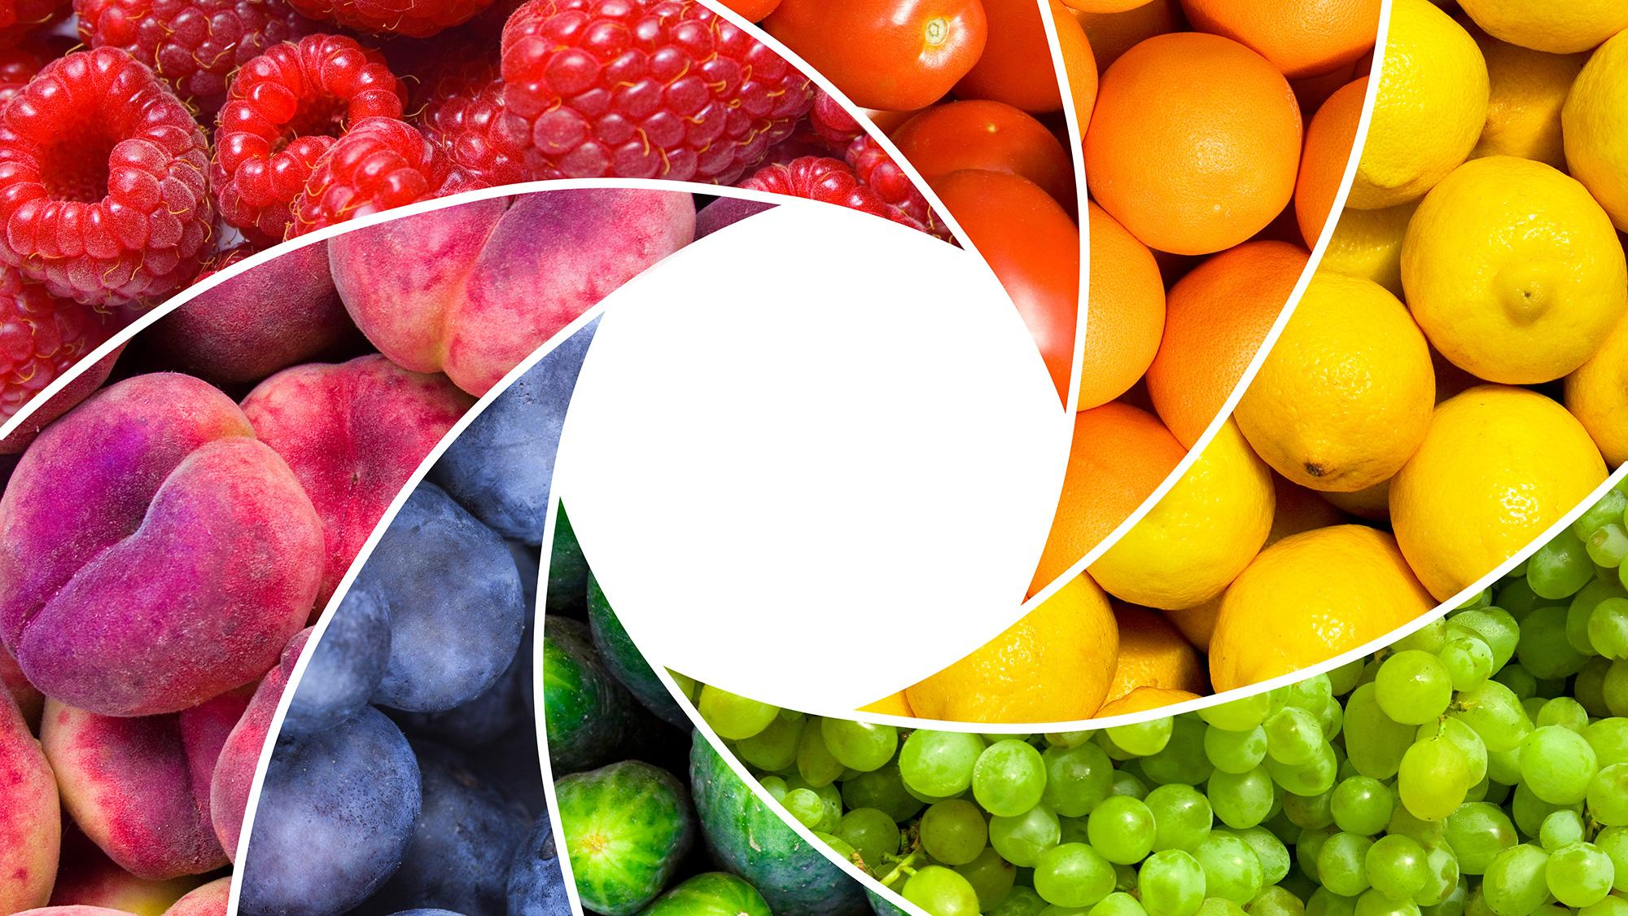
Eat the Rainbow
Different colored fruits and vegetables are full of nutrients. Which color(s) do you eat most?
Notes:
My Family “Eat the Rainbow”
What color(s) of fruit / vegetables do you eat the most?
What are you family favorite go to fruits? What is their least favorite fruit?
What are your family's favorite go to vegetables? What is their least favorite vegetable?
[Flipped Model Script]
Let’s dive into the Eat the Rainbow Food activity. Grab a pen and paper and prepare to write down some your answers to these questions!
What colors of fruits and vegetables do you and your family eat the most? Red foods, blue foods, yellow foods, green foods, orange foods or white foods?
What is your family's favorite kind of fruit? What is their least favorite fruit?
What are your family's favorite go to vegetables? What is their least favorite vegetable?
Now that you have a pretty good idea of what foods you and your family prefer, let’s move on.

Slide 9

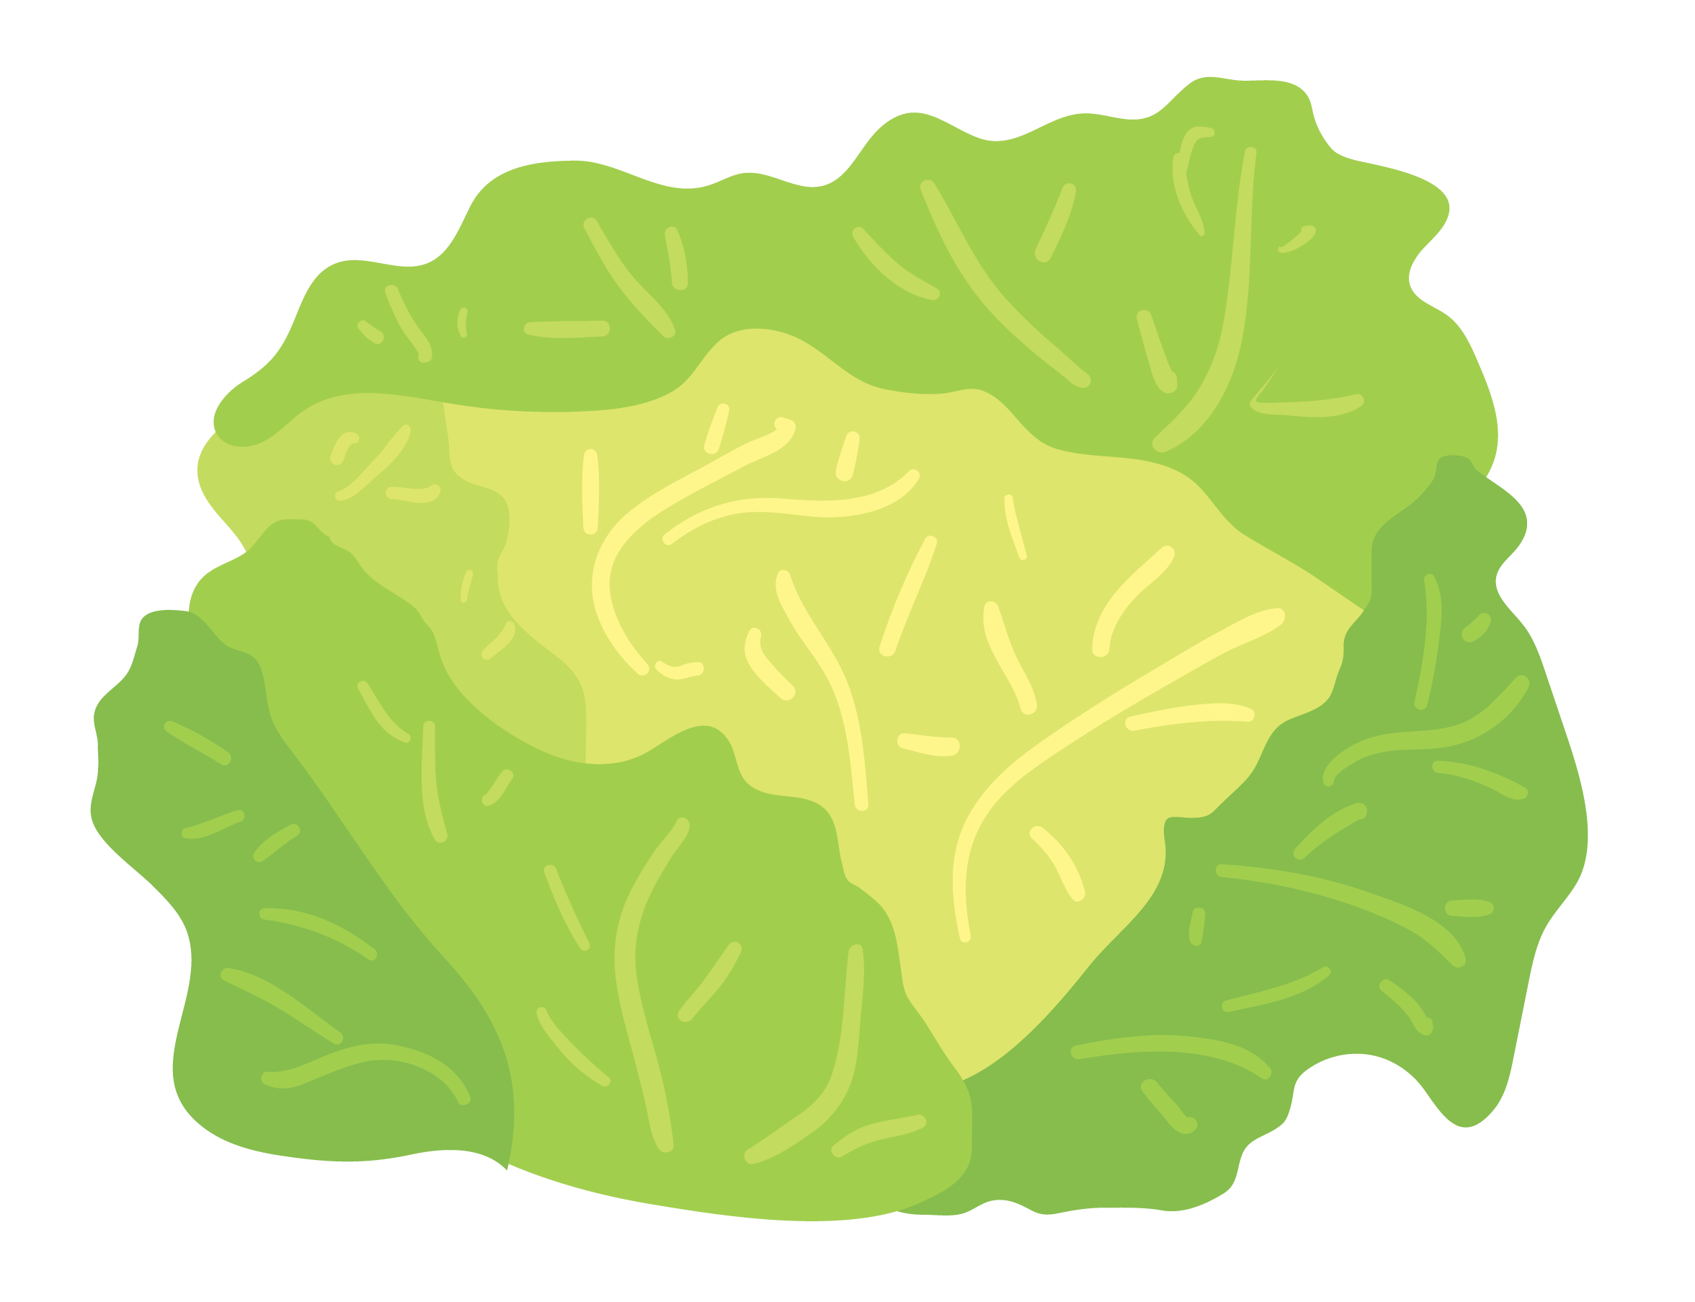
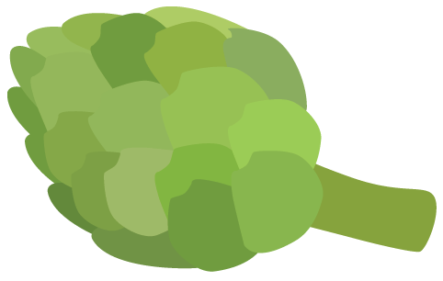


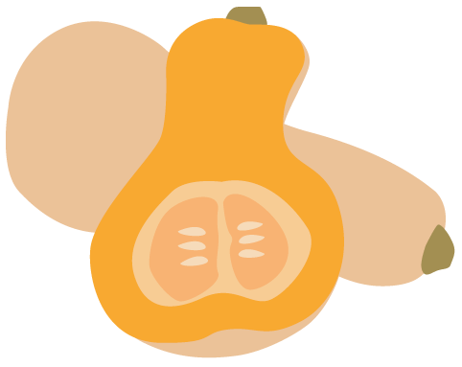


Eat the Rainbow
Green Foods
Lower your chance of getting cancer
Keep your eyes healthy
Keep your bones and teeth strong
Yellow & Orange Foods
Keep your heart healthy
Keep your eyes healthy
Lower your chance of getting cancer
Keep you from catching colds
Notes:
[Flipped model script]
Did you know that each color of food has its own specific health benefits? Eating a wide variety of colorful produce can increase our health and well being in a wide variety of ways.
For example:
Green Foods help lower your chance of getting cancer, help keep your eyes healthy while also keeping your teeth and bones strong!
Go ahead and name off some green colored fruits, vegetables and even herbs!
Spinach, Kale, green apples, broccoli, peas, green beans, bok choy, artichokes, lettuce, zucchini, cilantro, parsley, celery, kiwi, grapes, cucumber, peppers, avocado are all green foods - good job!
Next! Yellow and orange foods help to keep your heart and eyes healthy, while also lowering your chances of getting certain types of cancer. Yellow and orange foods can also help boost the immune system, preventing you from catching a cold or flu. How amazing is that!
What are some of your favorite yellow and orange colored foods? Go ahead and name out some yellow and orange colored produce.
Carrots, Oranges, Lemons, Pineapple, mangos, pumpkin, tomatoes, squash, peaches, nectarines, bananas, peppers and papaya are all yellow/orange foods - good job!

Slide 10

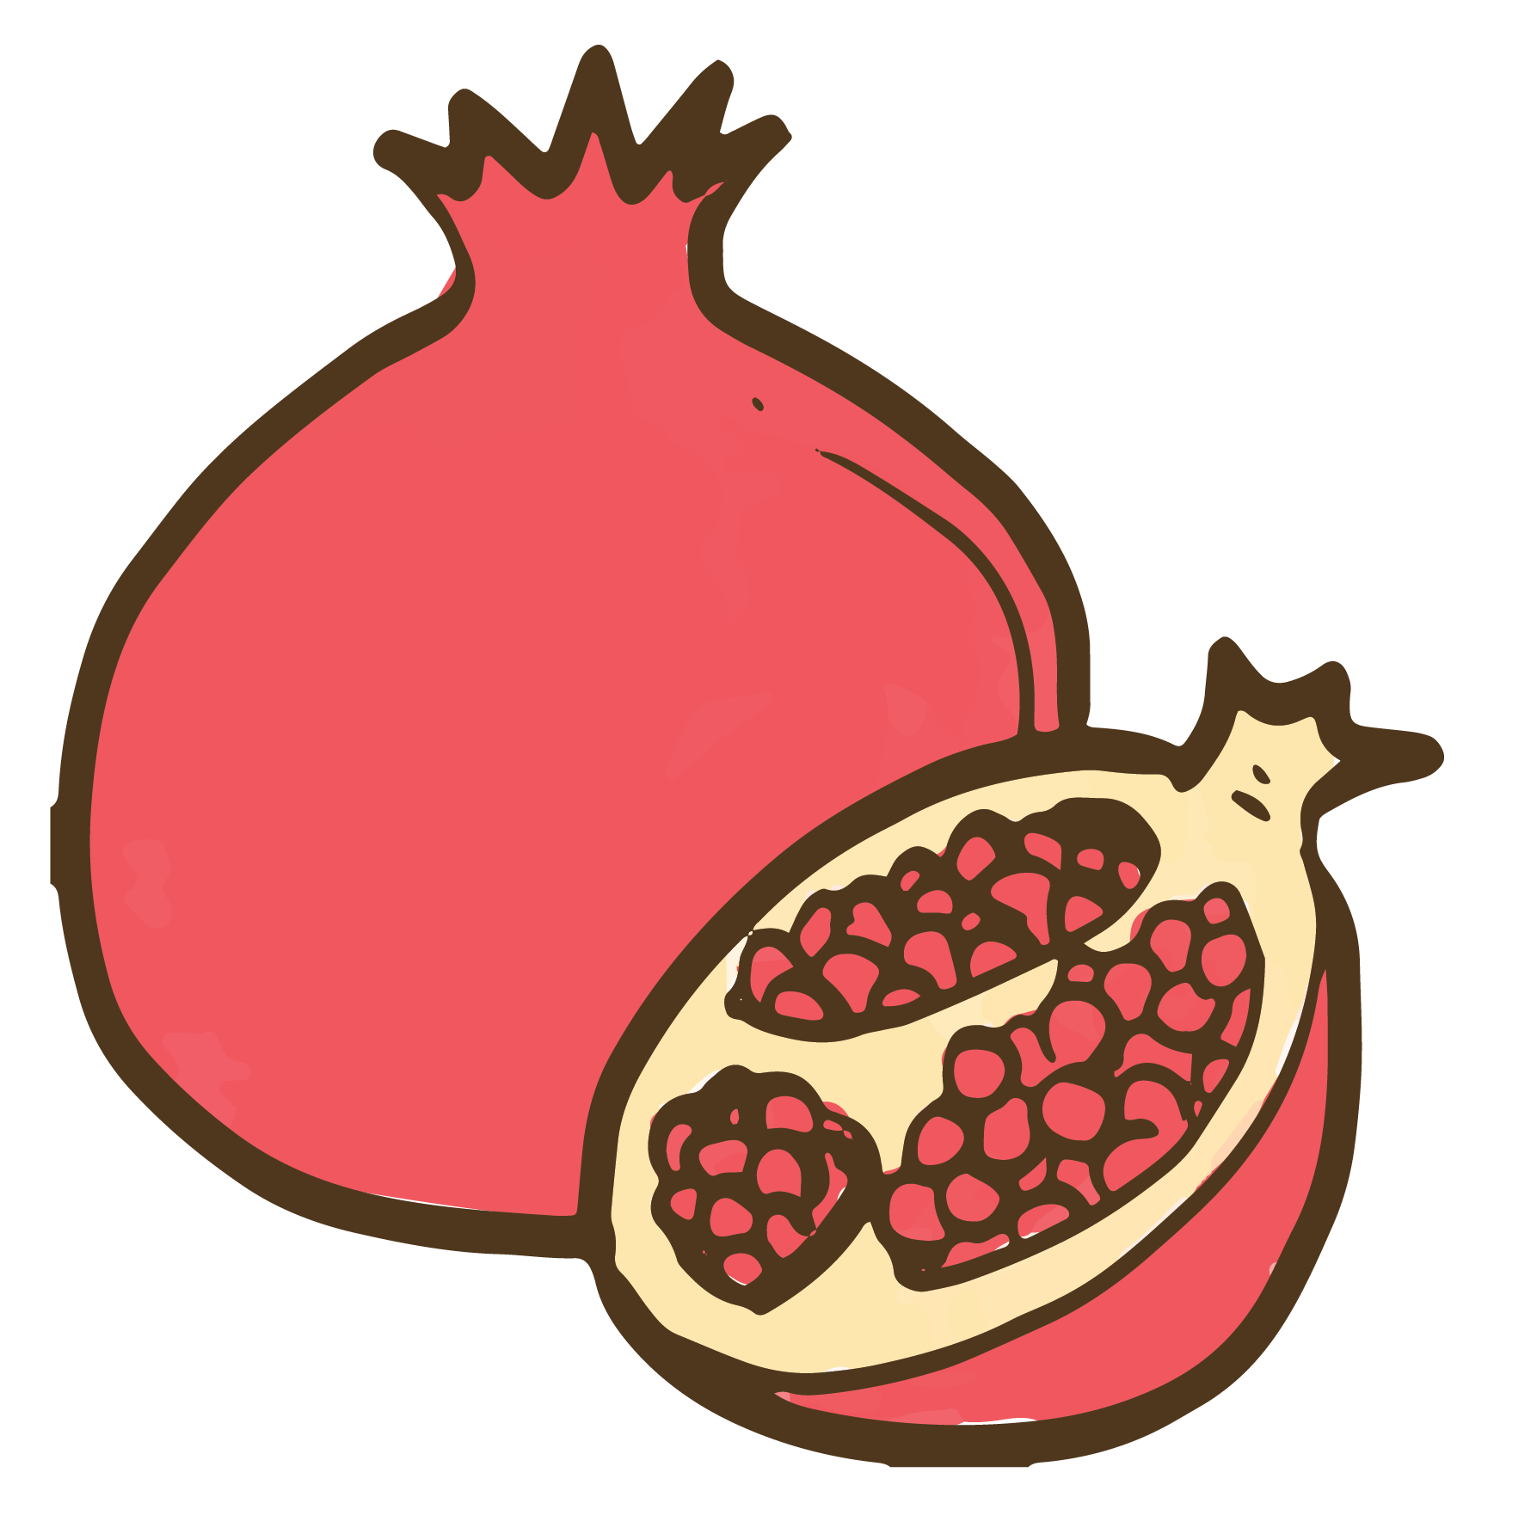
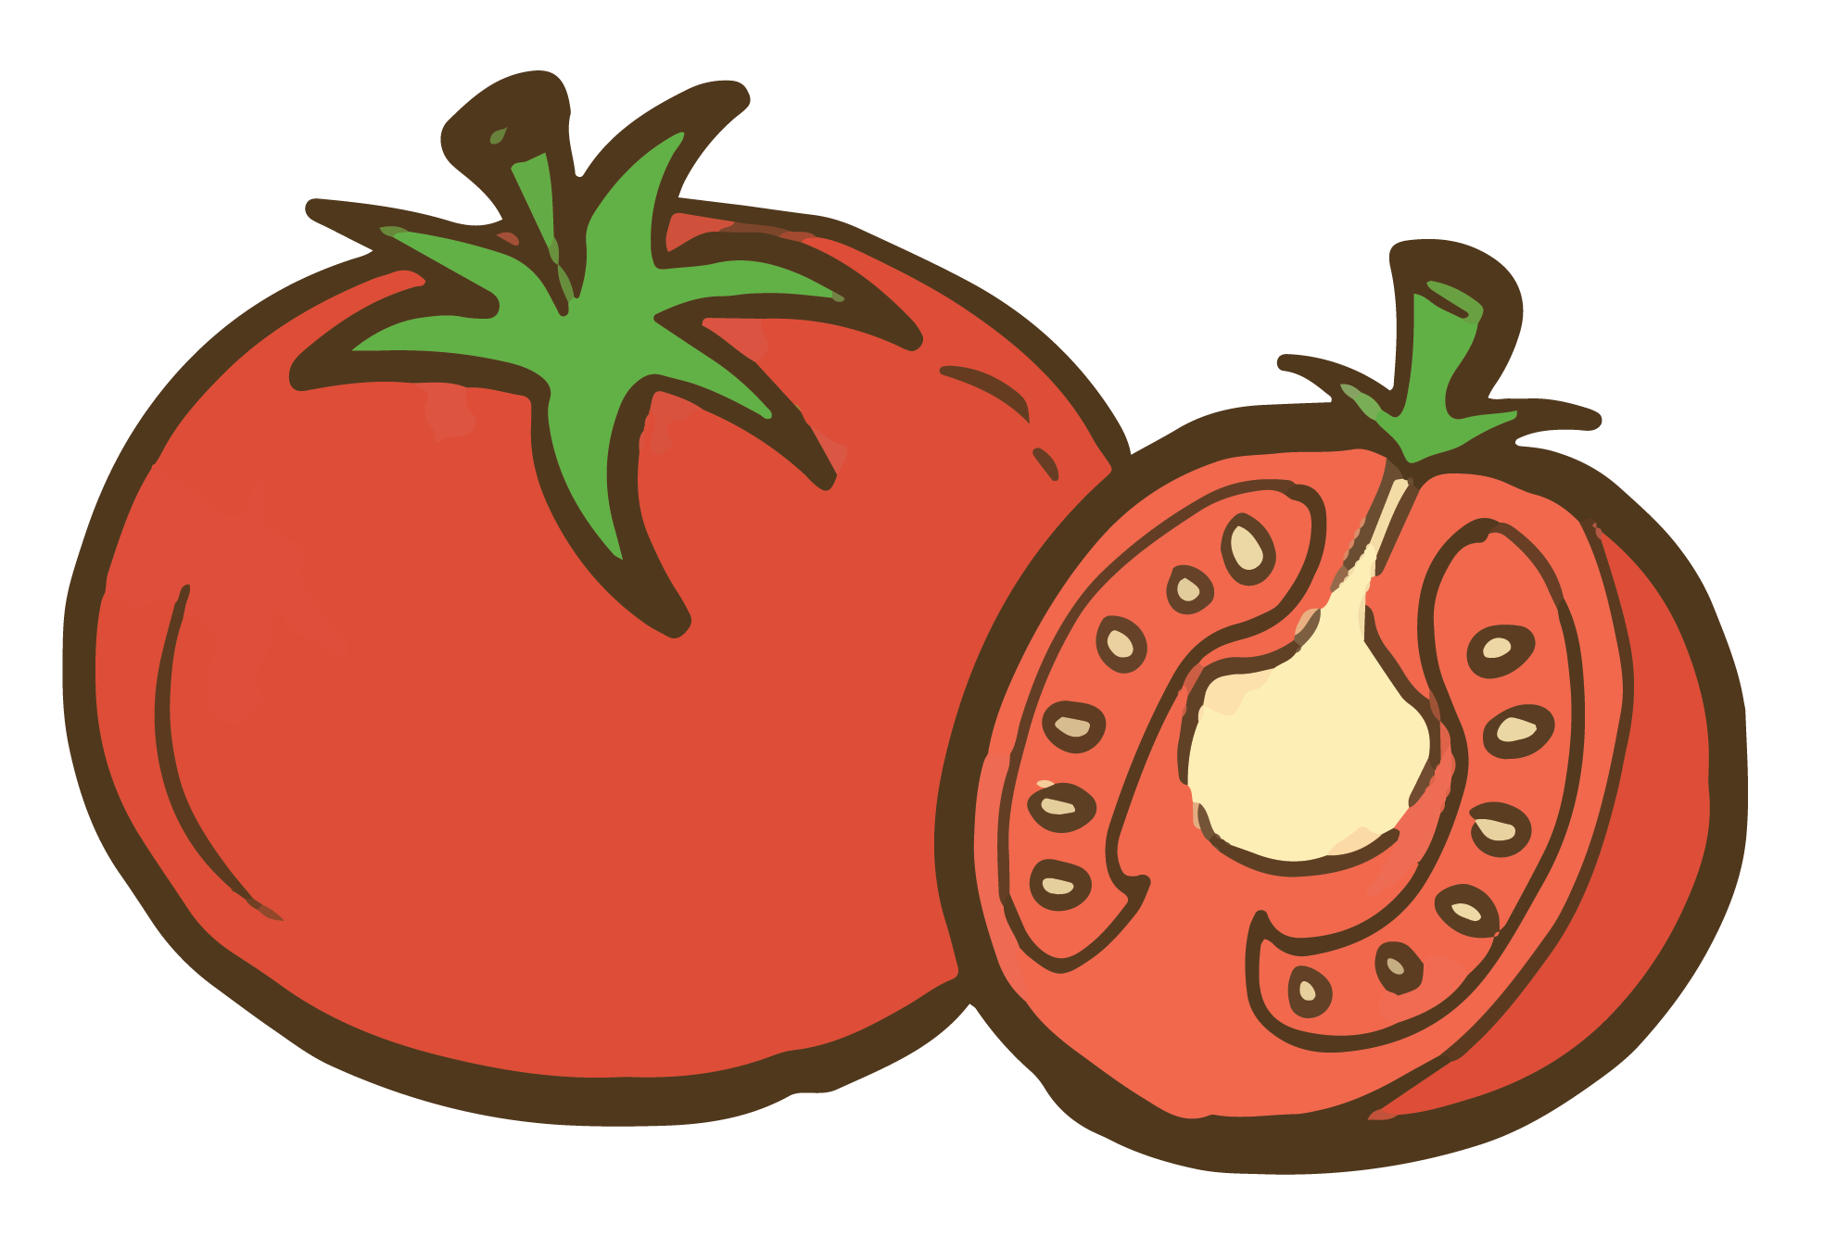
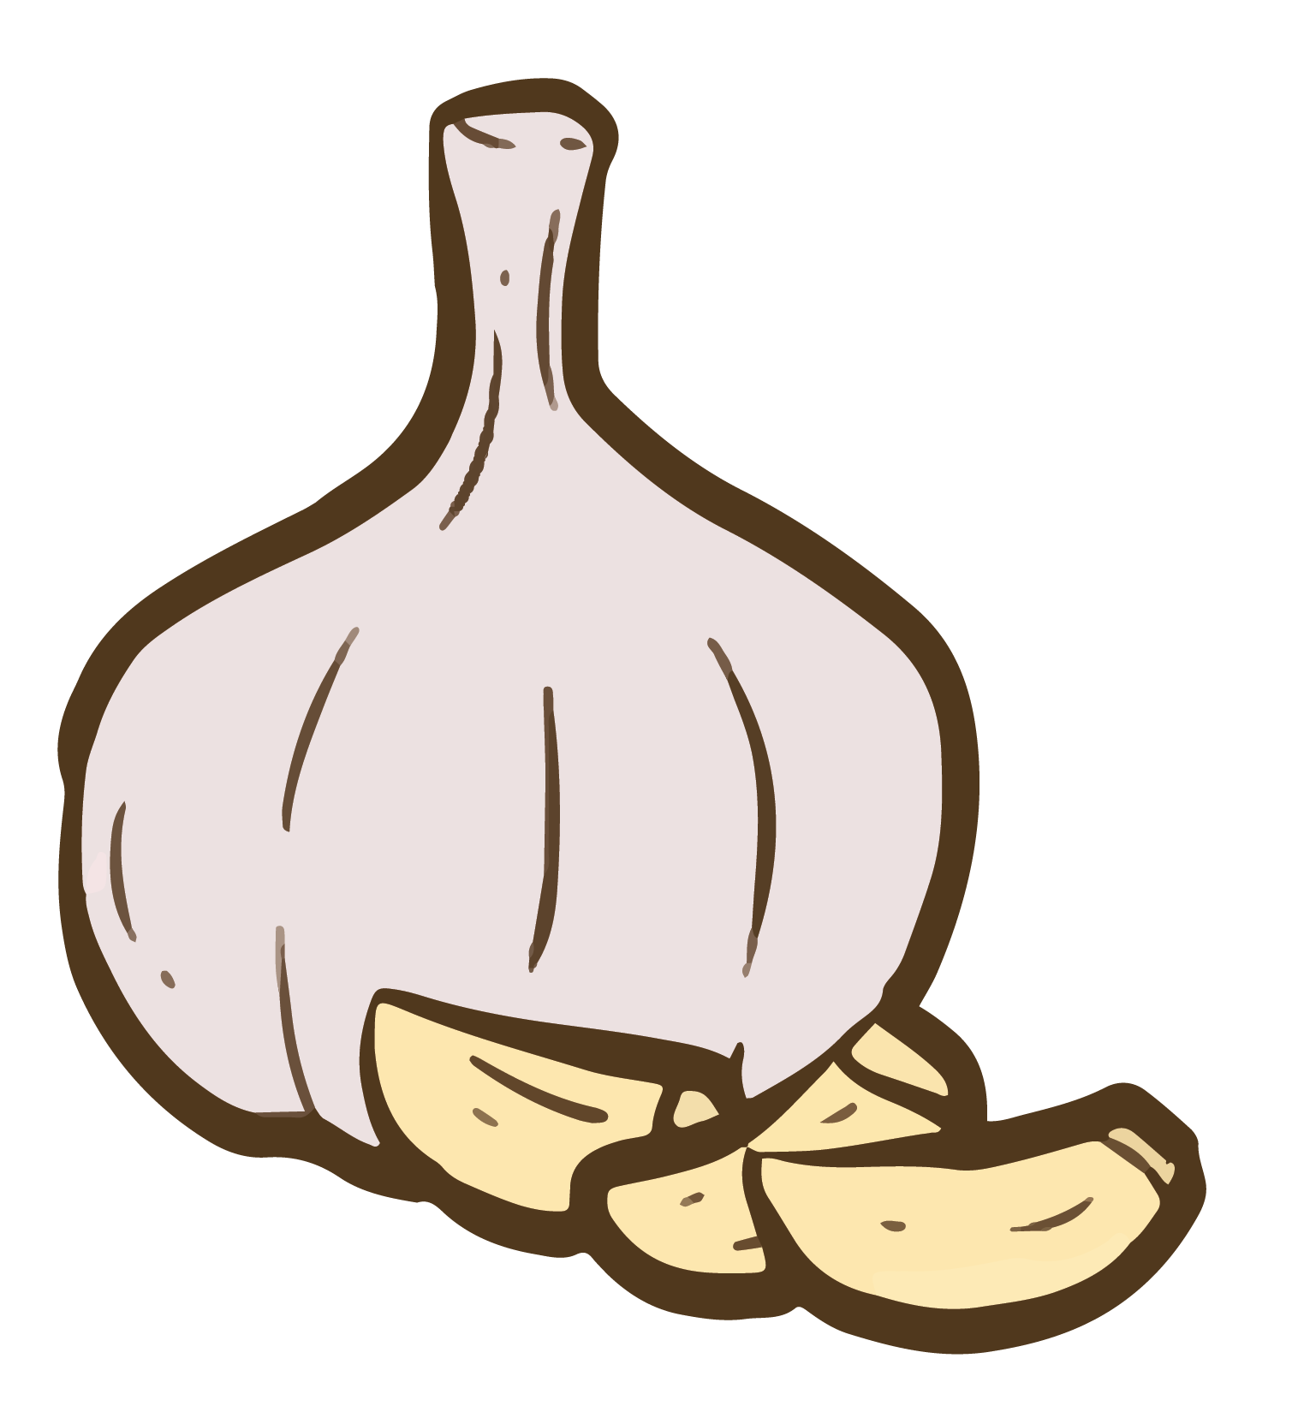
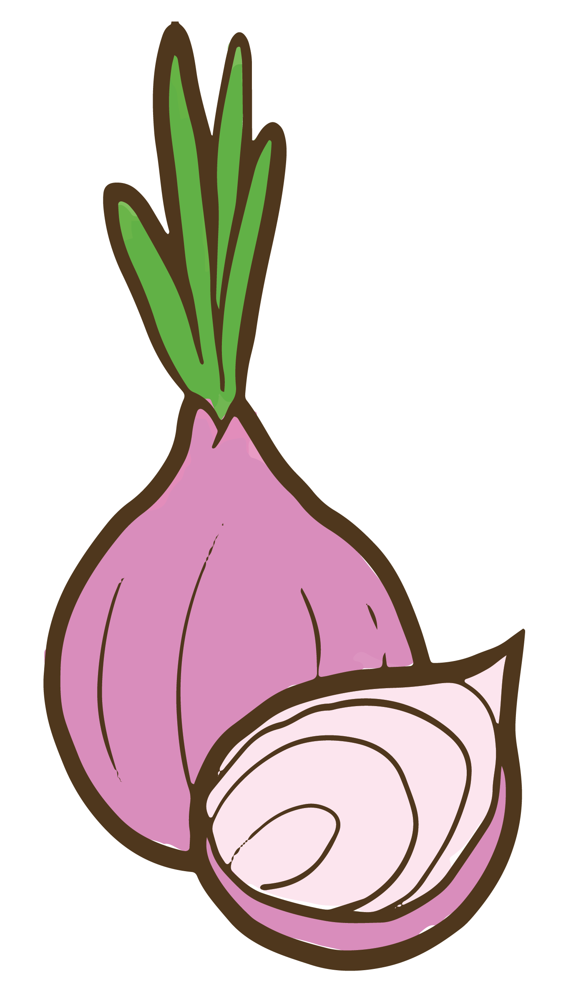

Eat the Rainbow
Red Foods
Keep your heart healthy
Keep your bladder healthy
Keep your memory strong
Lower your chance of getting cancer
White Foods
Keep your heart healthy
Have good cholesterol levels
Lower your chance of getting cancer
Notes:
[Flipped Model Script]
Now, lets go ahead and talk about red foods!
Red foods help keep your heart healthy and strong, as well as the bladder! Red foods also help keep your memory sharp, while lowering your chances of getting certain types of cancer.
Go ahead and name off some red foods that come to mind.
Tomatoes, pomegranate, cherries, apples, strawberries, raspberries, peppers & watermelon are all red foods - good job!
White Foods are also great for building a healthy heart! White foods contain healthy cholesterol levels and also help lowering your chance of getting cancer.
What are some of your favorite white foods? Go ahead and name off some white foods that come to mind.
Onions, potatoes, shallots, cauliflower, ginger, garlic, bananas, pears, mushrooms, leeks, parsnips and jerusalem artichoke are all white foods - good job!

Slide 11




Eat the Rainbow
Blue & Purple Foods
Stay healthy as you age
Keep your memory strong
Keep your bladder healthy
Lower your chance of getting cancer
Notes:
[Flipped Model Script]
Last but not least, we have blue and purple foods!
Blue and purple foods are important because they help you stay healthy as you age. They also help keep your memory strong and sharp! Blue and purple foods also keep your bladder healthy while lowering your chances of getting certain types of cancer.
Go ahead and name off some blue and purple foods!
Grapes, blackberries, beets, eggplant, blueberries, plums, huckleberries and certain types of potatoes are all blue/purple foods - good job!
What blue/purple foods would you add to as smoothie?

Slide 12
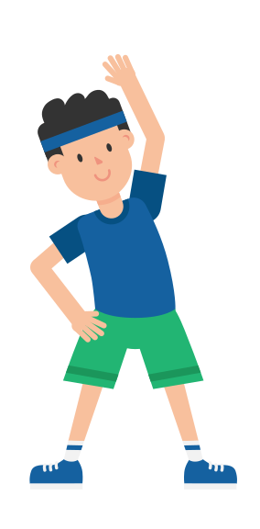
Stretch Break!
Notes:
[OPTIONAL ACTIVITY SLIDE]: If you don’t use this slide then “hide” it when presenting
If you don’t want to do a stretch break, do an ice breaker activity instead.

Slide 13

Now- Let’s check out some
tasty recipes!

Slide 14
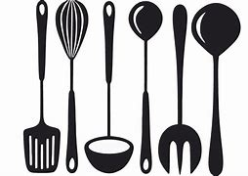
You Voted – Recipe Winner!
INSERT RECIPE LINK HERE
Notes:
Review the recipe that the majority wanted to make and discuss from last week. Add questions about that recipe here. It might be beneficial to put the actual recipe on this slide so you can talk about how to be creative with it or how to make ingredient substitutions.
[Instructor note] Pick the recipe participants voted on from last week in your poll. Discuss which one the majority wanted to discuss/talk about on this slide.
Veggie Bean Wrap:
https://www.youtube.com/watch?v=ZD2pLhwIFTk
Berry Cucumber Salad:
https://www.youtube.com/watch?v=h6MkzR_6Y0E
Creamy Avocado Veggie Dip:
https://www.youtube.com/watch?v=l5FE6Bao9a4
Zucchini Beef Boats
https://www.youtube.com/watch?v=1qgx8_Valy4
[Flipped Model Script]
Lets go ahead and read the following colorful plate recipe ideas:
Veggie Bean Wrap
Berry Cucumber Salad
Creamy Avocado Veggie Dip
Zucchini Beef Boats
What recipe would everyone like to watch today? Go ahead and click on the link to the video you would like to see. If you have time after class, you can go back and look at all of the recipe ideas.

Slide 15
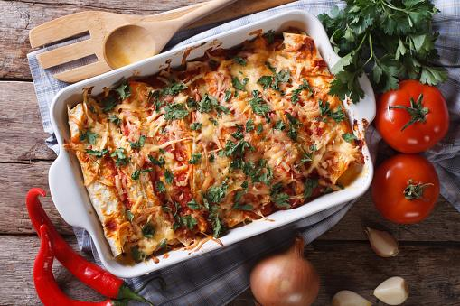
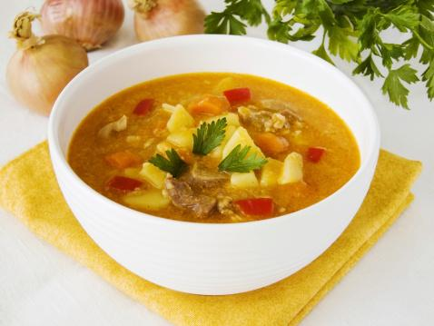
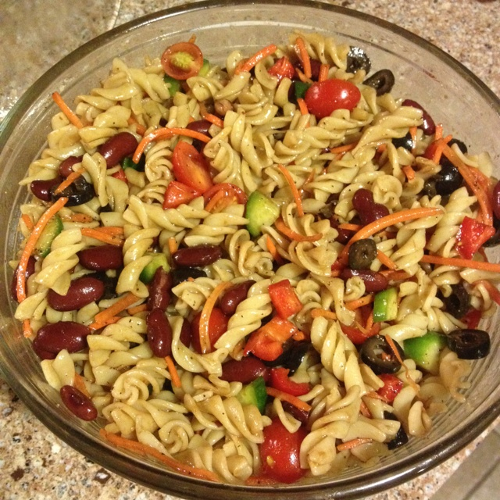
Recipe Poll – For Next Week!
Recipe Time: Time to Vote!
Three Sisters Stew
Minestrone Pasta
Vegetarian Enchilada
Casserole
Notes:
Script: What foods do you like to cook?... Tip for lower sodium, use low-sodium canned foods. Feel free to try out one or all these cooking videos and we can discuss which one you tried in our next meeting
These are all 2-5 minutes long.
[INSERT POLL HERE] What recipe would you like to watch for next week?
Three Sisters Stew
https://www.youtube.com/watch?v=gin1mW30YrA&list=PLTT2Pq-BBsVTRZSL-nSj9dMJeZB7z82-m&index=14
Vegetarian Enchilada Casserole
https://www.youtube.com/watch?v=ik6DCVG1_wU&list=PL8CU6BoIZcYBfA51Xg2wWvpZq_4dUOWRy&index=23&t=0s
Minestrone Pasta
https://www.youtube.com/watch?v=ydg-l7enLDk&list=PL8CU6BoIZcYBfA51Xg2wWvpZq_4dUOWRy&index=21

Slide 16
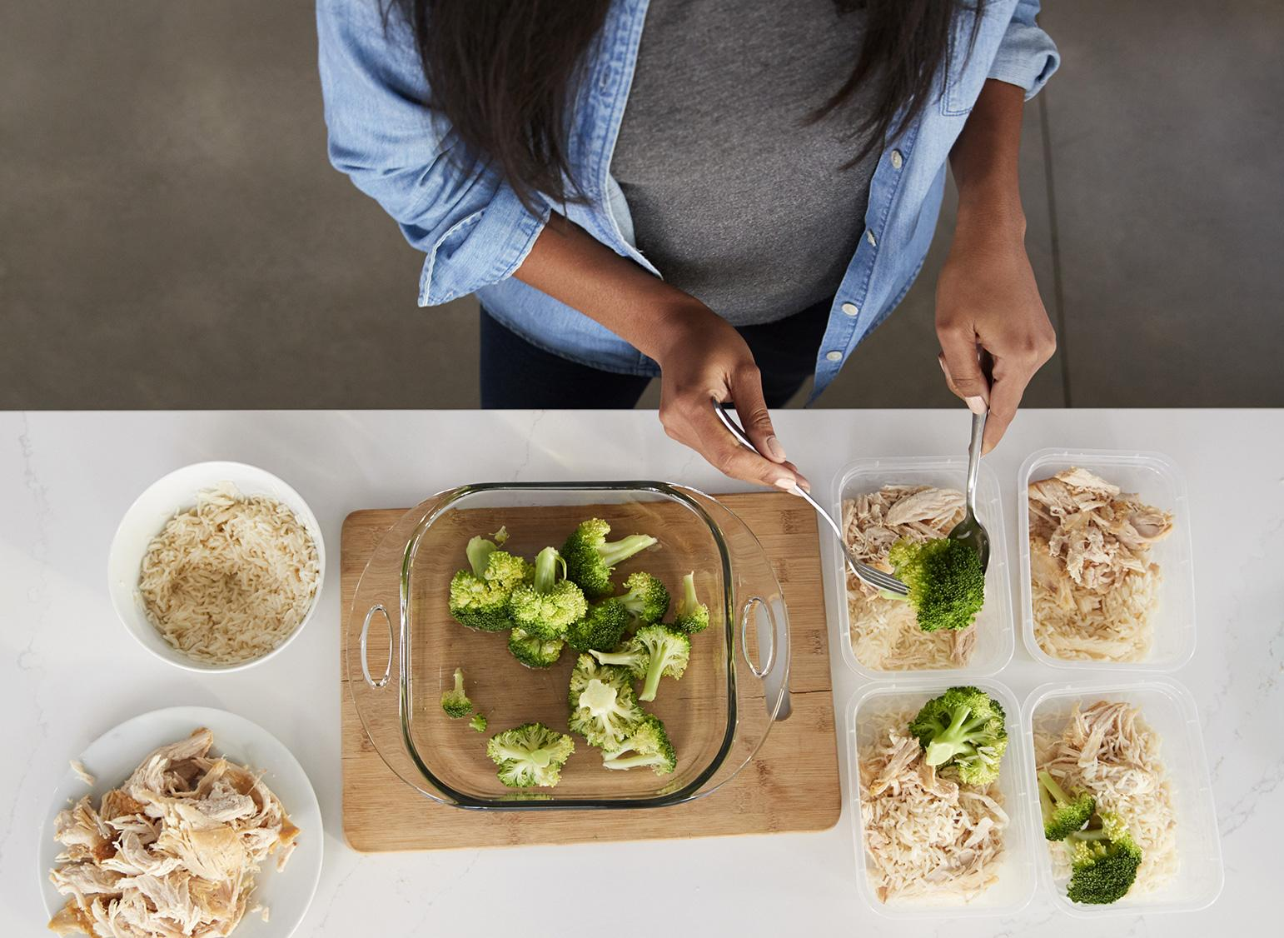
Cooking for One
Tips:
Plan meals.
Cook when you have the most energy.
Eat the most perishable first.
Cook large batches and freeze.
Buy only what you’ll eat.
Keep a stocked pantry.
Buy in bulk.
Share with a friend or neighbor.
Notes:
[OPTIONAL ACTIVITY SLIDE]: If you don’t use this slide then “hide” it when presenting
Plan your meals each week. Use the same ingredients in many meals but in different ways. For example, buy vegetables that can be eaten both cooked and raw like celery; use in soups, sandwiches, stir-frys and salads.
Cook or prep when you have the most energy. Cut up fruits and vegetables to store, or prep an entire meal. Dinner doesn’t have to be the biggest meal of the day, if you have more energy and time in the middle of the day eat your biggest meal then.
Eat the most perishable produce first like lettuce, and save heartier produce like broccoli. Even better—stock up on vegetables like winter squash, onions, and potatoes that last for months outside the fridge.
Cook larger batches and freeze. Cook batches of grains and beans and freeze for easy additions to meals. Soups and casseroles freeze well in single-serving portions.
Buy only what you’ll eat. Even if single servings are more expensive at the grocery store, it will still be cheaper than eating out.
Keep a stocked pantry. You’ll be more likely to cook if you already have long lasting ingredients like dried goods and seasonings.
Buy in bulk. If you lack storage space, ask a friend to split the bill and the groceries. Choose items that last a long time.
Bring extras to a friend or neighbor. Hopefully, they will return the favor!
Sample meals:
Eggs are a great single-serving dish. Add veggies, cheese and whole grain toast to make a satisfying meal.
Start with a dried grain like rice or pasta, add veggies (fresh, frozen or canned), a protein like salmon (fresh, frozen, or canned), and a sauce or flavorings like olive oil and garlic, or soy sauce and ginger.
Use cooked chicken in a salad with nuts and fruit, or on a sandwich with whole wheat bread.
Make a Chinese inspired noodle dish: mixed cooked pasta or soaked rice noodles, and stir-fried veggies with a mixture of soy sauce and peanut butter.
Mix cooked couscous with a dressing of vinegar, olive oil, salt and pepper and lots of fresh veggies, black beans and canned corn.

Slide 17
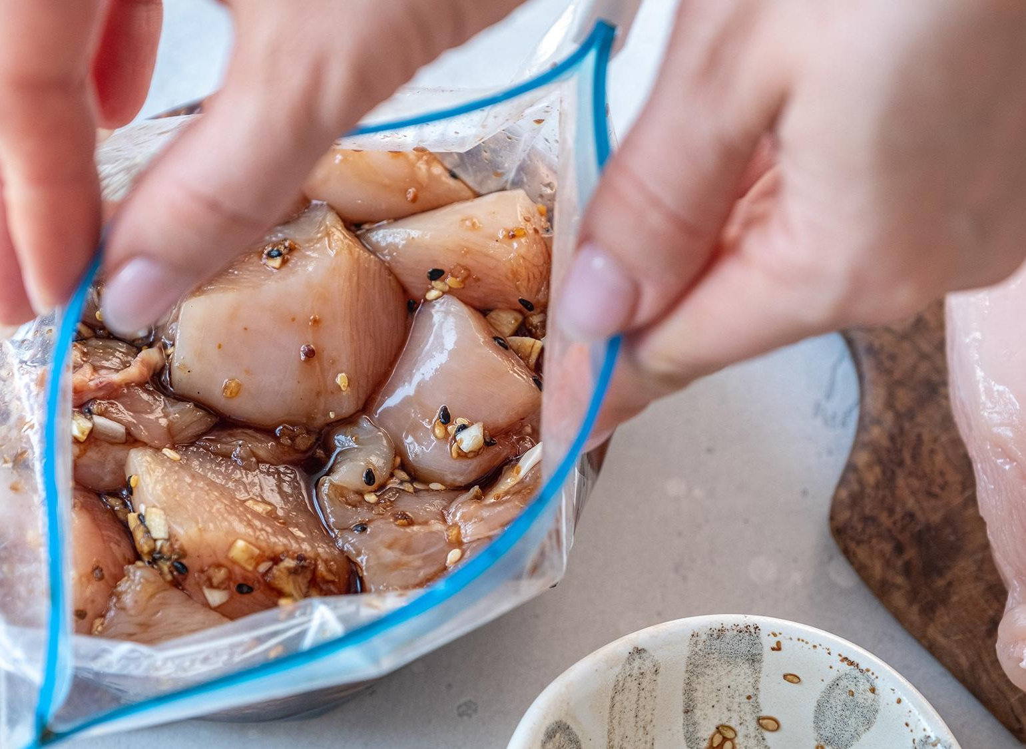
Eating Well When Low on Time or Energy
Tips:
Learn how to chop efficiently.
Use a sharp knife.
Learn to eyeball measurements.
Lay out equipment in the morning.
Enlist helpers.
Try a crock-pot or rice cooker.
Double the yield.
Prep veggies in bulk and freeze.
Notes:
[OPTIONAL ACTIVITY SLIDE]: If you don’t use this slide then “hide” it when presenting
Here are some tips.
Learn how to chop vegetables quickly and efficiently. Most people chop onions slowly. Take a few minutes to learn to do it quickly.
Pre-chop vegetables on the weekend or in the morning to cut down on time spent on evening prep. Or, chop more veggies than you need so you are preparing for the next meal. Put them in a reusable containers or plastic bag to store in the refrigerator.
Use a sharp knife. Dull knives are dangerous and require much more energy to use. Also, avoid using a small knife for larger foods.
Learn to eyeball common measurements; know what one cup of chopped veggies looks like on a cutting board or a teaspoon of a spice in the palm of your hand. In most cases, it’s not essential to be exact (baking is an exception).
Get a head start. In the morning, lay out any pots or pans you’ll need in the evening. If your veggies are already chopped and your pots laid out, you are more likely to cook.
Enlist helpers. Have kids in the house? Ask them to wipe and set the table, wash the veggies, or help gather the ingredients.
Try a different tool. Slow cookers (crock-pots) and rice cookers are great time savers and often available for a few dollars at second-hand stores.
Double the yield. Cook extra chicken one night that can be made into a few different meals like tacos or soup, or used as a salad topper.
Keep prepped veggies in the freezer. Always have frozen vegetables in the freezer—no need to wash or chop!

Slide 18
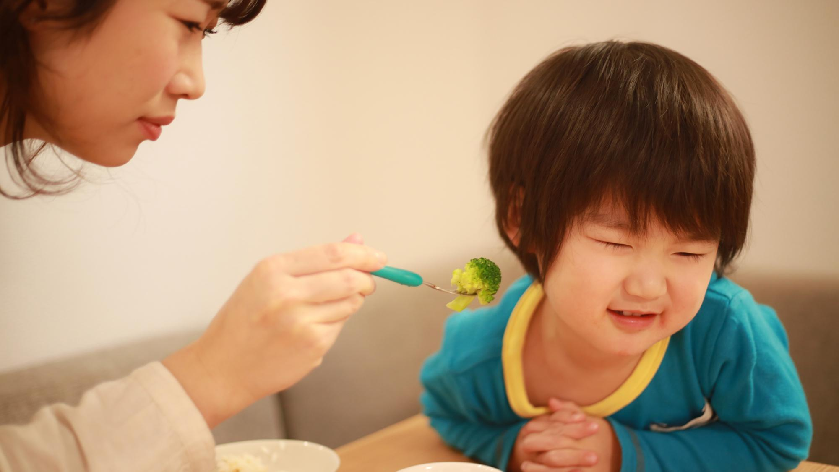
Positive Feeding: Toddlers & Preschool
What are some challenges to feeding your young child?
Notes:
OPTIONAL ACTIVITY [Slides 18-27]: If you don’t use this slide then “hide” it when presenting

Slide 19
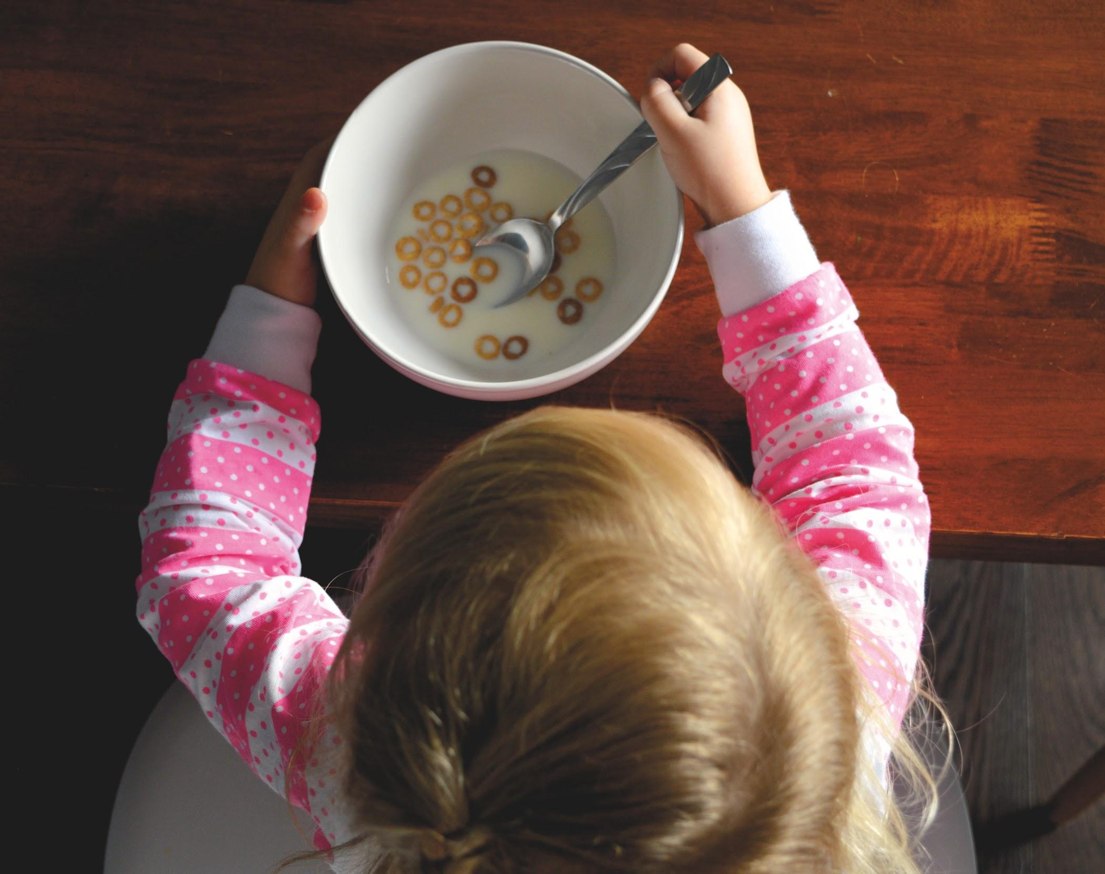
Positive Feeding: Toddlers & Preschool
What are the challenges to feeding your young child?
Toddlers...
are growing teeth, but are still at high risk
for choking.
may change tastes and appetite from
day to day.
may prefer foods in their simplest form
(without sauce or mixed with other foods).
like to “play” with food using all their senses;
plan for this rather than discouraging it.
Notes:
[OPTIONAL ACTIVITY SLIDE]: If you don’t use this slide then “hide” it when presenting
[Slide 2 of 5]
Young children learn by imitation. Enjoy eating fruits, veggies, and whole grains, and eventually your kids will, too!

Slide 20
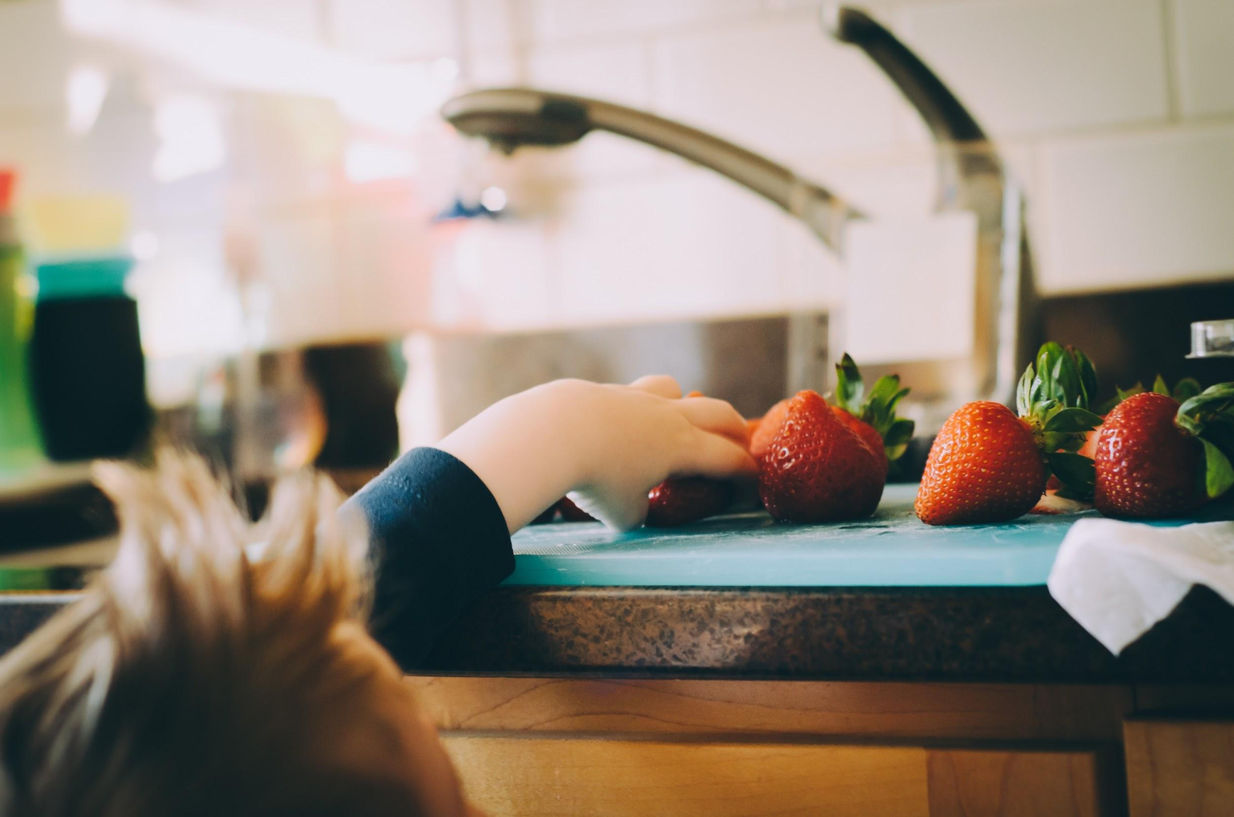
Positive Feeding: Toddlers & Preschool
What are the challenges to feeding your young child?
Preschoolers...
may need to be exposed to new
foods many times before
acceptance.
are ready for more structured
mealtimes and food routines.
are more exposed to processed
foods outside the home but can
begin to learn about healthy
decision-making.
Notes:
[OPTIONAL ACTIVITY SLIDE]: If you don’t use this slide then “hide” it when presenting
[Slide 3 of 5]
Young children learn by imitation. Enjoy eating fruits, veggies, and whole grains, and eventually your kids will, too!

Slide 21
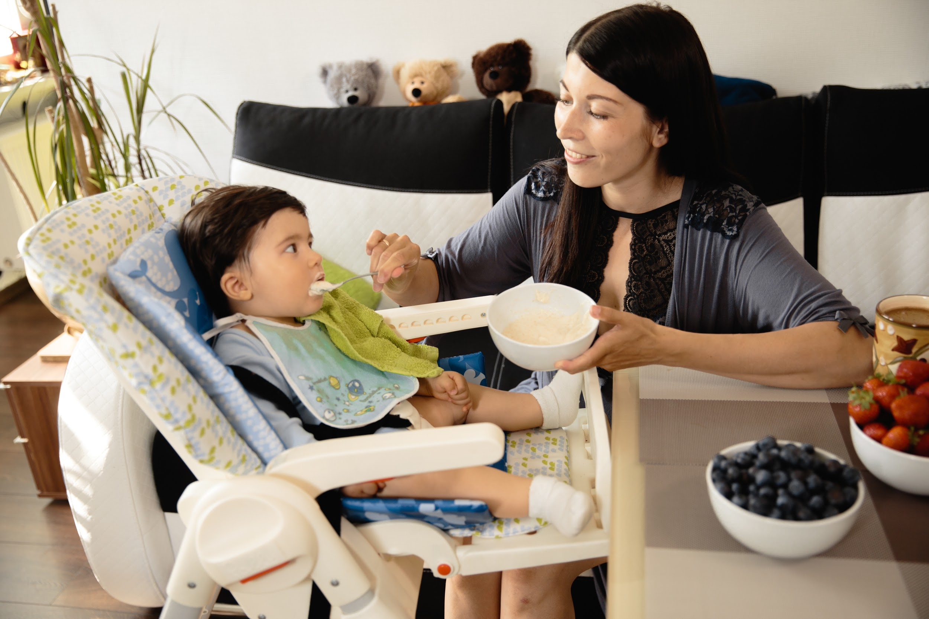
Positive Feeding: Toddlers & Preschool
What to offer?
16-24 oz whole milk per day for kids 12-24 months. Switch to low-fat at 24 months.
After age 1, tummies can handle berries, tomatoes, citrus, and honey.
Three meals plus two healthy snacks per day at predictable times.
Mild versions of whatever the rest of the family is eating. It’s not necessary to cook a separate menu.
Notes:
[OPTIONAL ACTIVITY SLIDE]: If you don’t use this slide then “hide” it when presenting
[Slide 4 of 5]

Slide 22
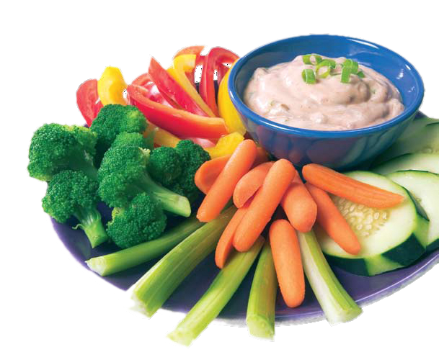
Positive Feeding: Toddlers & Preschool
Do you have a picky eater?
Your child might become more “picky” as he or she gets older. This is normal!
Be patient as your child tries new foods. He or she may need to try something several times before accepting it. Patience works better than pressure.
Never force a child to eat. Young kids eat different
amounts every day.
Young kids love to dip! They may be more willing to
try new foods they can dip it in yogurt, hummus, nut
butter, or salsa.
Notes:
[OPTIONAL ACTIVITY SLIDE]: If you don’t use this slide then “hide” it when presenting
[Slide 5 of 5]

Slide 23
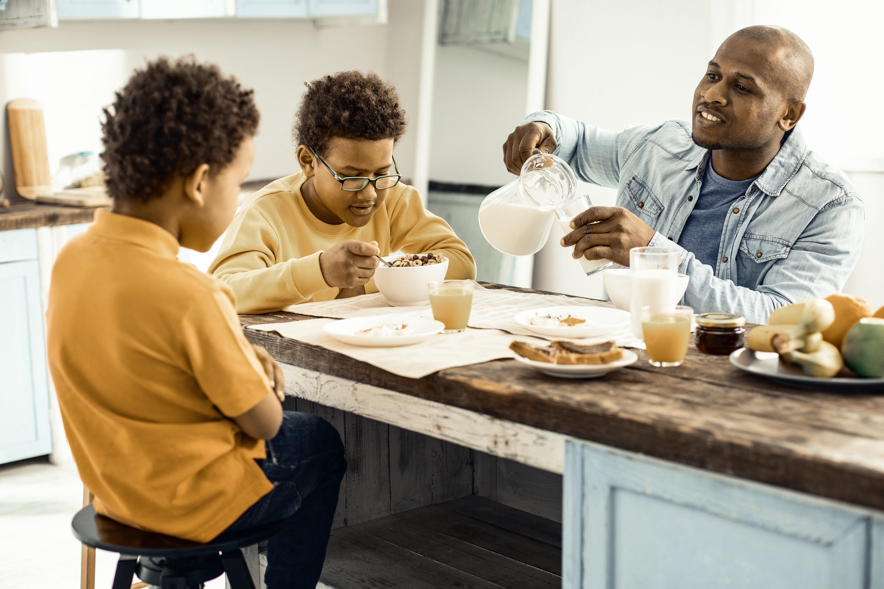
Positive Feeding: Toddlers—School-Age
Make time for mealtime!
Cook together, eat together, talk together.
Turn off the TV and cell phones. Make mealtime family time!
Involve kids in the process of preparing meals and cleaning up.
Remember: You decide what and when to eat, kids decide how much.
Notes:
[OPTIONAL ACTIVITY SLIDE]: If you don’t use this slide then “hide” it when presenting
[Slide 1 of 1]

Slide 24
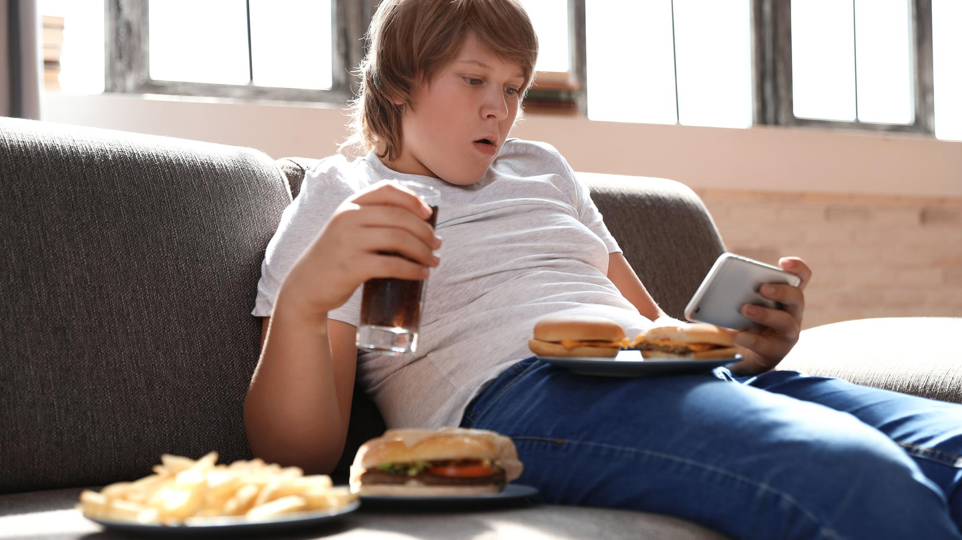
Positive Feeding: School-Age Kids
What are some challenges to feeding your growing child?
Notes:
[OPTIONAL ACTIVITY SLIDE]: If you don’t use this slide then “hide” it when presenting
[Slide 1 of 4]
What are the challenges to feeding your growing child?

Slide 25
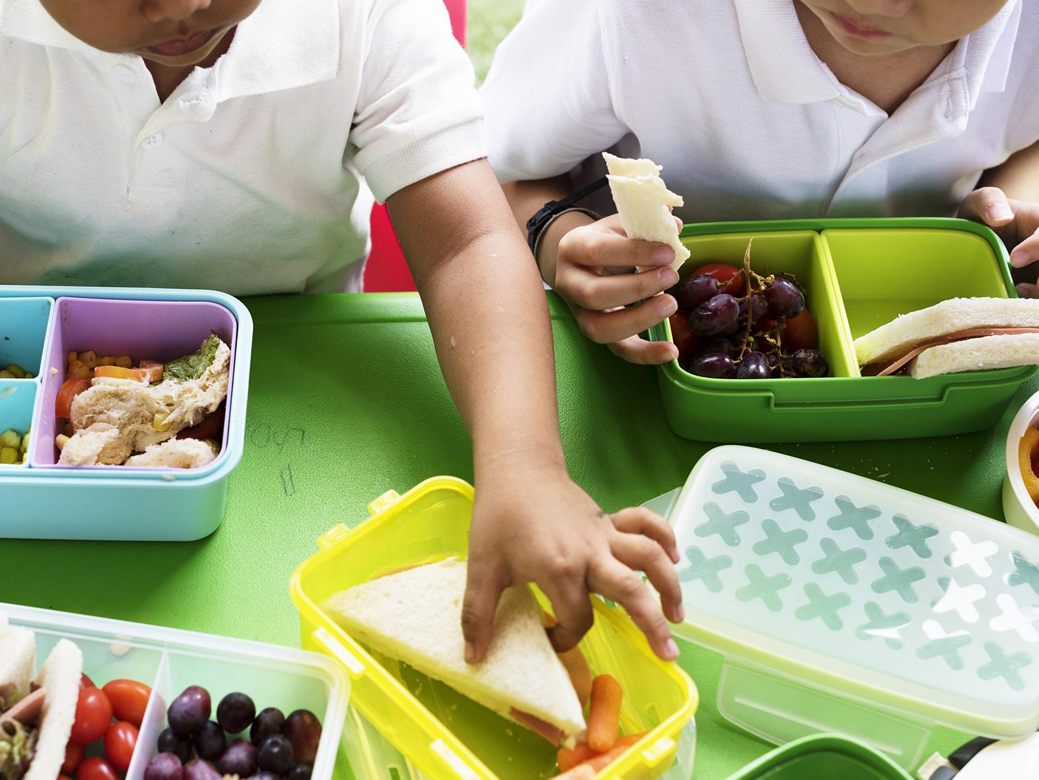
Positive Feeding: School-Age Kids
What are the challenges to feeding your growing child?
Elementary school kids...
are beginning to understand where
food comes from and that some foods
are good for growing bodies.
need to be active every day for physical
and mental health.
want to do things their peers are doing.
may feel guilty about eating animals.
benefit from structured meal times as
hey develop decision-making skills.
Notes:
[OPTIONAL ACTIVITY SLIDE]: If you don’t use this slide then “hide” it when presenting
[Slide 2 of 4]
Elementary School Kids...
are beginning to understand where food comes from and that some foods are good for growing bodies.
need to be active every day for physical and mental health.
want to do things their peers are doing.
may feel guilty about eating animals.
benefit from structured mealtimes as they develop decision-making skills.

Slide 26
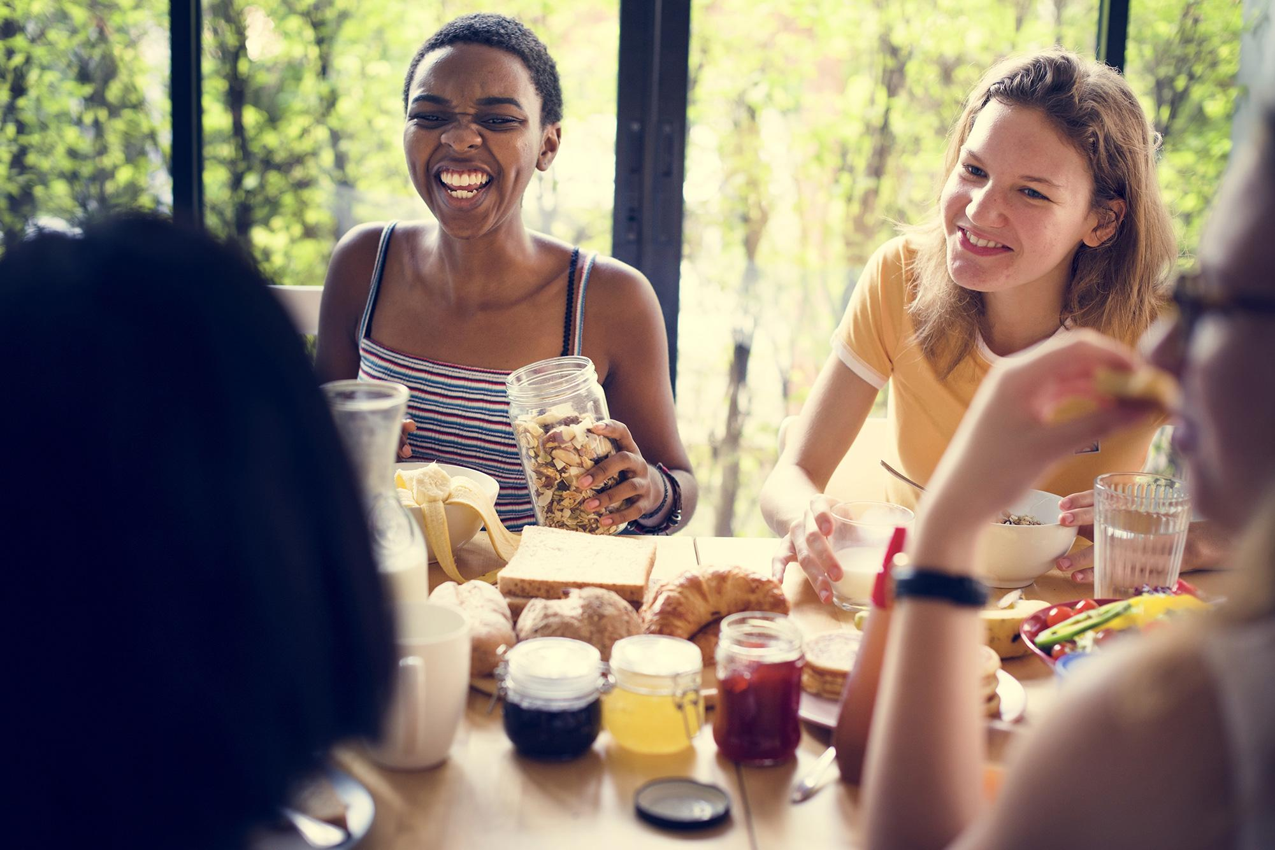
Positive Feeding: School-Age Kids
What are the challenges to feeding your growing child?
Adolescents...
need to be active every day for physical
and mental health.
may start to see connections between
diet, physical appearance, and health.
may be more adventurous with food
choices.
are vulnerable to peer pressure around
what to eat and how to look.
may gain weight more rapidly with the onset of adult hormones.
Notes:
[OPTIONAL ACTIVITY SLIDE]: If you don’t use this slide then “hide” it when presenting
[Slide 3 of 4]
Adolescents...
need to be active every day for physical and mental health.
may start to see connections between diet, physical appearance, and health.
may be more adventurous with food choices.
are vulnerable to peer pressure around what to eat and how to look.
may gain weight more rapidly with the onset of adult hormones.

Slide 27
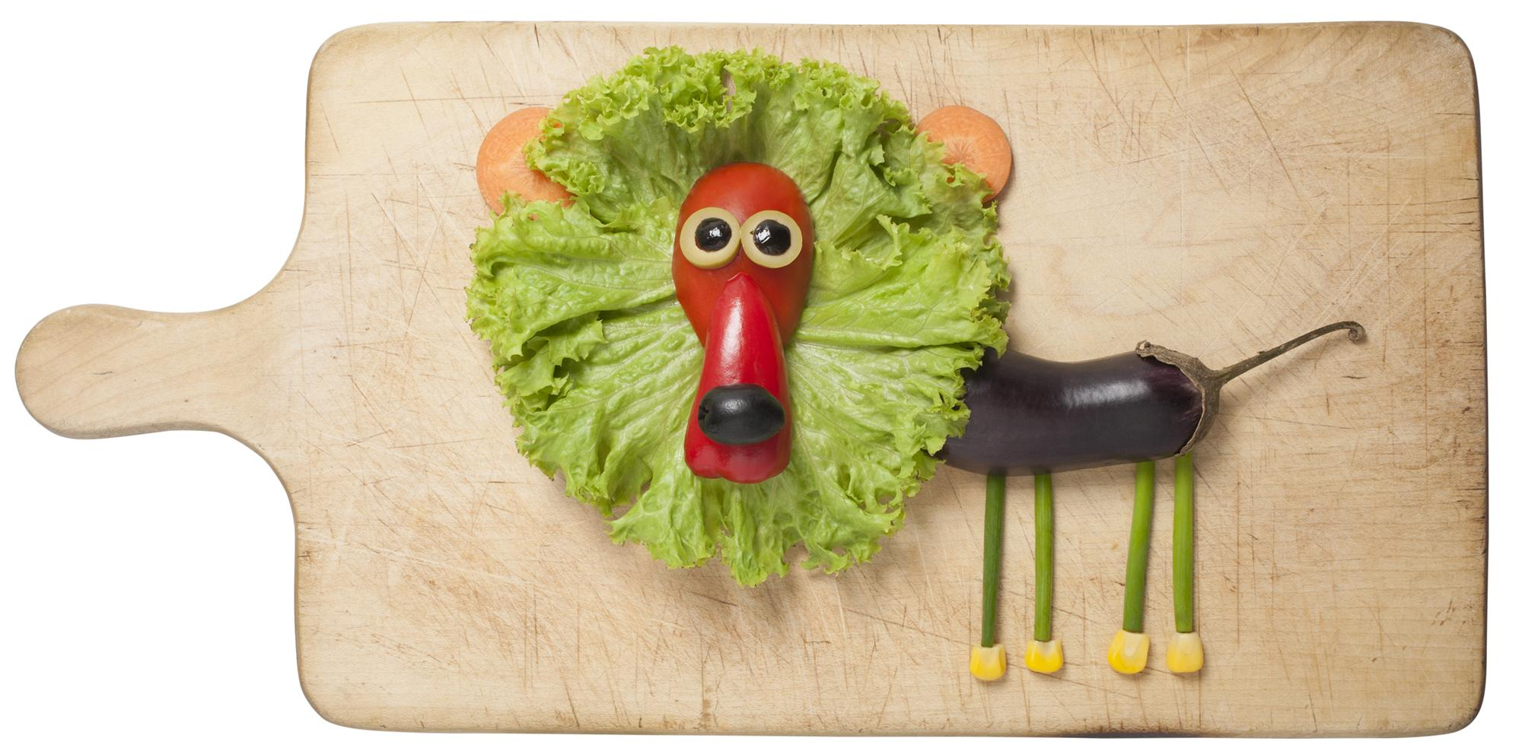
Positive Feeding: School-Age Kids
Make fruits and vegetables fun!
Let kids select which produce to buy.
Wash and cut produce for easy, “snackable” access.
Keep a bowl of fresh fruit within reach.
Experiment with dips and spices
to make these foods more
interactive.
Notes:
[OPTIONAL ACTIVITY SLIDE]: If you don’t use this slide then “hide” it when presenting
[Slide 4 of 4]
Make Fruits and Vegetables Fun
Keep a bowl of fresh fruit on the kitchen table.
Put washed and cut fruits and veggies on a shelf in your refrigerator where your child can see them.
Let them pick fruits and veggies at the store.
Experiment with dips and spice powders to make these foods more interactive.
Hungry Kid Tip—Kids are usually hungry right when they get home from school or right before you begin making dinner. Having sliced fruits and veggies already prepared makes it easy to feed them.

Slide 28
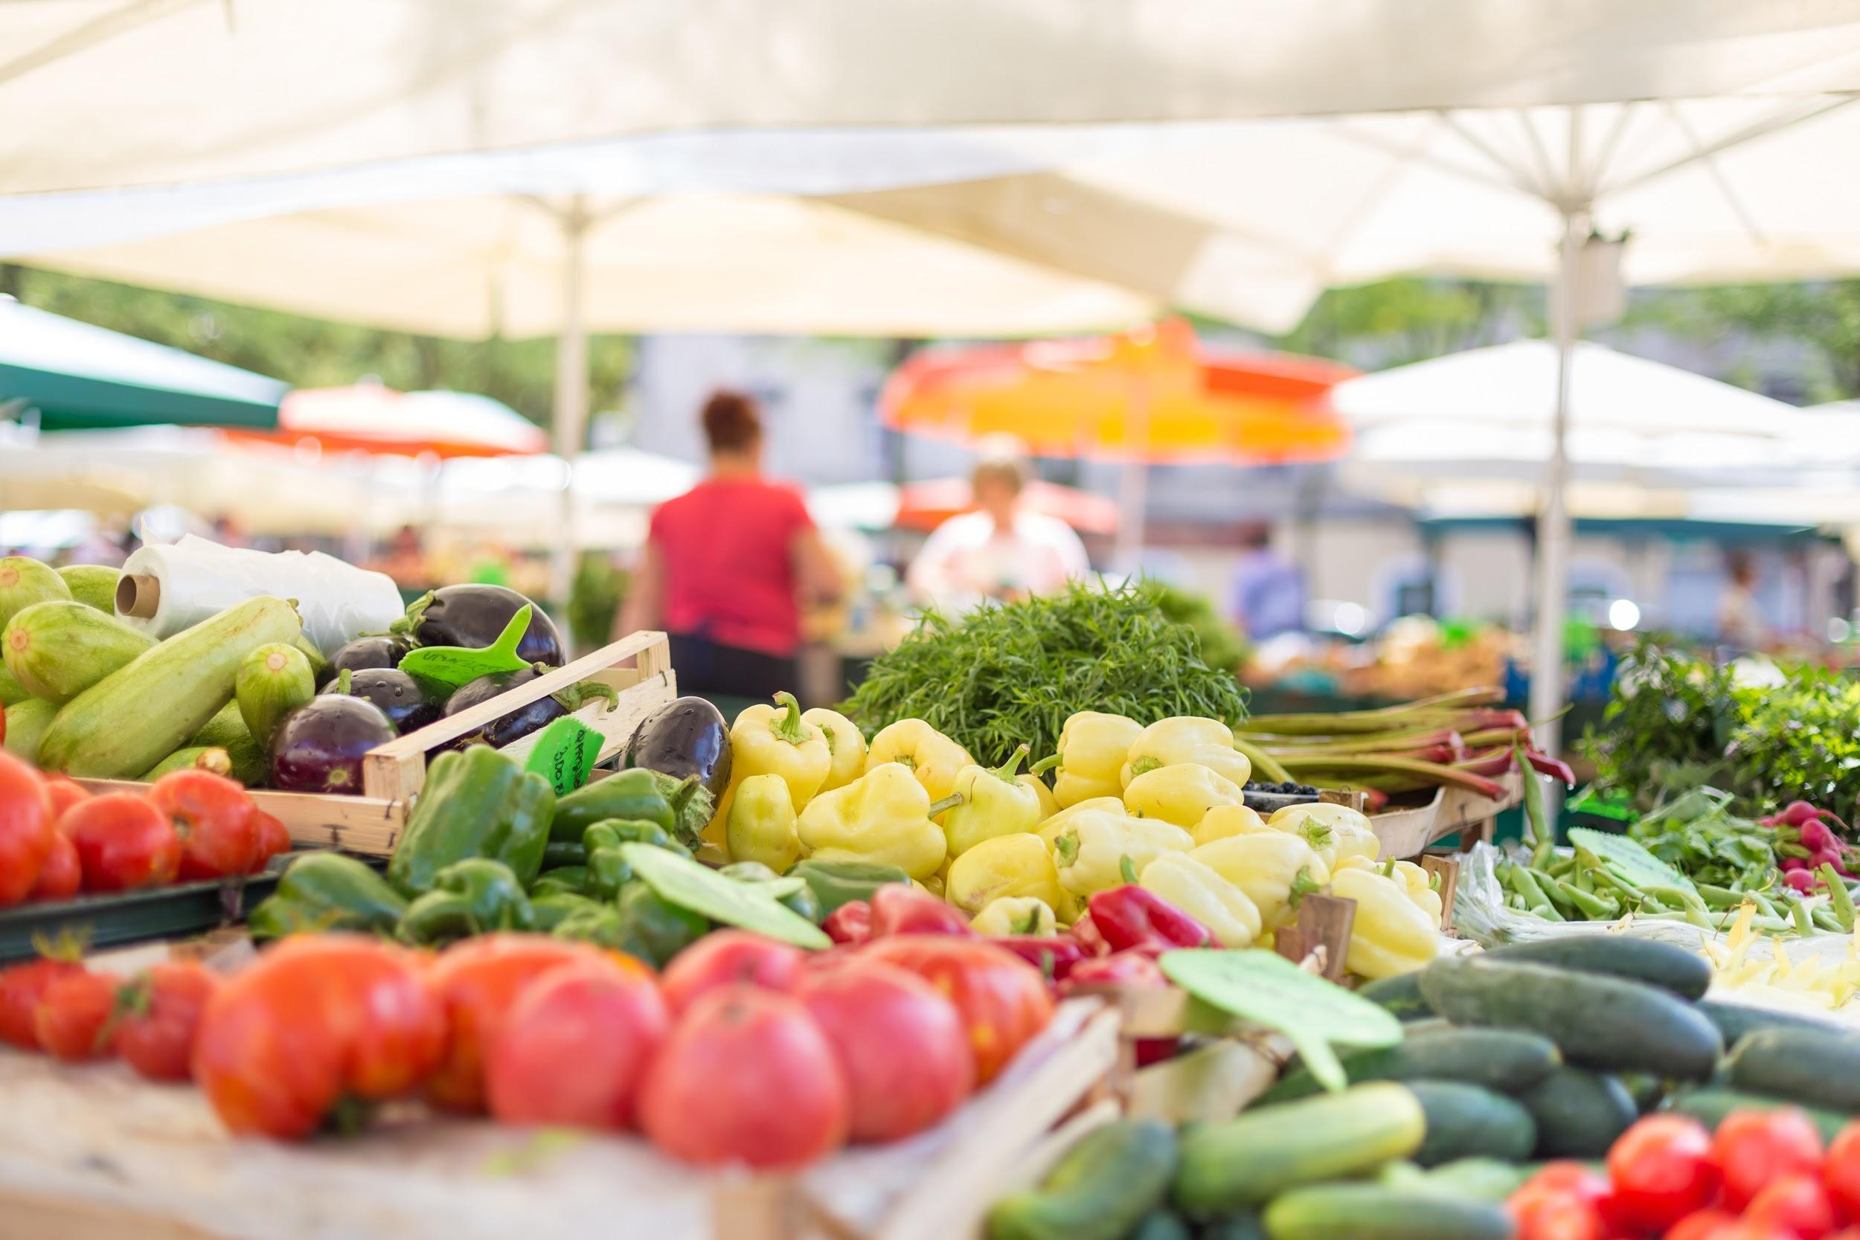
Farmers’ Markets
Have you visited a Farmers’ Market?
Find farmers’ markets at eatfresh.org
Notes:
[OPTIONAL ACTIVITY SLIDE]: If you don’t use this slide then “hide” it when presenting
Have you visited a Farmers’ Market?
These can be a great way to stock up on fresh, local, and affordable produce each week. If your neighborhood has a farmers’ market, consider making this part of your weekly routine.
Get the most for your money by...
Buying produce that is in season and abundant. Look to see which veggies and fruits are well-stocked. (See p. 35.)
Shopping near the end of the market hours. Farmers don’t want to leave with produce and are often willing to give deals instead of bring food back with them.
Deciding how you will use the produce you purchase before you buy it to avoid waste.
Are these veggies or fruit good eaten raw?
Do I know how to prepare this food?
Do I have resources/recipes to cook if the ingredients are unfamiliar?
Good questions to ask (or have your kids ask) the farmers:
“I notice your produce is not certified organic. What are your growing practices? Do you spray or use chemical fertilizers, pesticides, or fertilizers?”
“I notice your produce is certified organic. How do you control for pests and weeds? What are the hardest items to grow organic?”
“How do you suggest I prepare this food? I’m looking for some new ideas.”
“Are there any new items we can expect in the next few weeks?”
“Do you grown your own produce or get it from other farmers?”
Go to EatFresh.org to find farmers’ markets near you.

Slide 29

See You Next Week!
Next Week: Understanding Food Labels
Date: ________
Time: ________
Until next class, please bring a food label from home! What do you look for on a nutrition label?
Notes:
[Flipped Model Script]
Now that you have a well understanding on Eating the Rainbow, let’s prepare for next week's lesson: Understanding Food Labels.
In order to be fully prepared for class, please bring a food label from home to refer to in lesson 4.
See you then! Have a great rest of your day!

Slide 31


In accordance with Federal law and U.S. Department of Agriculture (USDA) civil rights regulations and policies, this institution is prohibited from discriminating on the basis of race, color, national origin, sex, religious creed, disability, age, political beliefs, or reprisal or retaliation for prior civil rights activity.
To file a program discrimination complaint, a complainant should complete a Form AD-3027, USDA Program Discrimination Complaint Form, which can be obtained online at https://www.ascr.usda.gov/sites/default/files/ USDA-OASCR%20P-Complaint-Form-0508-0002-508-11-28- 17Fax2Mail.pdf, from any USDA office, by calling (866) 632-9992, or by writing a letter addressed to USDA. The letter must contain the complainant’s name, address, telephone number and a written description of the alleged discriminatory action in sufficient detail to inform the Assistant Secretary for Civil Rights (ASCR) about the nature and date of an alleged civil rights violation. The completed AD-3027 form or letter must be submitted to USDA by:
Mail:
U.S. Department of Agriculture
Office of the Assistant Secretary for Civil Rights
1400 Independence Avenue, SW Washington, D.C. 20250-9410; or
Fax: (833) 256-1665 or (202) 690-7442;
Email: program.intake@usda.gov.
This institution is an equal opportunity provider.

Slide 32
Conforme a la ley federal y las políticas y regulaciones de derechos civiles del Departamento de Agricultura de los Estados Unidos (USDA), esta institución tiene prohibido discriminar por motivos de raza, color, origen nacional, sexo, credo religioso, discapacidad, edad, creencias políticas, venganza o represalia por actividades realizadas en el pasado relacionadas con los derechos civiles.
Para presentar una queja por discriminación en el programa, el reclamante debe completar un formulario AD-3027, Formulario de queja por discriminación del programa del USDA, que se puede obtener en línea, en https://www.ascr.usda.gov/sites/default/files/ USDA-OASCR%20P-Complaint-Form-0508-0002-508-11-28- 17Fax2Mail.pdf, en cualquier oficina del USDA, llamando al (866) 632-9992, o escribiendo una carta dirigida al USDA. La carta debe contener el nombre, la dirección y el número de teléfono del reclamante, y una descripción escrita de la supuesta acción discriminatoria con suficiente detalle para informar al Subsecretario de Derechos Civiles (ASCR, por sus siglas en inglés) sobre la naturaleza y la fecha de la presunta violación de los derechos civiles. La carta o el formulario AD-3027 completado debe enviarse al USDA por medio de:
Correo postal:
U.S. Department of Agriculture
Office of the Assistant Secretary for Civil Rights
1400 Independence Avenue, SW Washington, D.C. 20250-9410; o´
Fax: (833) 256-1665 o´ (202) 690-7442;
Correo electrónico: program.intake@usda.gov.
Esta institución ofrece igualdad de oportunidades.

